Slide 1
Contributions of RMI to polar stratospheric ozone research
Roeland Van Malderen
Scientific Service “Observations”
Royal Meteorological Institute of Belgium
Special acknowledgements to Peter von der Gathen (AWI),
Alexander Mangold & Hugo De Backer (RMI).

Slide 2
Outline
Stratospheric ozone chemistry
Polar ozone chemistry
Measuring ozone
The time variability of ozone
The Match project
Match results

Slide 3
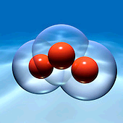
Stratospheric O₃ chemistry
Polar O₃ chemistry
Measuring O₃
O₃ time variability
The Match project
Match results
Stratospheric ozone chemistry… in a nutshell
stratospheric ozone (O₃) accounts for about 90% of total ozone (maximal at 20-25 km altitude)
beneficial role: acts as primary UV radiation shield
ozone in the stratosphere is present by the balance of (1) the photolysis of O₂ (O₂ + hc/λ → O + O) followed by (2a) an exothermic reaction of atomic and molecular oxygen (O₂ + O + M → O₃ + M*), (2b) the ozone photolysis (O₃ + hc/λ → O₂ + O) and (3) ozone destruction (O₃ + O → O₂ + O₂) → Chapman reactions
  by-product of this cycle (2a)+ (2b): heating of the stratosphere due to conversion of UV in thermal energy
ozone is also destroyed by catalytic loss involving chlorine, nitrogen, bromine or hydrogen (present in ODS):
  Cl_{x} (Cl+ClO)
  NO_{x} (NO+NO₂)
  Br_{x} (Br+BrO)
  HO_{x} (OH+HO₂)
at 40 km, this Cl-ClO catalytic chain can destroy nearly 1000 ozone molecules before the Cl or ClO is converted to a benign chlorine form (“reservoir species”) such as HCl and ClONO₂.
over its stratospheric lifetime, an individual Cl atom can destroy about 100000 ozone molecules
    O₃ + hc/λ → O + O₂
    ClO + O → O₂ + Cl
    Cl + O₃ → O₂ + ClO
    Net: O₃ + O₃ → 3 O₂
e.g.

Slide 4
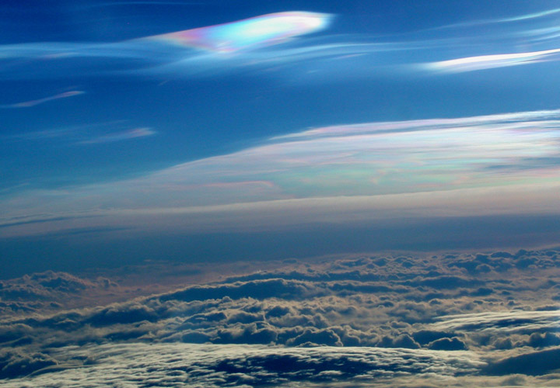
Stratospheric O₃ chemistry
Polar O₃ chemistry
Measuring O₃
O₃ time variability
The Match project
Match results
Polar ozone chemistry
The catalytic ozone loss becomes even more important when the molecules are adsorbed or absorbed on particles (→ heterogenous chemistry on the surface of the particles)
stratospheric particles of interest:
  sulfate aerosols, typically composed of a solution of sulfuric acid (H₂SO₄) and water (e.g. from volcanic origin)→ ozone decreases after large volcanic eruption
  polar stratospheric clouds (PSCs): clouds in the winter polar stratosphere.
    at very high altitudes, between 15 and 25 km
    at temperatures of around -80ºC, colder than average lower stratosphere temperatures
    at those extremely low temperatures, water and nitric acid (HNO₃) condense to form clouds
    associated with the polar vortex: during the long dark polar winter, stratospheric winds move in a circular pattern over the polar region, isolating the air there.

Slide 5
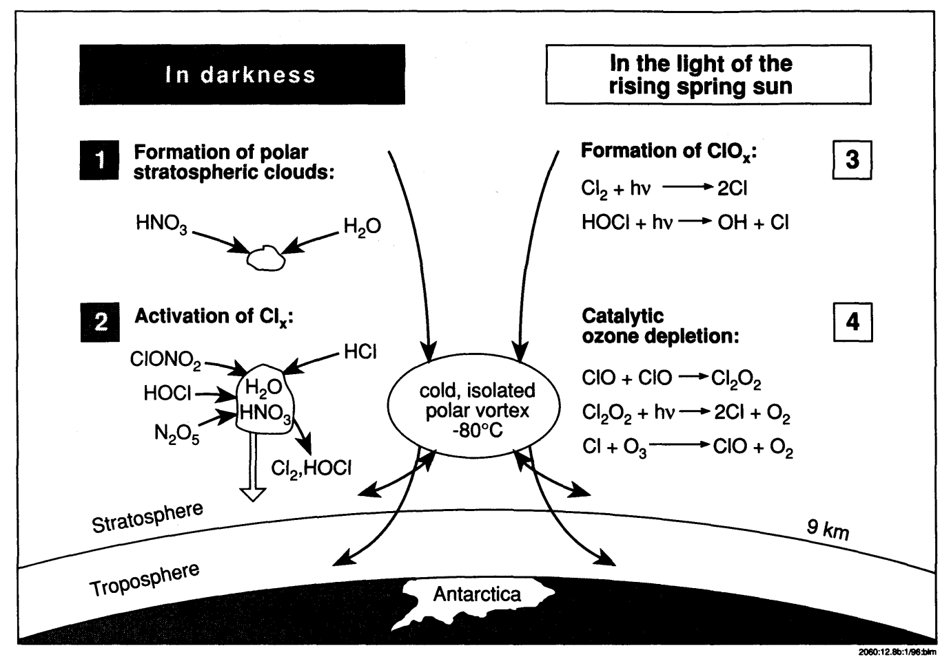
Stratospheric O₃ chemistry
Polar O₃ chemistry
Measuring O₃
O₃ time variability
The Match project
Match results
Polar ozone chemistry
The reservoir species are mostly nonreactive in their gaseous state. However, on the surfaces of PSCs, they become highly reactive with one another, forming Cl₂ and HOCl (and H₂O and HNO3 as “side products”)
The formed nonreactive HNO₃ remains on the surfaces of the PSC. As some of the PSCs might undergo sedimentation, the HNO₃ is carried out of the stratosphere (“denitrification”)
The formed chlorine species Cl₂ and HOCl are short lived. They are quickly photolyzed by sunlight (even in visible wavelengths!) when the sun returns to the Antarctic/Arctic in the early Spring.
via the Cl-ClO catalytic chain, ozone can be destroyed over this area in the spring season.
UV
2
UV
PSC
PSC
2
UV
Key ingredients to have ozone loss at the poles
  cold: polar vortex
  clouds: PSCs
  chlorine: ClO catalytic cycle
3
  UV radiation: springtime sunlight
  different seasons: dark & light
4

Slide 6
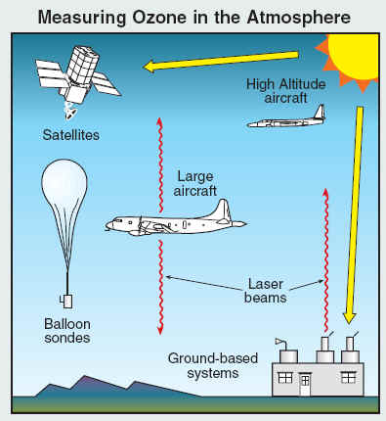
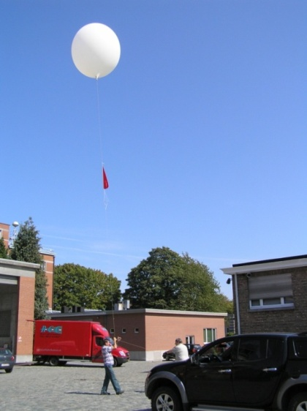
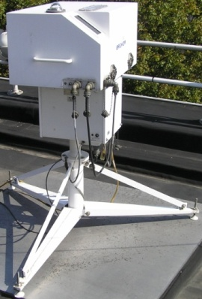
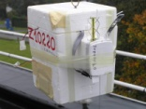
Stratospheric O₃ chemistry
Polar O₃ chemistry
Measuring O₃
O₃ time variability
The Match project
Match results
Measuring ozone
from ground-based instruments, from satellites, on board aircraft, from high-altitude balloons
optical techniques (with the sun (“passive”) and lasers (“active”) as light sources) or using chemical reactions that are unique to ozone
At RMI:
  total O₃ column measurements with Dobson or Brewer spectro-photometers in the UV (280-360 nm) since 1971
  vertical ozone profiles with ozonesondes since 1969

Slide 7
Stratospheric O₃ chemistry
Polar O₃ chemistry
Measuring O₃
O₃ time variability
The Match project
Match results
The time variability of ozone depleting substances
In the 1950s, CFCs (chlorofluorocarbons) or “Freon” were introduced in the industry as “miracle compounds”: inert, non-toxic, non-flammable, long-living, cheap, safe, many applications:
  foam blowing
  aerosol propellants
  refrigeration and air conditioning
  industrial cleaning of metals and electronic components
Other halons contain also Br and have been used in fire extinguishing systems.
These CFCs and other halons are transported to the stratosphere (e.g. by tropical lifting).
In the stratosphere, Cl and Br are freed from CFCs and halons by UV photolysis ➔ Cl_{x} and Br_{x} catalytic cycles.

Slide 8
Stratospheric O₃ chemistry
Polar O₃ chemistry
Measuring O₃
O₃ time variability
The Match project
Match results
The time variability of ozone depleting substances
1997 peak value
EESC
= equivalent effective = stratospheric chlorine
= a relative measure of the = potential for stratospheric = ozone depletion that = combines the contributions of = chlorine and bromine from = surface observations from = Ozone Depleting Substances (ODS)
emissions
lifetimes
Montreal Protocol (1989)
due to the long lifetimes of some CFCs and halons (50-100 years) in the stratosphere, the decline is rather slow.

Slide 9
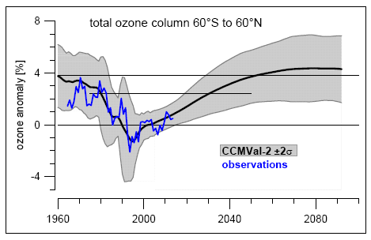
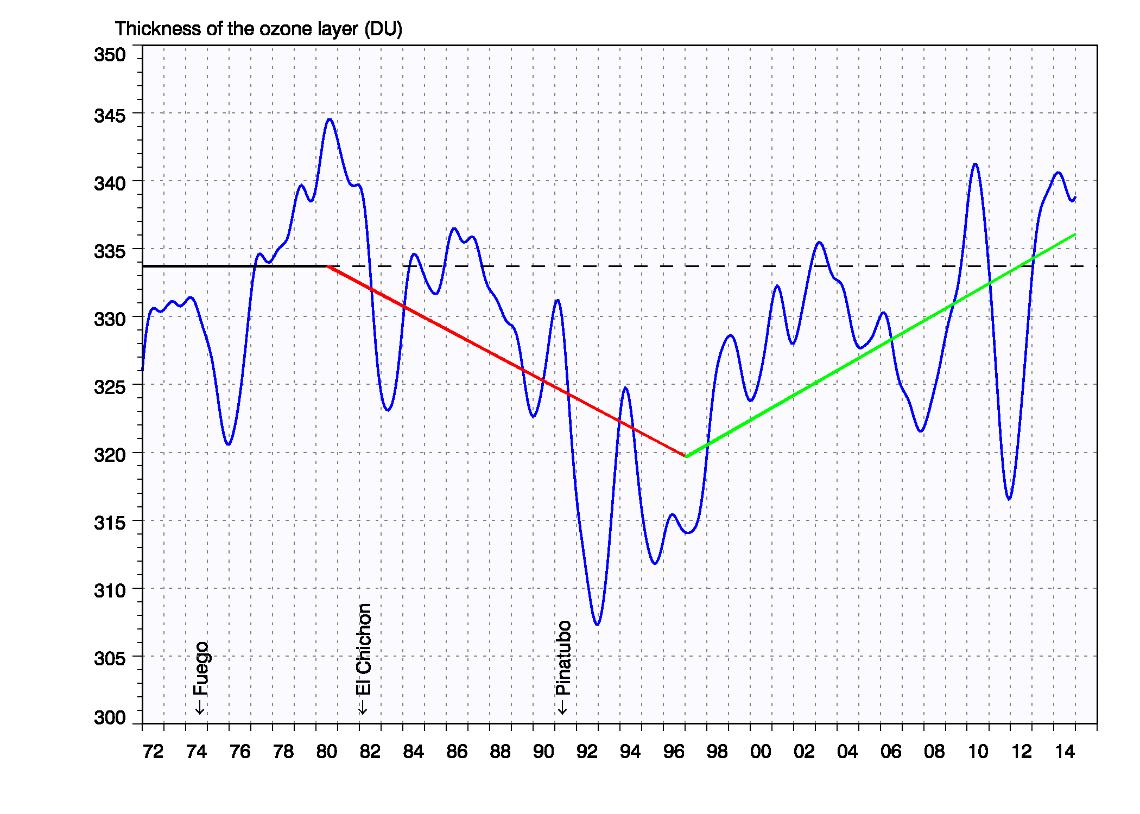
Stratospheric O₃ chemistry
Polar O₃ chemistry
Measuring O₃
O₃ time variability
The Match project
Match results
The time variability of ozone:
Global
Uccle
From WMO Scientific Assessment of Ozone Depletion, 2014
➔ onset of ozone recovery?

Slide 10
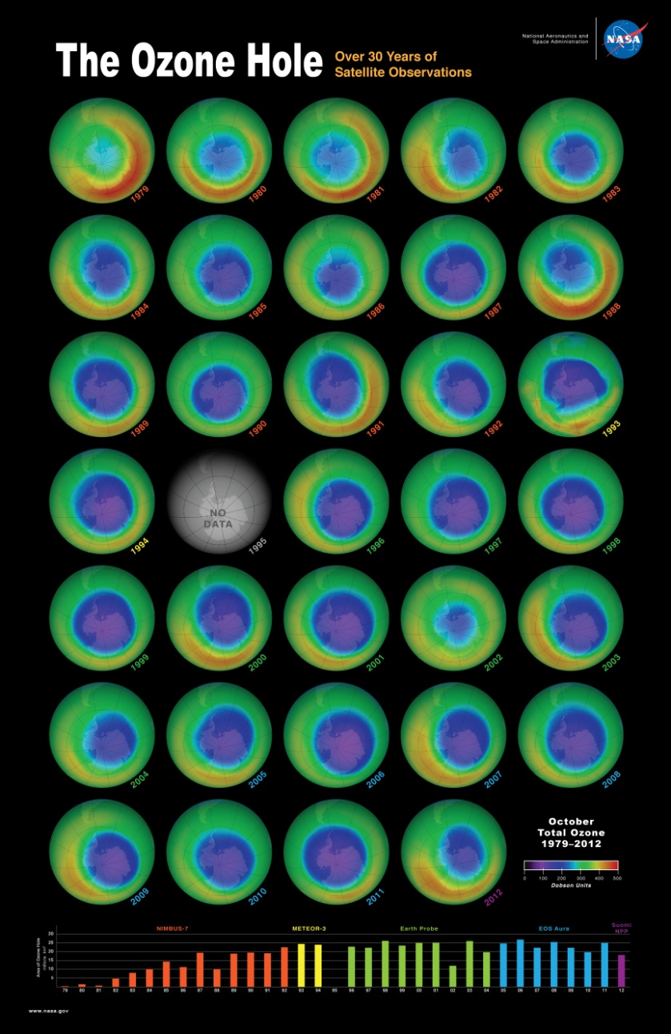
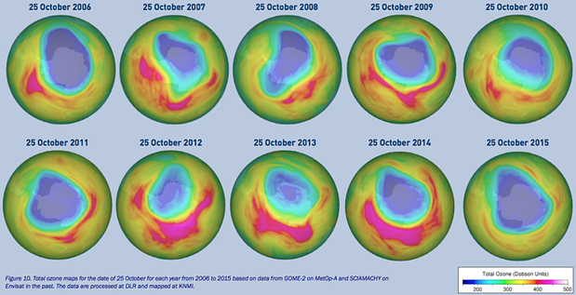
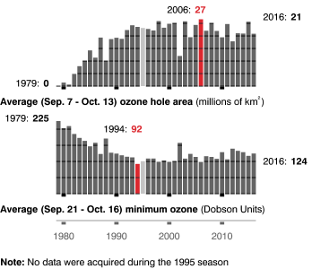
Stratospheric O₃ chemistry
Polar O₃ chemistry
Measuring O₃
O₃ time variability
The Match project
Match results
The time variability of ozone:
Antarctica
onset of ozone hole recovery?
Solomon et al. , Science, 2016: “healing” of ozone hole

Slide 11
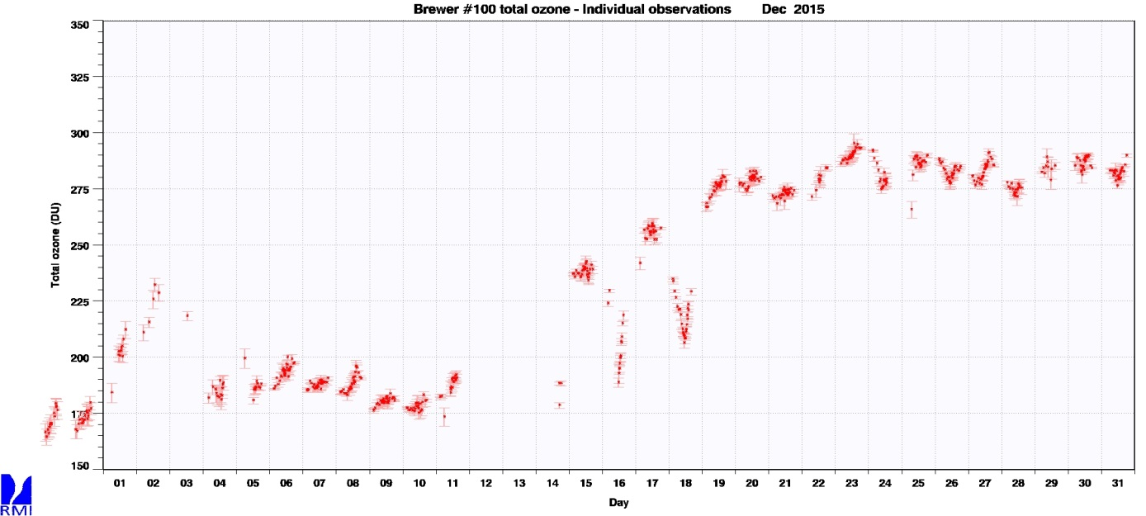
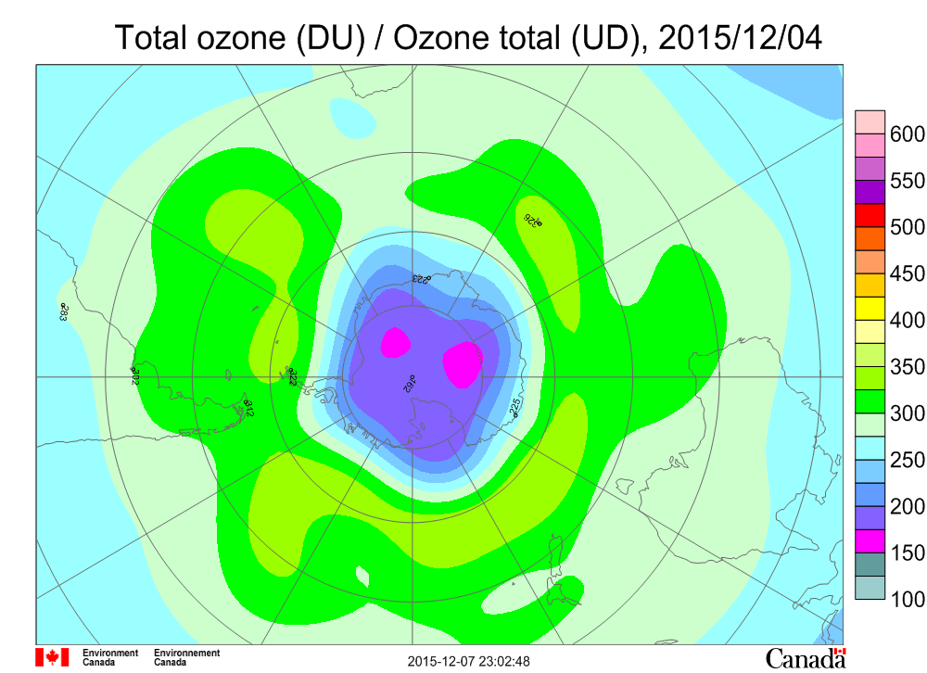
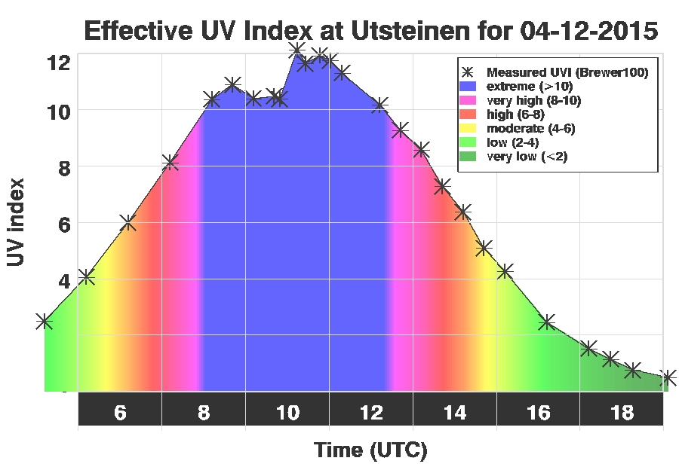
Stratospheric O₃ chemistry
Polar O₃ chemistry
Measuring O₃
O₃ time variability
The Match project
Match results
RMI at
Antarctica
@ Princess Elisabeth station
Brewer total O₃, Dec 2015

Slide 12
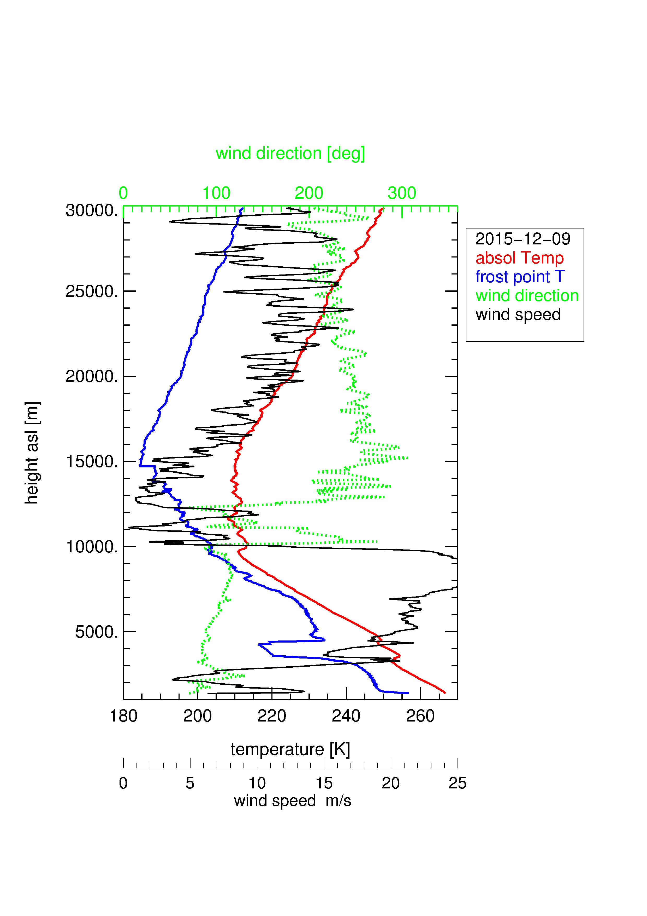
Stratospheric O₃ chemistry
Polar O₃ chemistry
Measuring O₃
O₃ time variability
The Match project
Match results
RMI at
Antarctica
@ Princess Elisabeth station
Brewer total O₃, Dec 2015

Slide 13
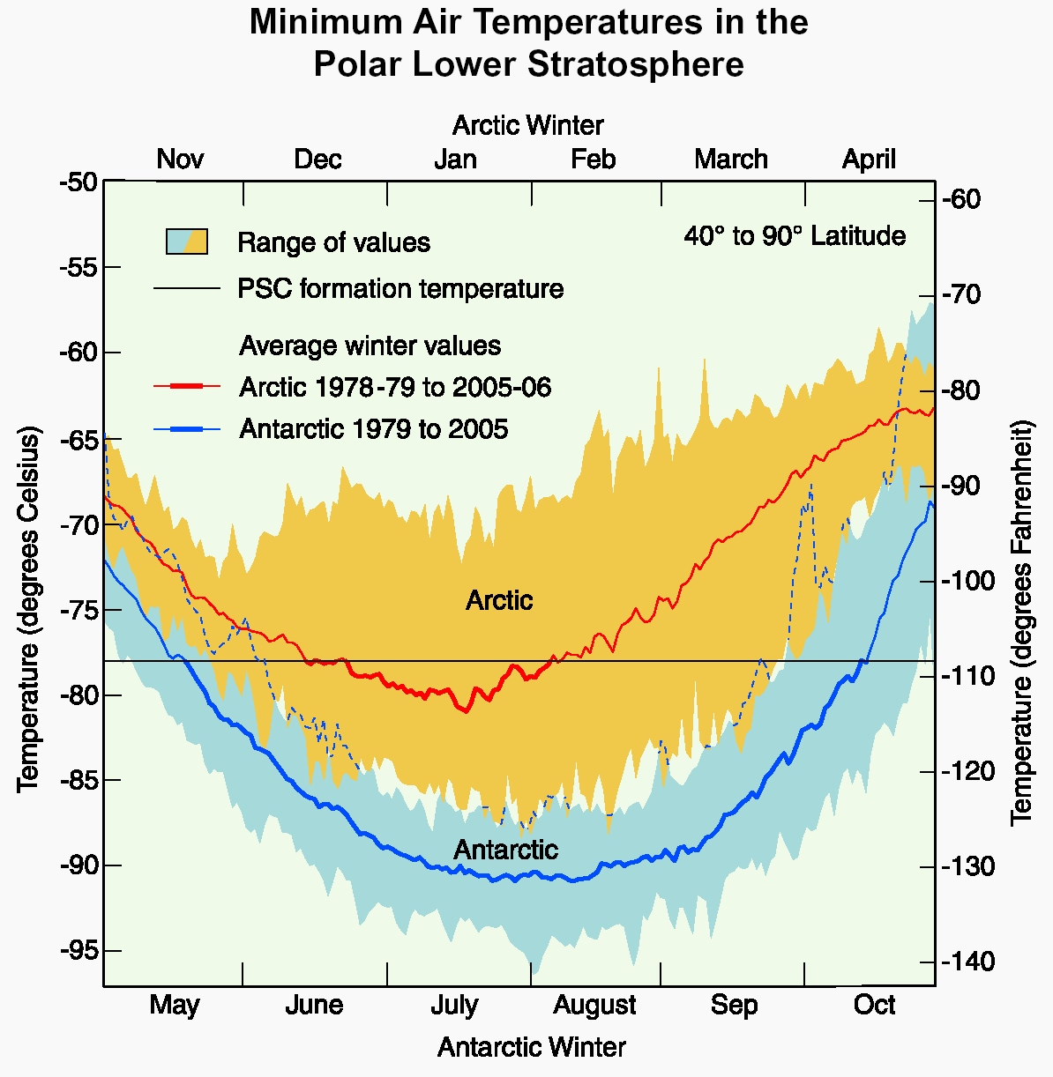
Stratospheric O₃ chemistry
Polar O₃ chemistry
Measuring O₃
O₃ time variability
The Match project
Match results
The time variability of ozone:
Arctic
WMO 2006

Slide 14
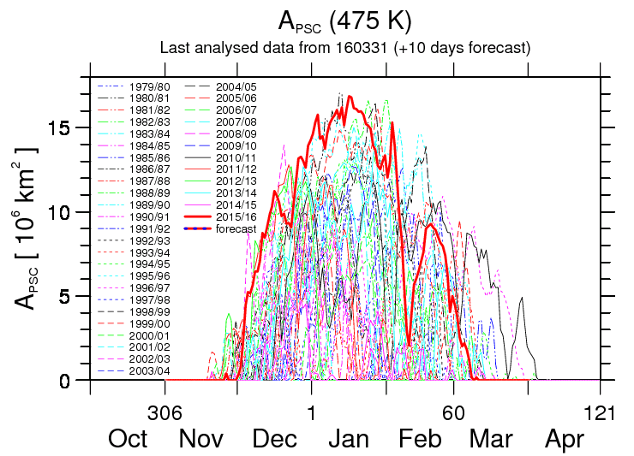
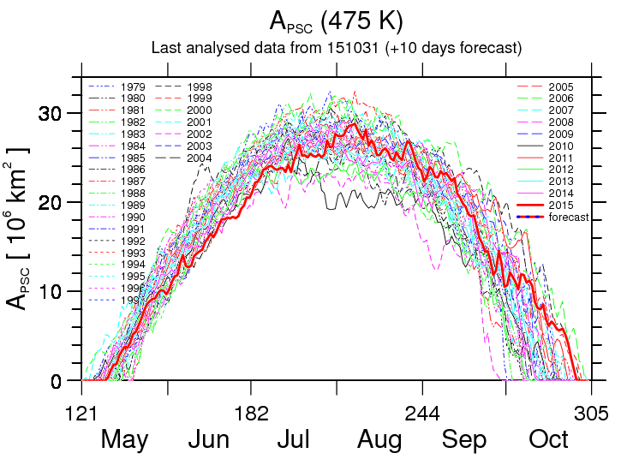
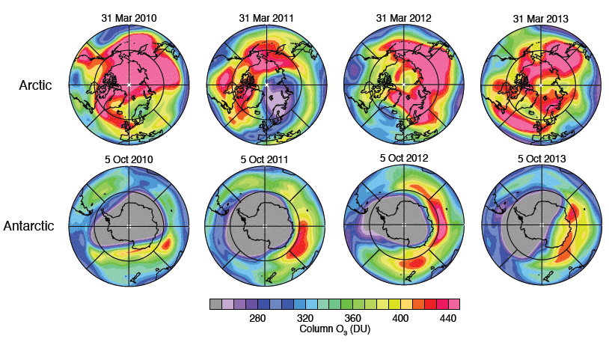
Stratospheric O₃ chemistry
Polar O₃ chemistry
Measuring O₃
O₃ time variability
The Match project
Match results
The time variability of ozone:
Arctic
Arctic
Antarctica
The PSC areas are much smaller in the Arctic than in the Antarctic.
They also usually do not last long enough in spring (e.g. 2015/2016).
In March 2011, large ozone depletion was observed in the Arctic

Slide 15
Stratospheric O₃ chemistry
Polar O₃ chemistry
Measuring O₃
O₃ time variability
The Match project
Match results
The time variability of ozone:
Arctic
The extent of the Arctic spring ozone depletion is dominated by the very large meteorological variability exhibited by the Northern Hemisphere polar vortex!
larger year-to-year variability in Arctic than in Antarctic

Slide 16
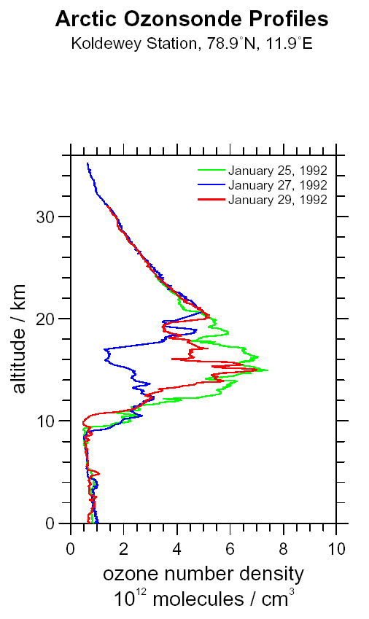
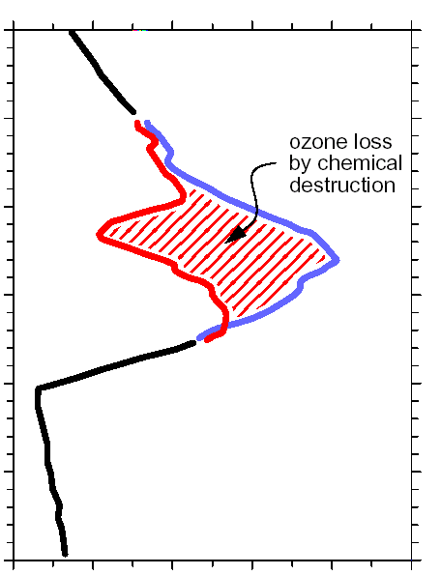
Stratospheric O₃ chemistry
Polar O₃ chemistry
Measuring O₃
O₃ time variability
The Match project
Match results
The Match project
Koldewey Station (NYA), 78,9ºN, 11,9ºO
30
25
4-day period of vertical ozone observations at Arctic station, when the stations was in the vortex edge region
in the Arctic: chemical ozone loss has similar magnitude than natural dynamical variability (e.g. advection of different air masses).
need to separate dynamical and chemical effects
  conservative tracers or Lagrangian approach
  chemical ozone loss rate calculation
20
Altitude [ km ]
15
10
natural
dynamical
variability
5
0
0
2
4
6
8
10
ozone concentration [ 10¹² cm⁻³ ]

Slide 17
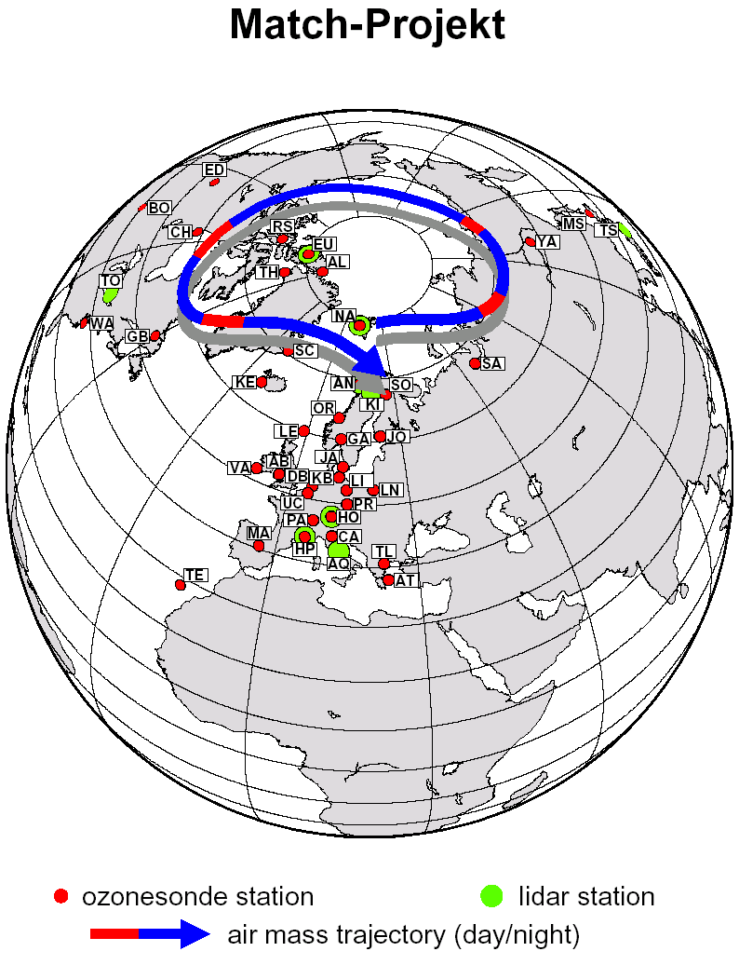
Stratospheric O₃ chemistry
Polar O₃ chemistry
Measuring O₃
O₃ time variability
The Match project
Match results
The Match project
air parcel trajectory calculation to identify air masses, inside the polar vortex, probed by different ozonesonde (lidar) stations launched at different points along the trajectory = MATCH
(backward + forward) isentropic trajectories on different potential temperature levels (≈12-25 km)
correction for diabatic cooling/ heating of the air masses, which might produce descent/ascent across isentropic surfaces.
edge of the vortex is defined in terms of potential vorticity

Slide 18
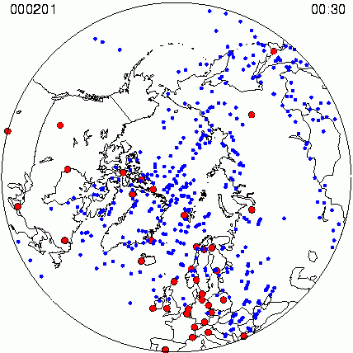
Stratospheric O₃ chemistry
Polar O₃ chemistry
Measuring O₃
O₃ time variability
The Match project
Match results
The Match project
15 Arctic and 2 Antarctic campaigns since the early 90ies (EU + natl. funding)
35 stations (including Uccle)
~500-1200 ozonesondes per winter
>1000 match events per winter

Slide 19
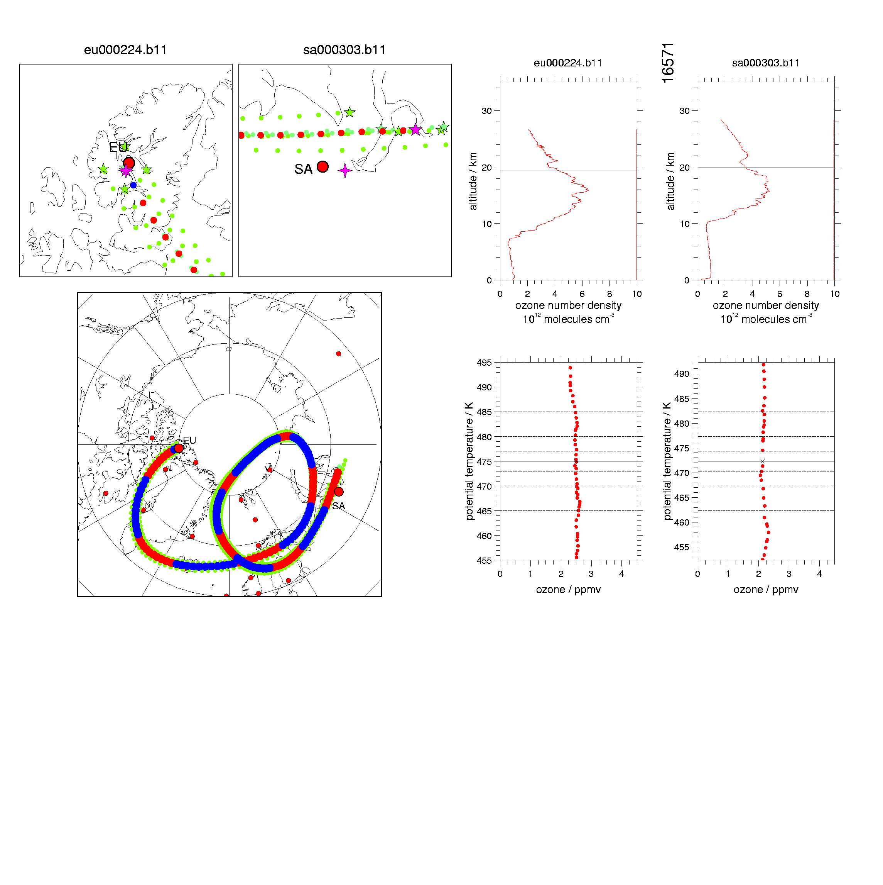
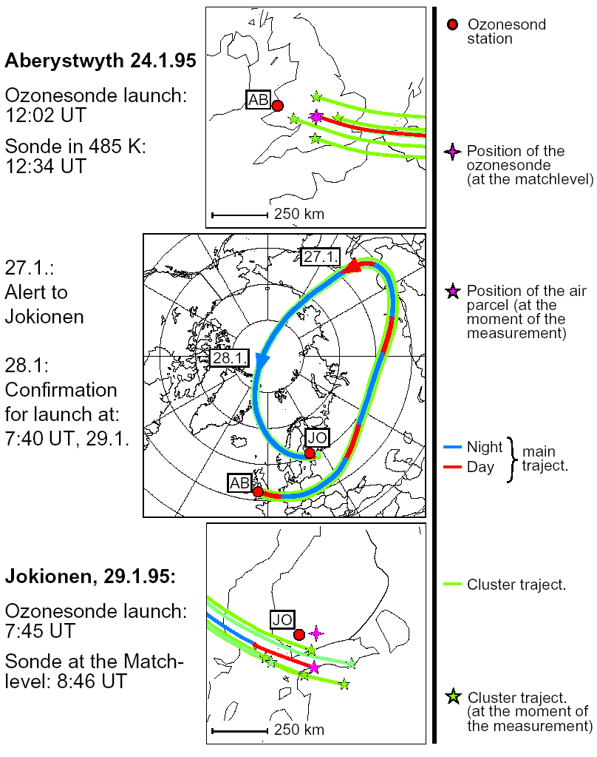
Stratospheric O₃ chemistry
Polar O₃ chemistry
Measuring O₃
O₃ time variability
The Match project
Match results
The time variability of ozone
Notes:
SA = Salekhar, Siberia, Russia

Slide 20
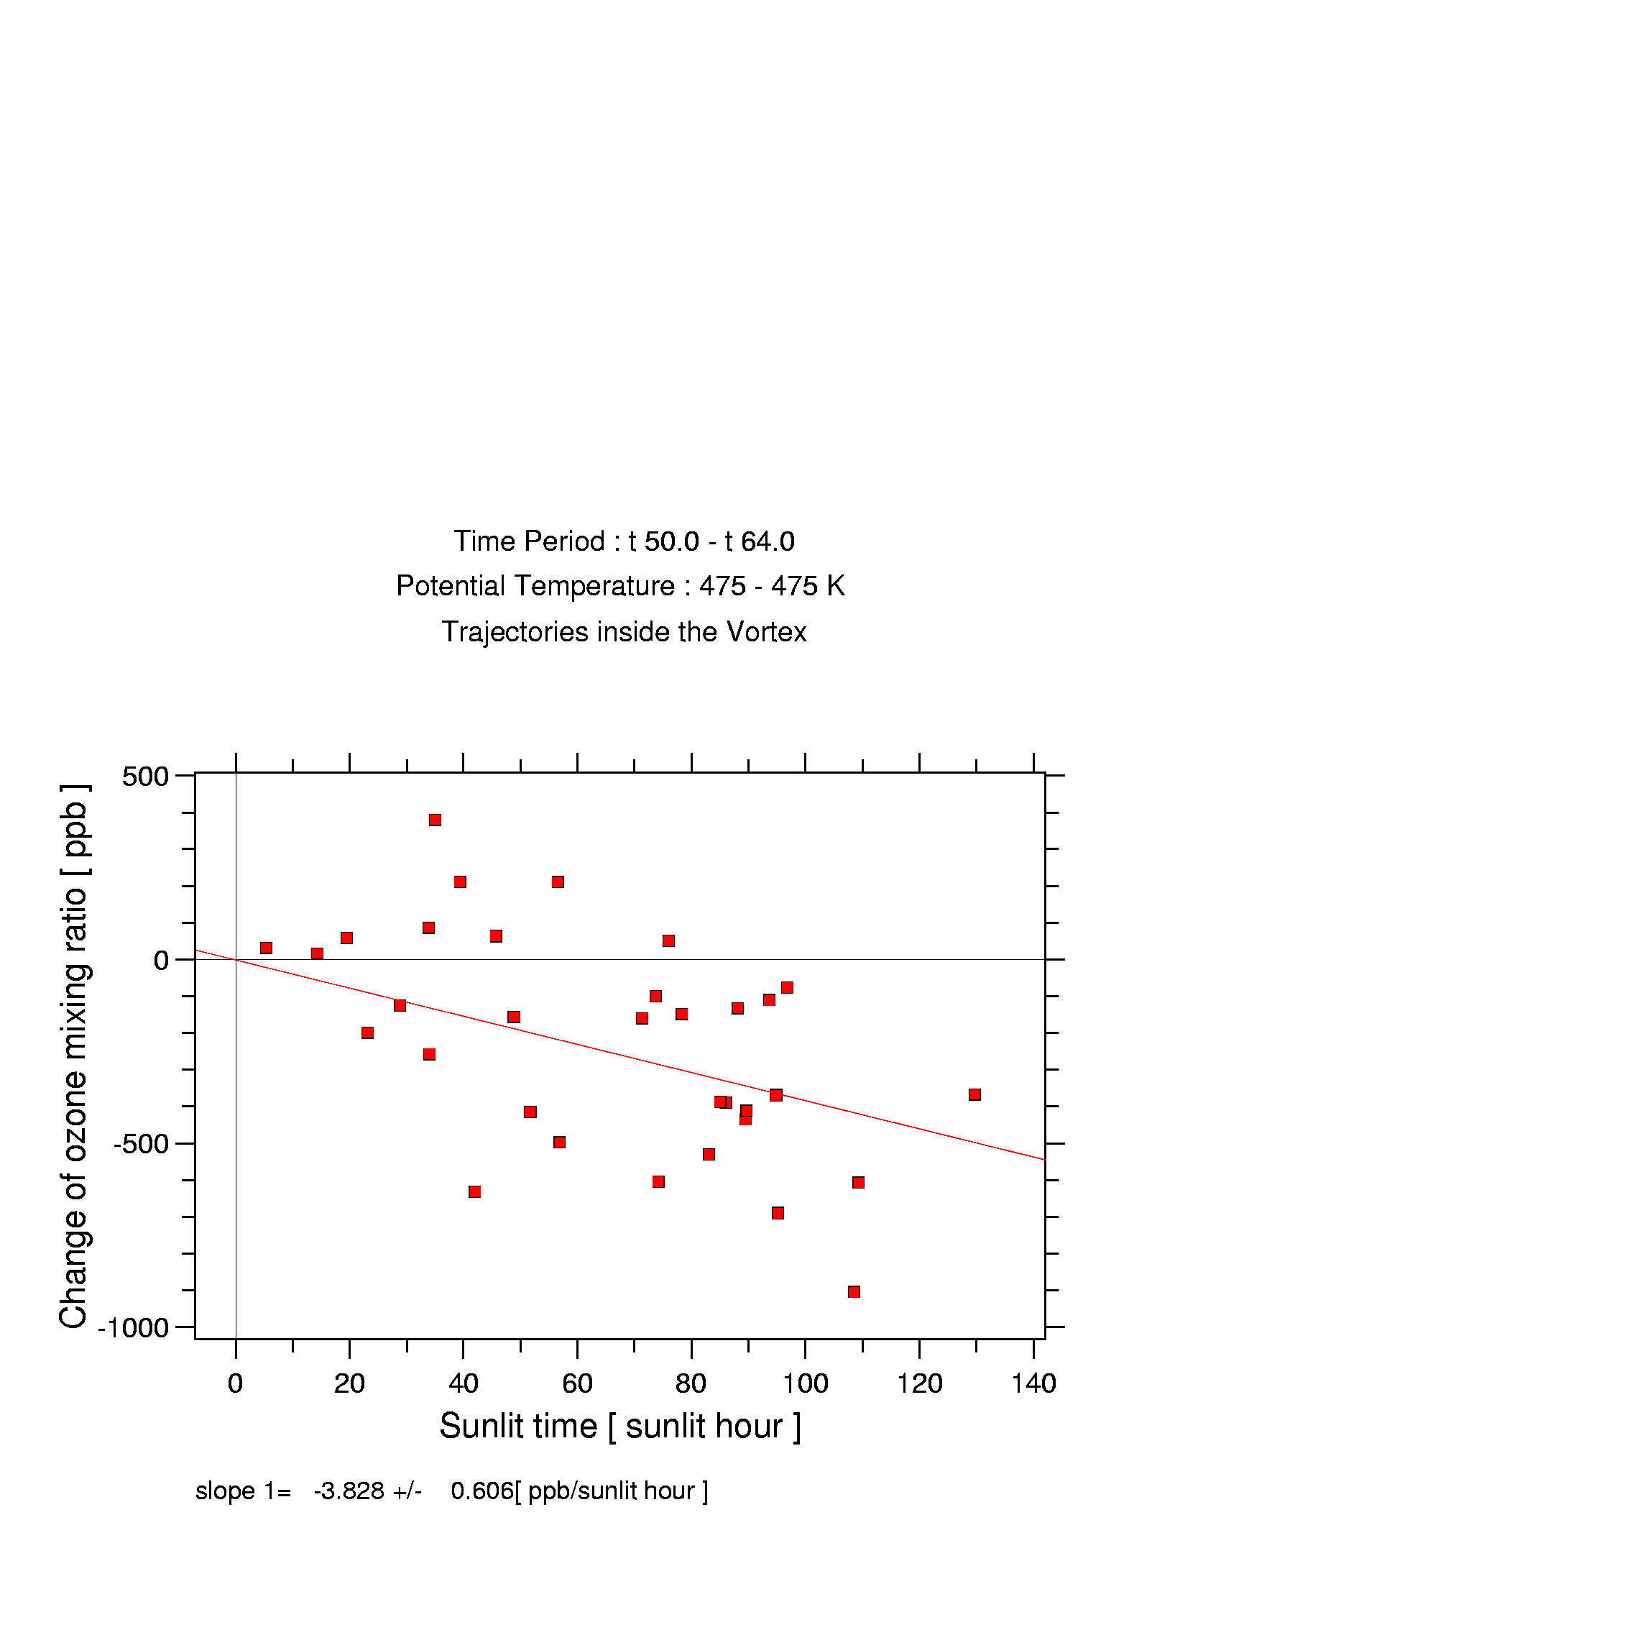
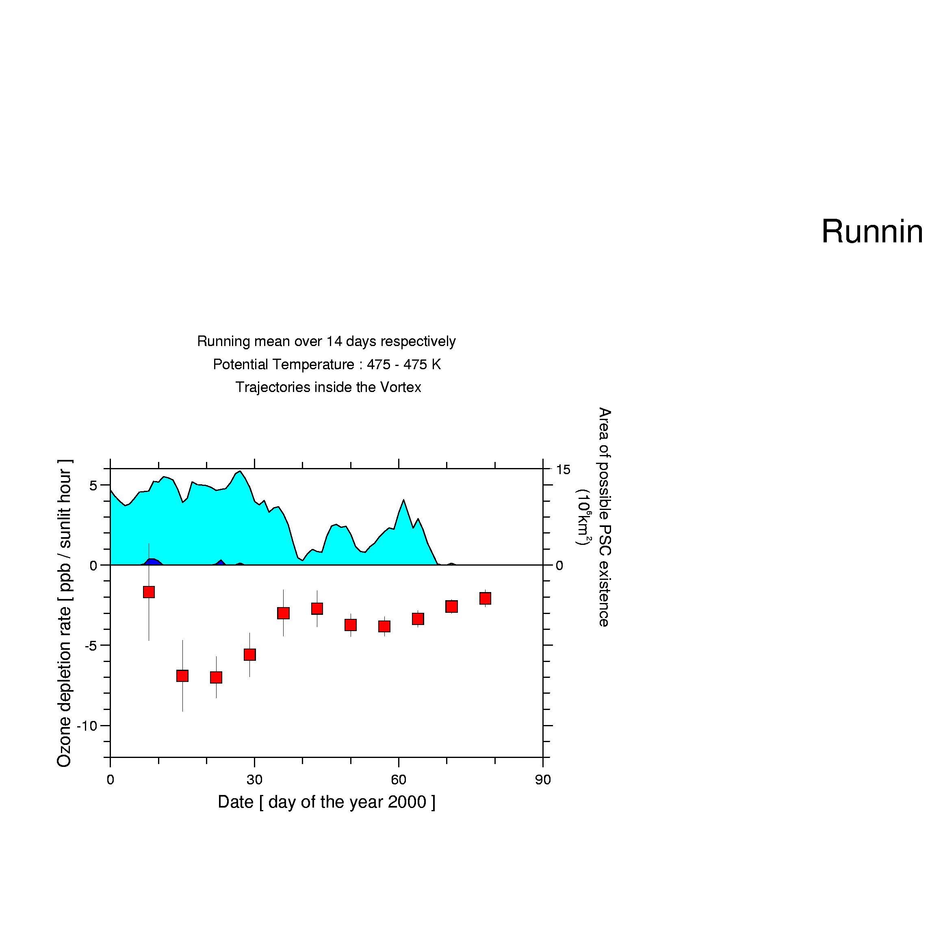
Stratospheric O₃ chemistry
Polar O₃ chemistry
Measuring O₃
O₃ time variability
The Match project
Match results
Ozone loss rates
Regression analysis

Slide 21
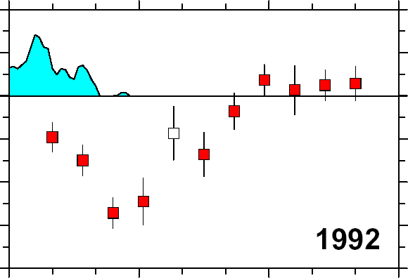
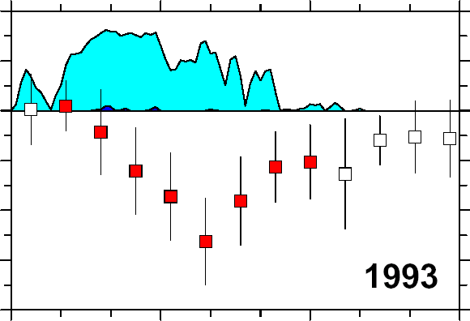
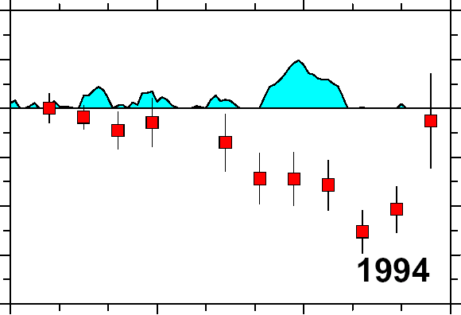
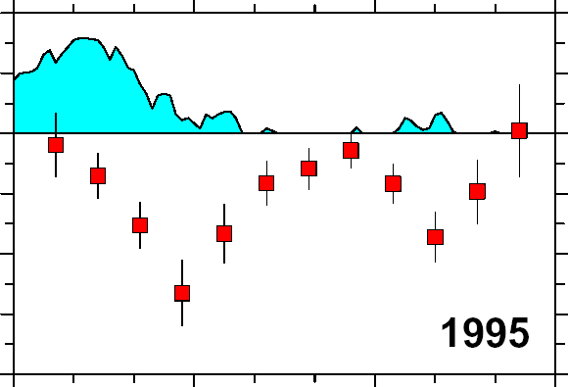


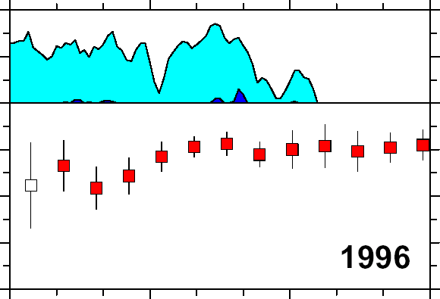
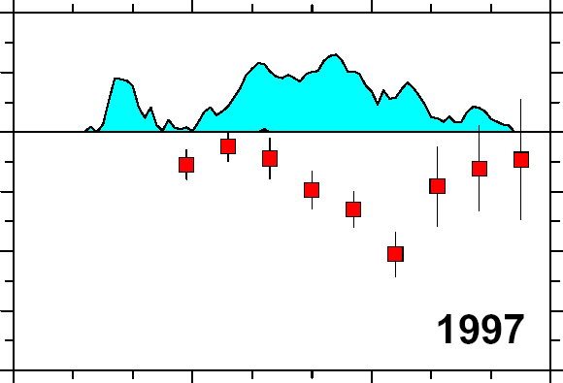
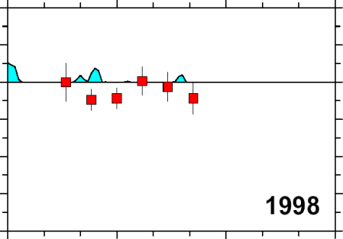
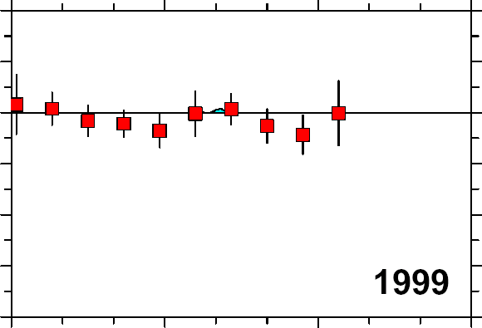
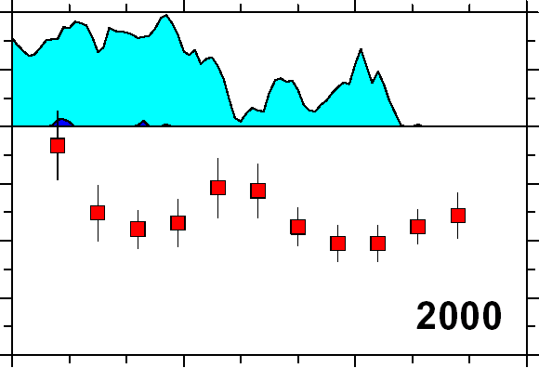
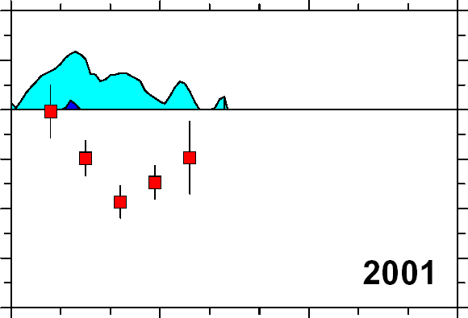
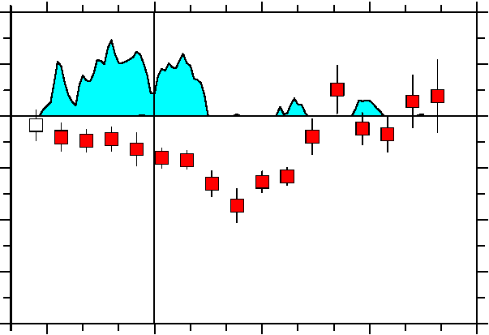
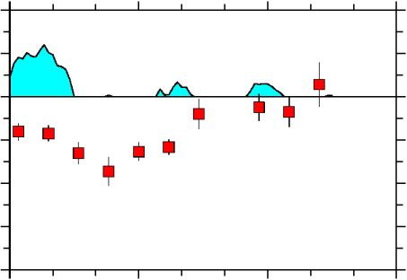


Stratospheric O₃ chemistry
Polar O₃ chemistry
Measuring O₃
O₃ time variability
The Match project
Match results
Match results 1992-2003
Q = 475 K (~19-20 km)
Ozon loss rate [ ppb / day ]
Area of potential PSC formation [ 10⁶ km² ]
2002
Warm winter,
no campaign
2003
-30
Date [ day of the year ]

Slide 22
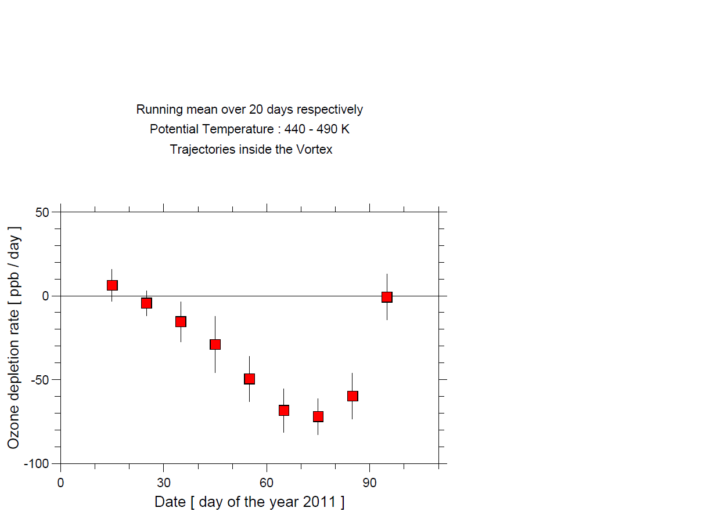
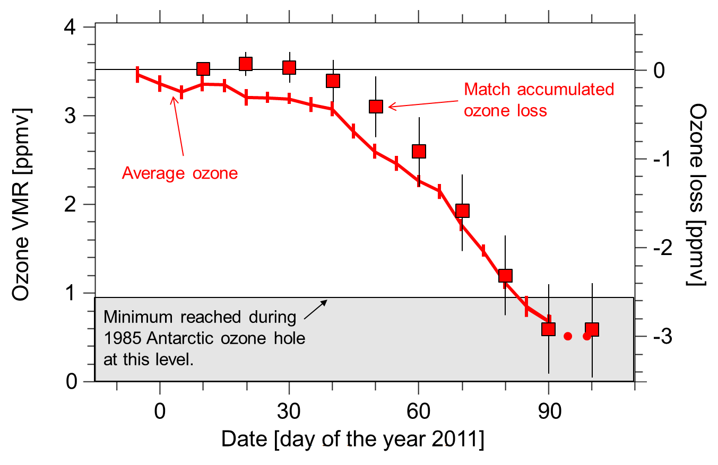
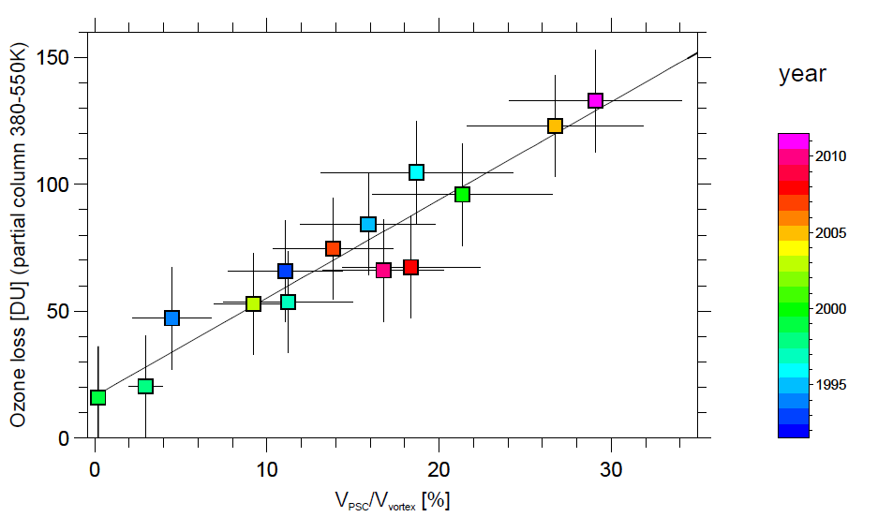
Stratospheric O₃ chemistry
Polar O₃ chemistry
Measuring O₃
O₃ time variability
The Match project
Match results
Match results 2011
Ozone and ozone loss inside vortex @ eΘ=465K
(unmixed vortex air)
Range of previous
Arctic ozone
loss rates
Antarctic 2003
ozone hole “regime”
Arctic 2011
Total ozone loss 2011:
133+/-20 DU

Slide 23
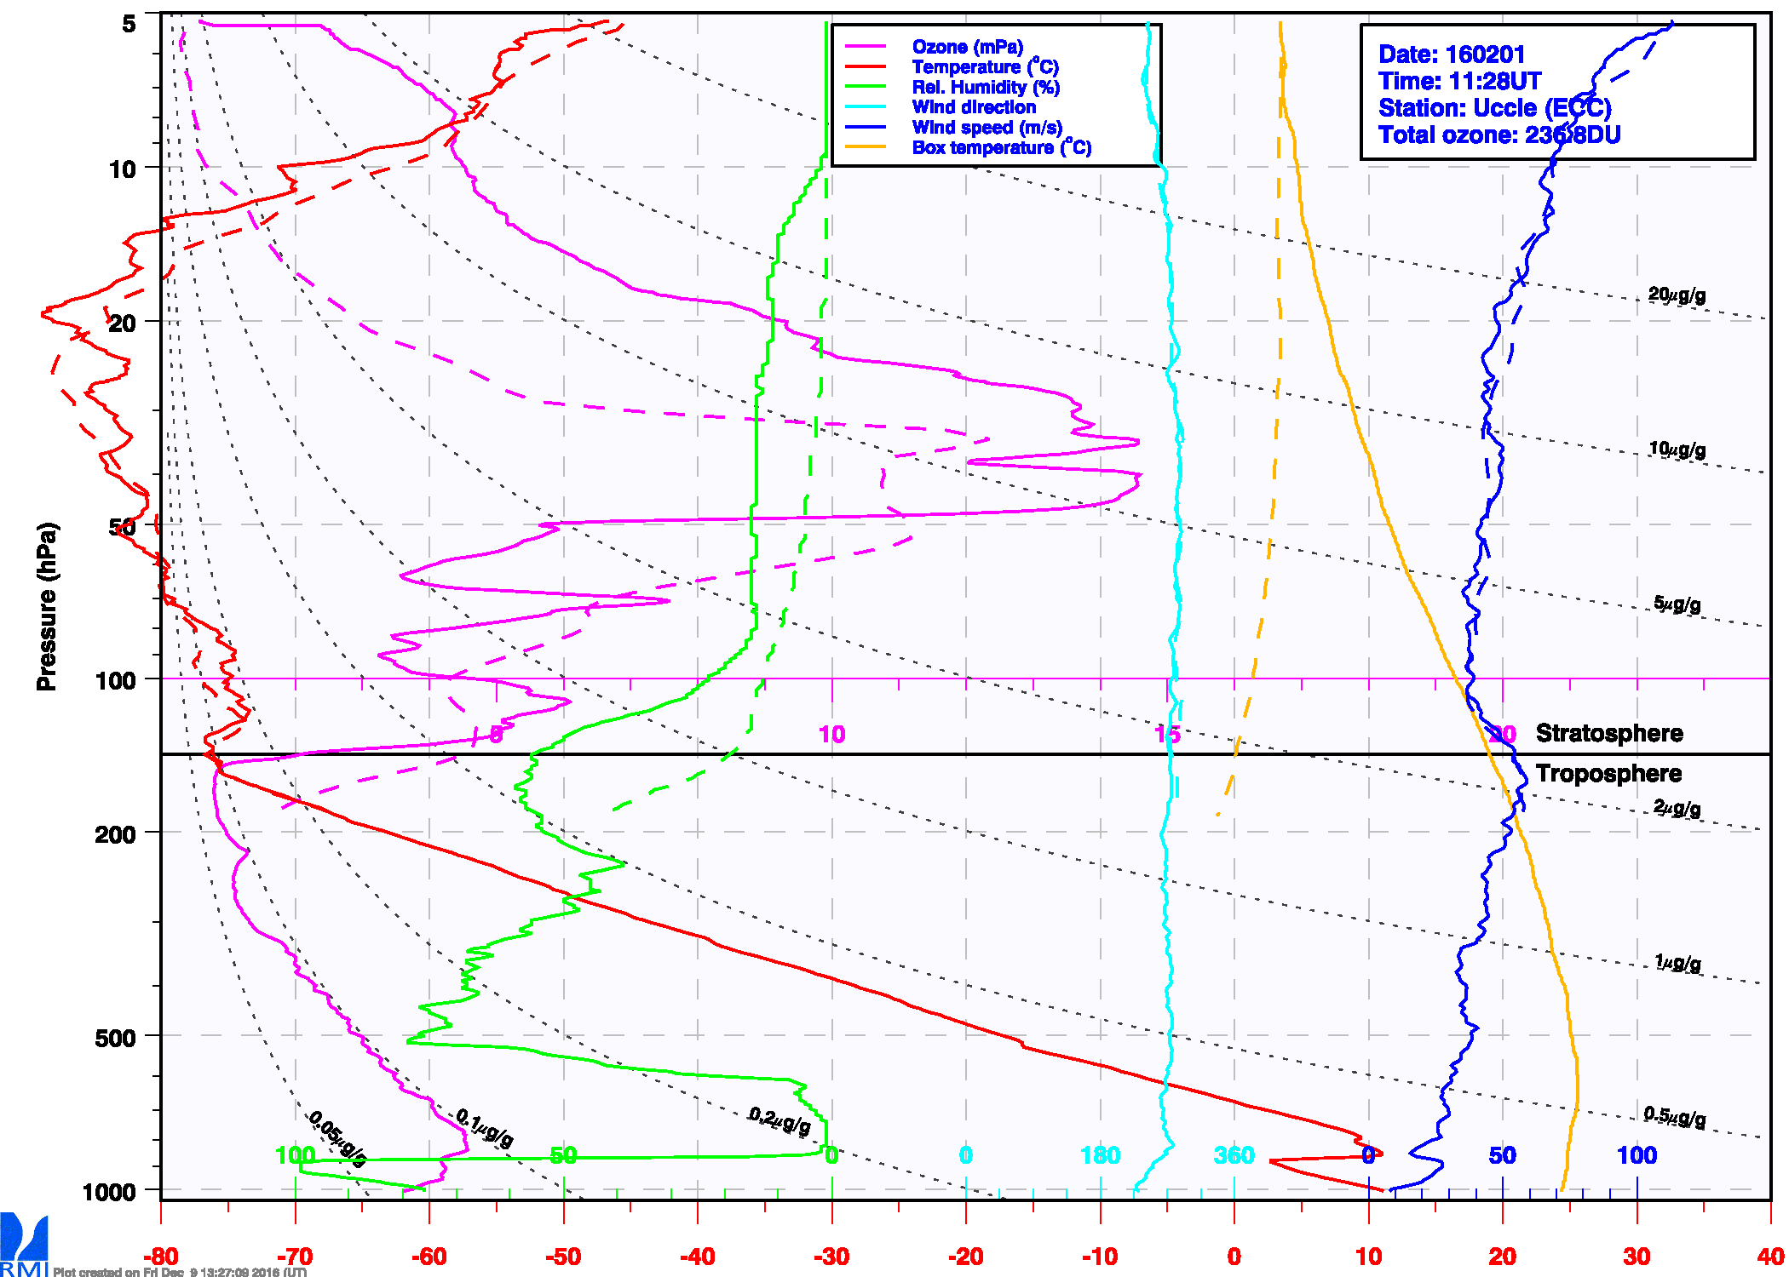
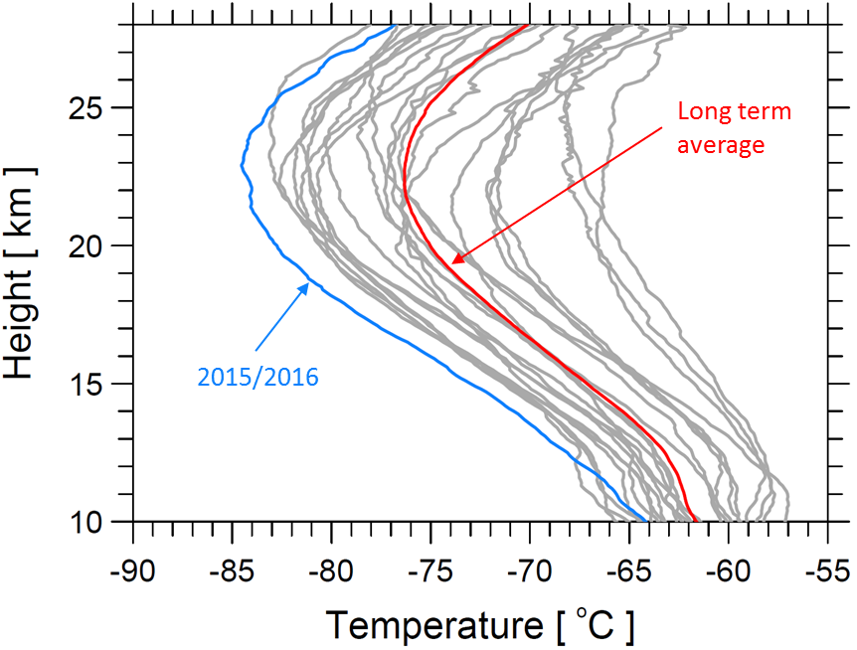
Stratospheric O₃ chemistry
Polar O₃ chemistry
Measuring O₃
O₃ time variability
The Match project
Match results
Match results 2016
Ny-Alesund (Svalbard) Dec-Jan mean temperature profiles
Uccle ozonesonde profile data at 1 Feb 2016
+ photographs of PSCs over UK, the Netherlands, Germany…

Slide 24
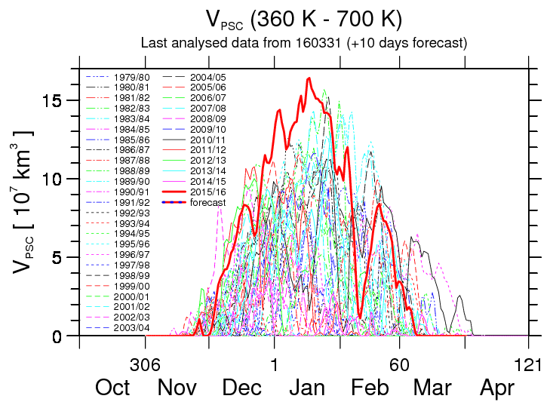
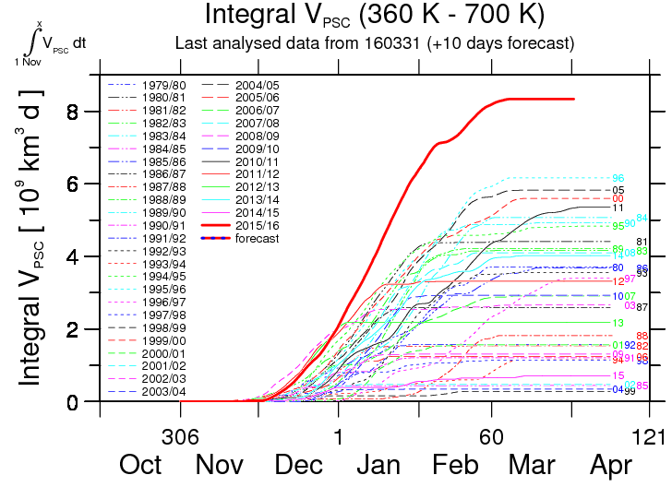
Stratospheric O₃ chemistry
Polar O₃ chemistry
Measuring O₃
O₃ time variability
The Match project
Match results
Match results 2016
record high of integrated volume of PSC!
PSC did not last as long as the 2011 PSC

Slide 25
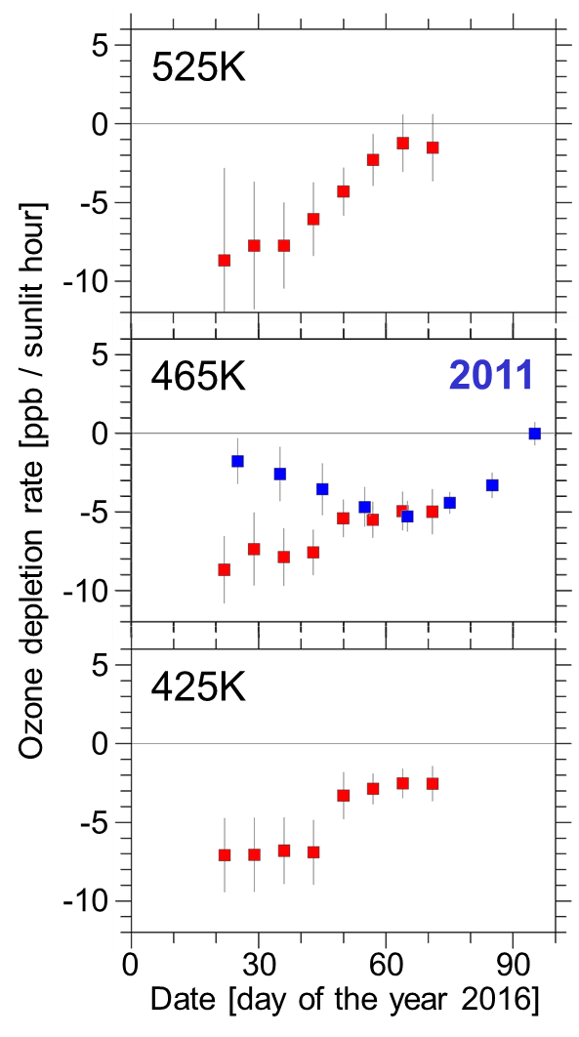
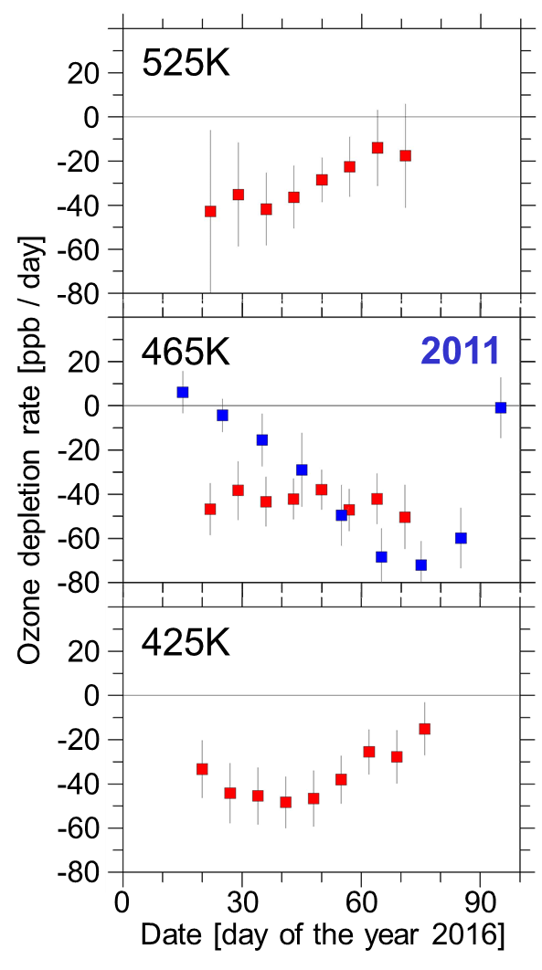
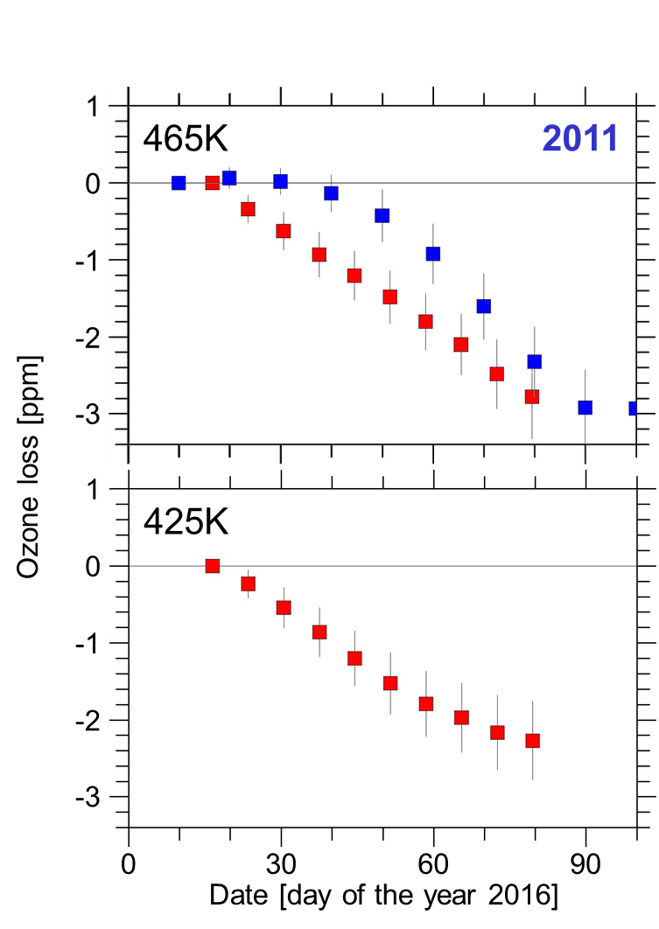
Stratospheric O₃ chemistry
Polar O₃ chemistry
Measuring O₃
O₃ time variability
The Match project
Match results
Match results 2016
The final warming overlapped with the ozone loss period!

Slide 26

Stratospheric O₃ chemistry
Polar O₃ chemistry
Measuring O₃
O₃ time variability
The Match project
Match results
Match results 2016
climate sensitivity of Arctic ozone loss:
15 DU additional ozone loss per K cooling of the Arctic stratosphere
80 DU additional ozone loss
warm
5-6°C change in temperature
cold
long term two-to-threefold increase in the maximum values reached during the cold winters
cold Arctic stratospheric vortices seem to get colder

Slide 27
Thank you for your attention

Slide 28
Extra slides

Slide 29

Stratospheric O₃ chemistry
Polar O₃ chemistry
Measuring O₃
O₃ time variability
The Match project
Match results
Filters built into the Match approach
divergence of trajectory cluster small
  avoids shear zones that tend to have larger mixing
  selects dynamical situations where trajectories are more reliable
PV change along trajectory small
  avoids wave breaking events and unreliable trajectories
vertical gradient in ozone profiles small
  avoids lamina structures that indicate wave breaking and mixing
  makes results less sensitive on uncertainties in the calculated radiative cooling rates
clusters!

