Slide 1
HEGIFTOM Kick Off Workshop, 22-25-29 March 2021 telecon
NDACC/ACTRIS MAX-DOAS:
Relation to TOAR-II
M. Van Roozendael, F. Hendrick
BIRA-IASB, Brussel, Belgium

Slide 2
Status of UV-Vis NDACC MAX-DOAS network

Slide 3
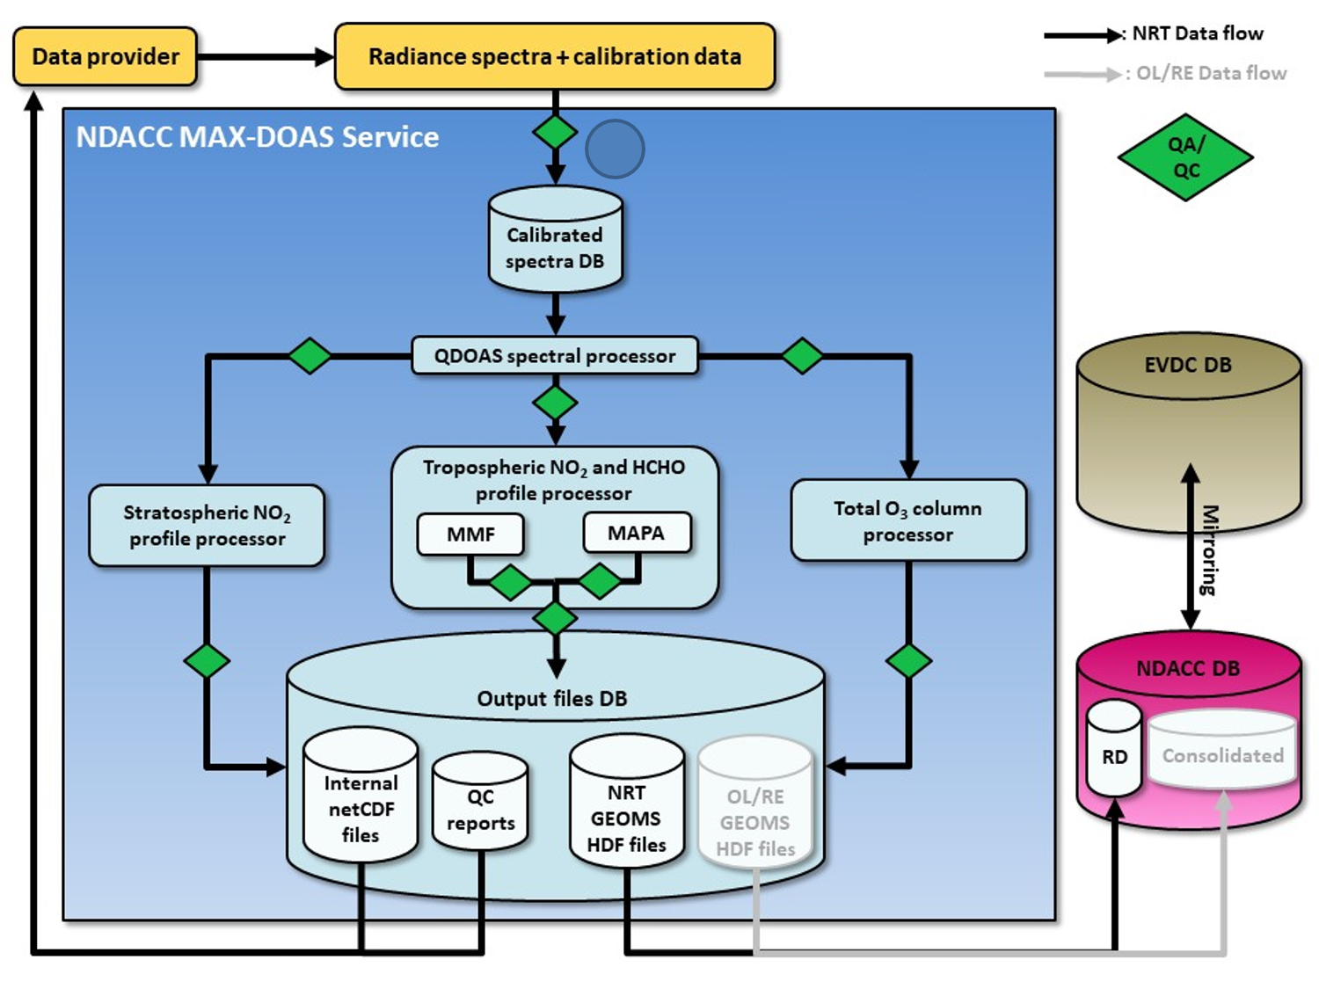
MAX-DOAS Central Processing Service
Implements standardised algorithms selected by round-robin
Data products:
Tropospheric NO₂
Tropospheric HCHO
Total O₃
Stratospheric NO₂
Developed with ESA support (FRM₄DOAS)
Will also be part of ACTRIS CREGARS service

Slide 4
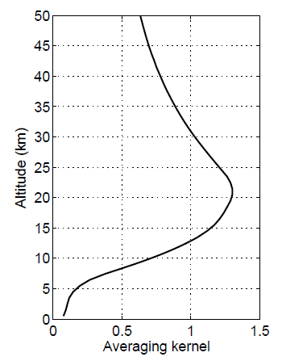
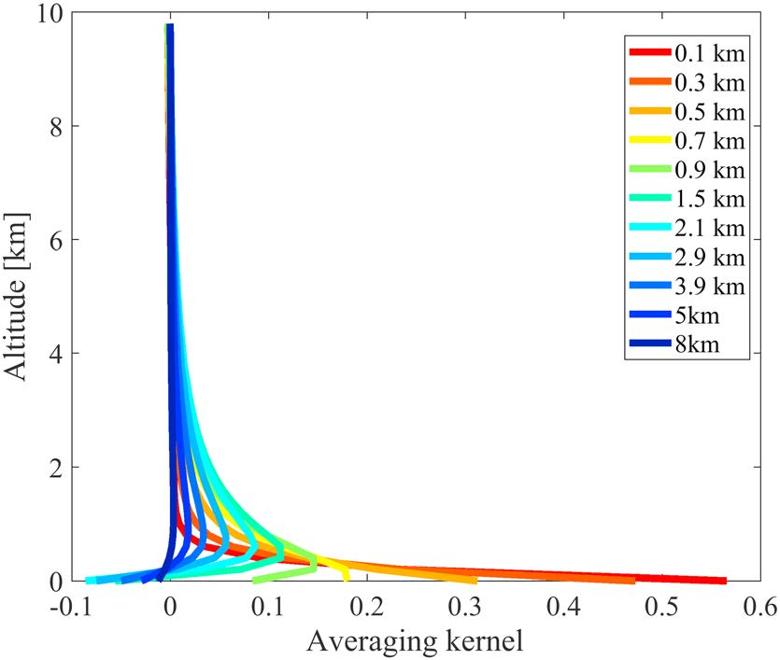
Information content of UV-Vis measurements not fully exploited yet
Aim for TOAR-II: explore potential for tropospheric ozone retrieval
Close cooperation with Pandora team
Direct-sun
Zenith
Twilight
(90° SZA)
MAX-DOAS

Slide 5
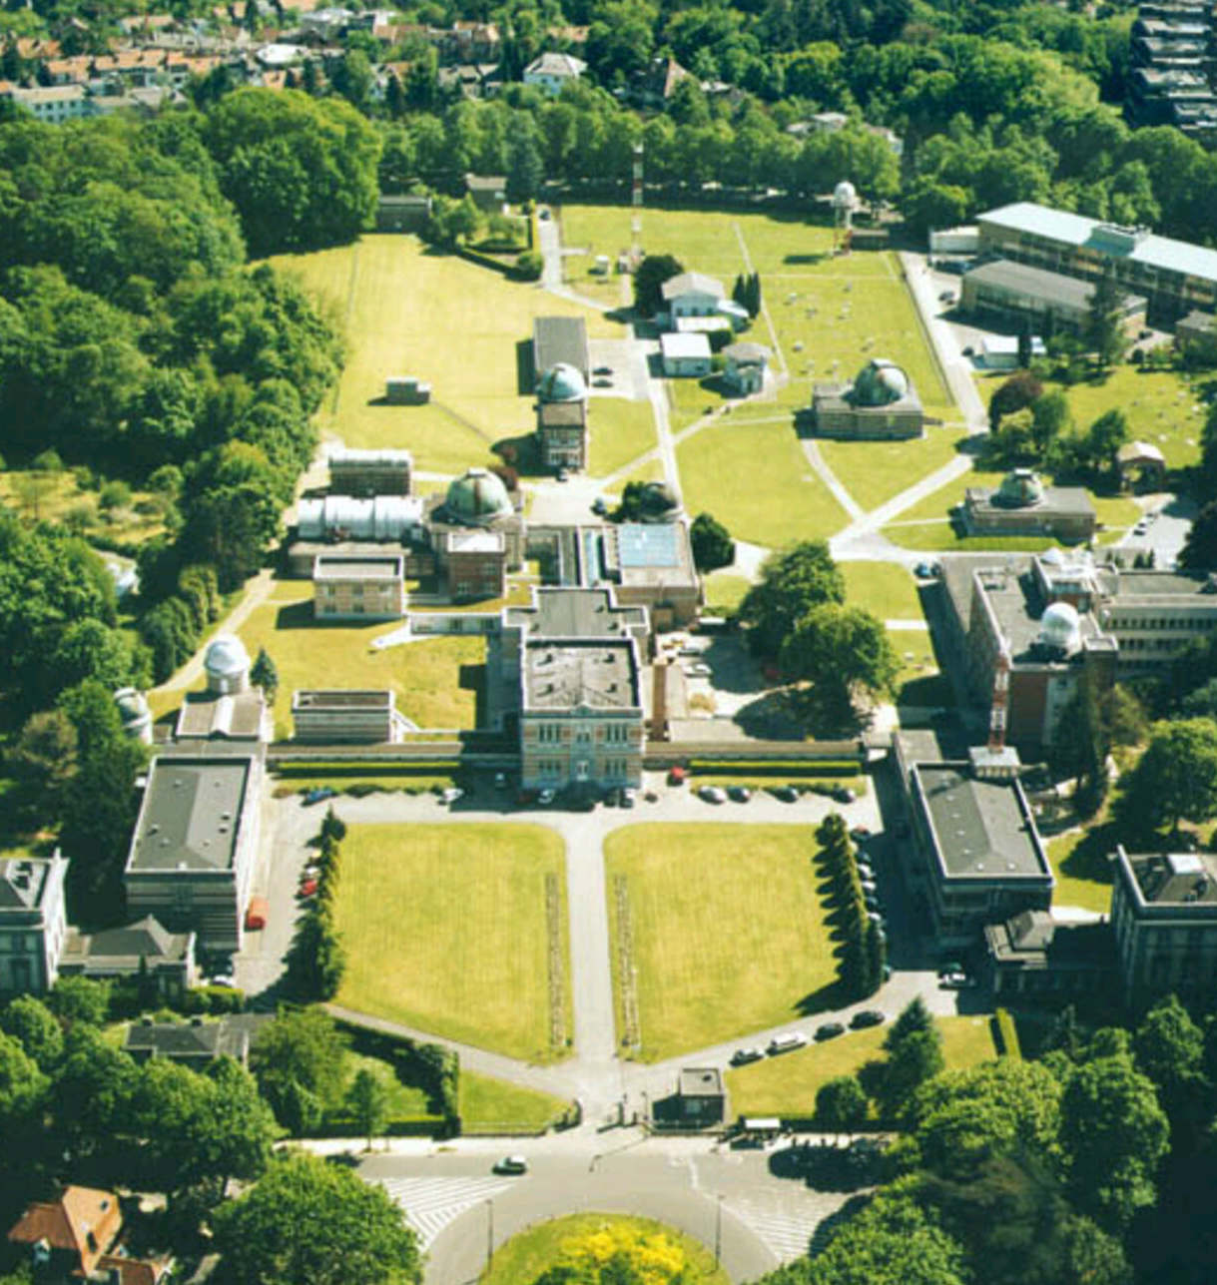
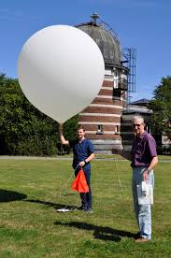
Candidate test/development site: Uccle
Single + double Brewer
Regular ozone sonde and PTU launches (> twice a week)
Cimel sunphotometer
Ceilometer
Surface ozone monitor
Pandora-2S
MAX-DOAS
Strategy under development together with Pandora team (see Alex Cede talk)

