Slide 1
Global ozonesonde network: status of QA/QC and homogenization activity
R. Van Malderen, H. G. J. Smit, and ASOPOS panel

Slide 2
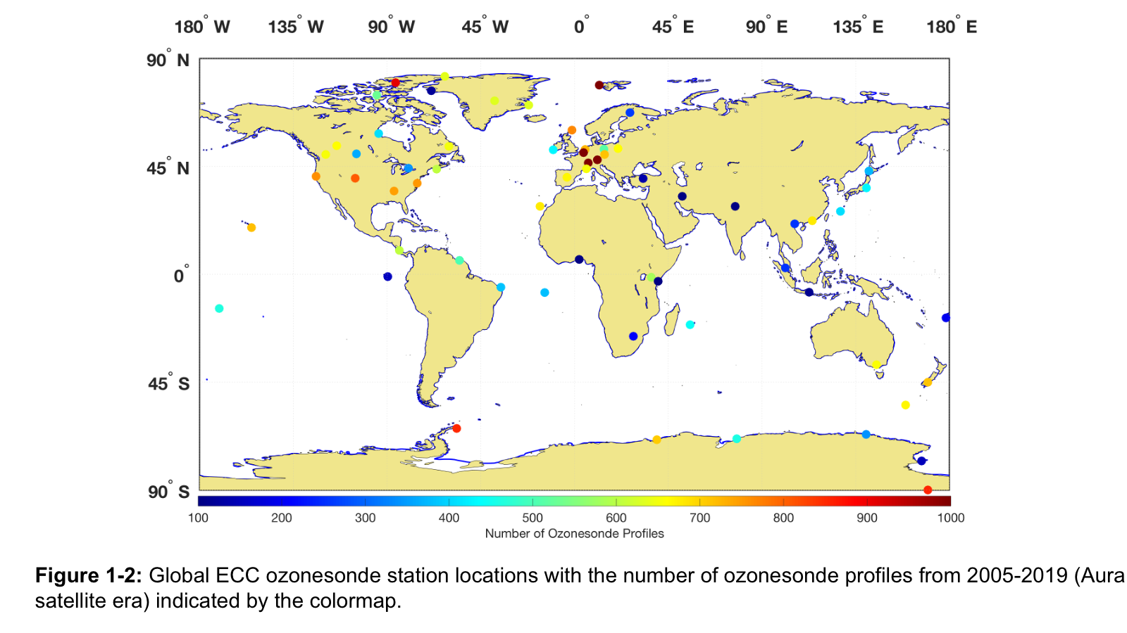
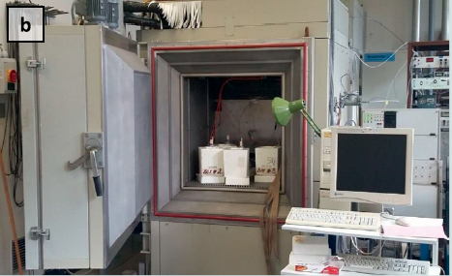
Ozonesonde network
Network of ozonesonde stations
World Calibration Centre of Ozonesondes
(at Forschungszentrum Jülich, PI: Herman Smit)
a
intercomparison campaigns (JOSIE) in simulation chamber
reference instrument (UV-absorption spectrometer, OPM)
panel for the Assessment of Standard Operating Procedures for Ozone Sondes (ASOPOS)
about 60 active ozonesonde stations
TRACEABILITY

Slide 3
Internal consistency: small changes -> significant effects
Standard Operating Procedures (SOPs)
Standards for sonde type – solution strength combinations
preparing ozonesondes
data correction methods
guidelines for data format and metadata reporting
guidelines for transferring long-term data to these standards (“harmonization”) and resolving artifacts (biases)
------------------------------------------------------------------------------------------------

Slide 4
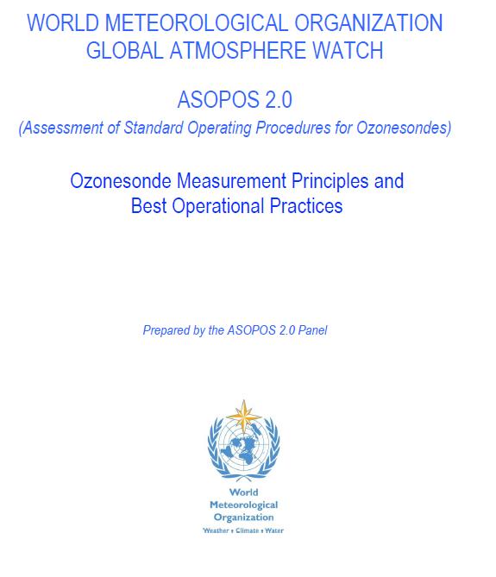
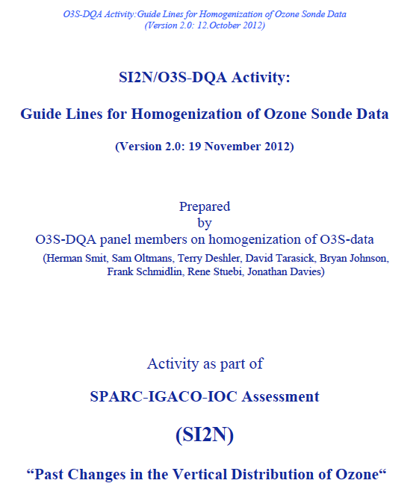
Internal consistency
ASOPOS 1.0: Establishing SOP 1.0 (GAW Report#201)
SOPs based on JOSIE and balloon (BESOS) experiments
Achievement: 10 % uncertainty in the global network
ASOPOS 2.0: Establishing new SOP 2.0 (GAW Report#xxx)
Uncertainty of 5 % in the global network through the use of a single coherent set of SOPs on preparation, METADATA & data processing at all stations in the global network
O3S-DQA: Homogenisation of the long term O3S-data of the global network (2012……)
JOSIE and BESOS showed that the global (O3S) network is suffering from bias effects e.g. through the use of different ECC sonde types together with different sensing solution types (SSTs)
Achievement: Reduction uncertainty in global network over 1980-2015 from 10-20% down to 5-10%
Tarasick et al, AMT, 2016; Van Malderen et al., AMT, 2016, Witte et al., JGR 2017, 2018 A&B, 2019; Sterling et al., AMT, 2018
2004
2021
------------------------------------------------------------------------------------------------
2012

Slide 5
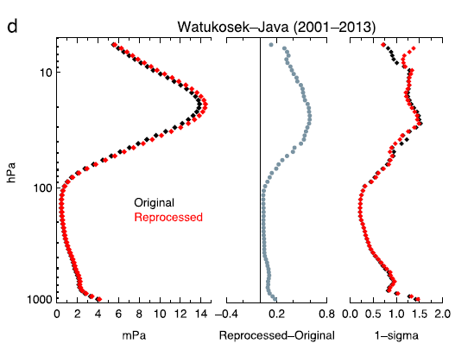
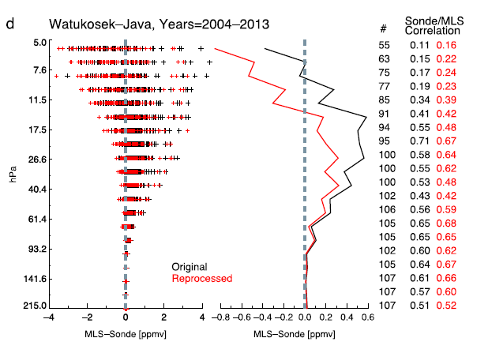
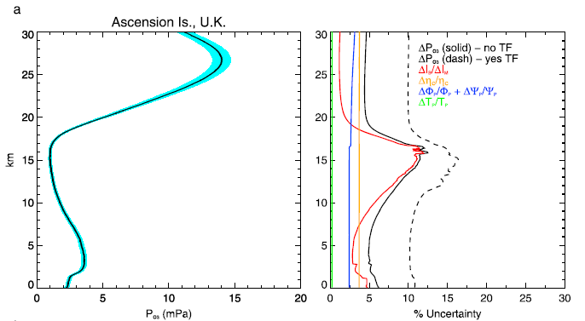
O3S-DQA: principles
Witte et al., JGR, 2017
correcting for changes (→biases) in …
ECC ozonesonde type (SPC, EN-SCI)
sensing solution strength/volume
“pump” temperature measurements
pre-flight procedures (background current, pump flow rate)
post-processing (pump efficiency correction tables, total ozone normalization, etc.)
estimation of UNCERTAINTIES (random) for every ozone partial pressure measurement
Witte et al., JGR, 2018

Slide 6
O3S-DQA: status
Canadian network (10 sites) Tarasick et al., AMT, 2016
SHADOZ network (10 sites) Witte et al., JGR, 2017, 2018, Thompson et al., JGR, 2017
NOAA network (9 sites) Sterling et al., AMT, 2018
Individual sites (5): Uccle & De Bilt (Van Malderen et al. , AMT, 2016), Wallops Island (Witte et al., JGR, 2019), Lindenberg, Mc Murdo
➔ 34 homogenized sites
Fig. taken from the ASOPOS 2.0 report, courtesy of A. Thompson

Slide 7
Homogenization activities in 2021
scale up the currently (35) homogenized ozonesonde time series to about 50 from total of 60 operational, regular long-term ozone sounding stations.
provide all homogenized time series in one unique data format (uncertainties + flagging + metadata)
Possible option: homogenization 2.0, implementing
correction for TCO Drop-off in 25% of ozonesonde network during specific period → relevant for TOAR-II?
correcting for radiosonde pressure sensor biases → not relevant for TOAR-II
alternative background current subtraction and sensor time lag response correction (e.g. Vömel et al., AMT, 2020; Smit et al., in preparation) → very relevant for TOAR-II
internal consistency checking by cross-correlation of EU O3S network, SHADOZ network, etc.

