Slide 1
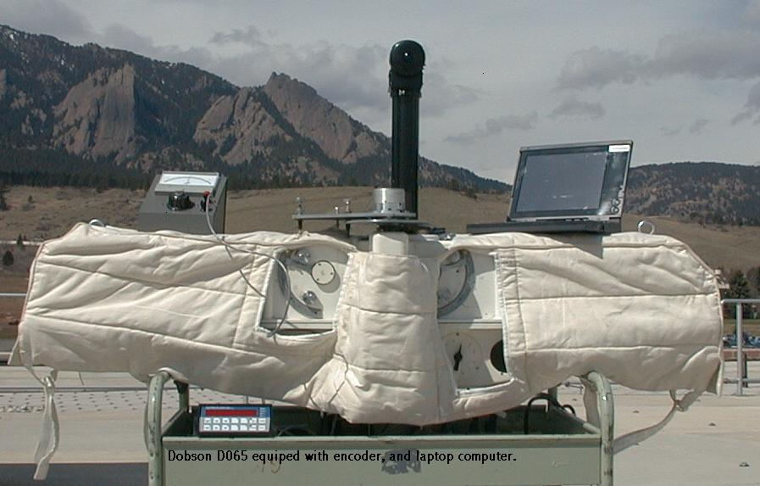
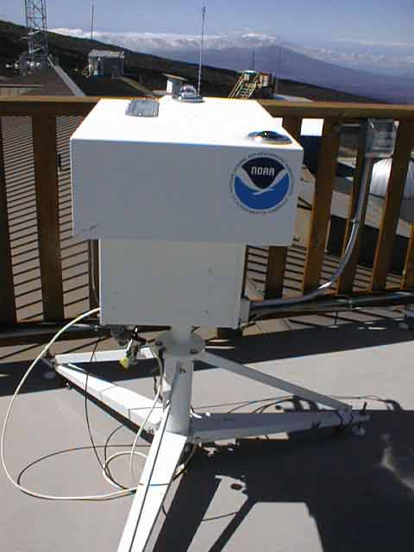
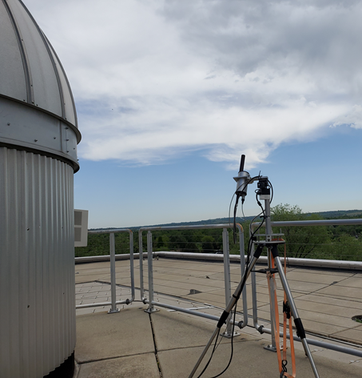
Umkehr ozone for TOAR-II
Collaborations and data usage:
  Satellites: Jeannette Wild, Larry Flynn, PK Bhartia, Natalia Kramarova and others (i.e. EUMet GOME/2, OMI/Tropomi, IASI, MLS, JPSS OMPS and CrIS, TEMPO)
  TOAR I: Audrey Gaudel, Owen Cooper, Kai-Lan Chang and others
  Pandonia: Alexander Cede, Elena Lind, Jay Herman and others
NOAA/GML: Irina Petropavlovskikh, Koji Miyagawa, Glen McConville, Audra McClure, Bryan Johnson, Scott Stierle (NEUBrew network).
Other institutions: Janusz Jarosławski (IoG, Poland), Raievska-Wiech Bonaventura (IoG, Poland), Maillard-Barras Eliane (MeteoSwiss), Martin Stanek (Czech HMI), Alberto Redondas (AEMET), Kostas Fragkos (IRDO, Romania), Harald Rieder (Austria), Klara Cizkova (Czech Republic)

Slide 2
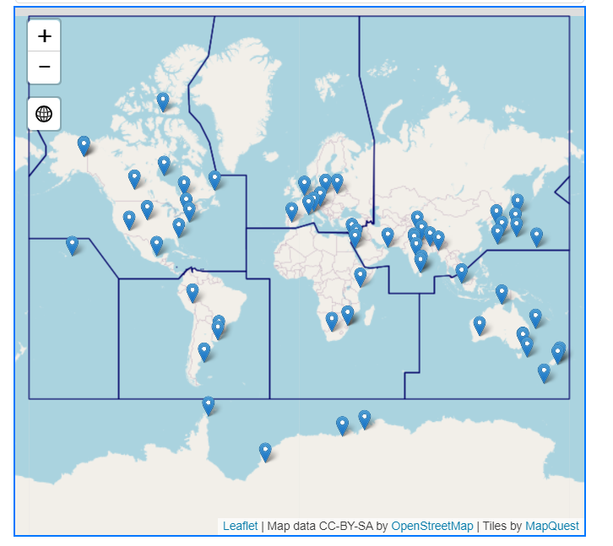
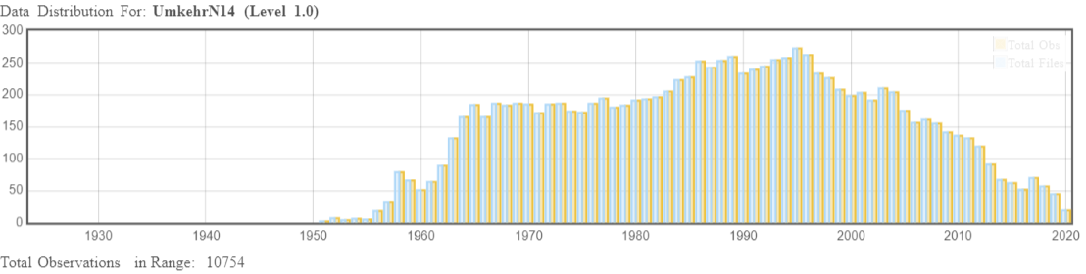
State of the art of the network (in terms of coverage in time and space, data availability)
Archival: WOUDC, EUBrew, NOAA, stations
File format: Excel (.csv) and text (.txt)

Slide 3
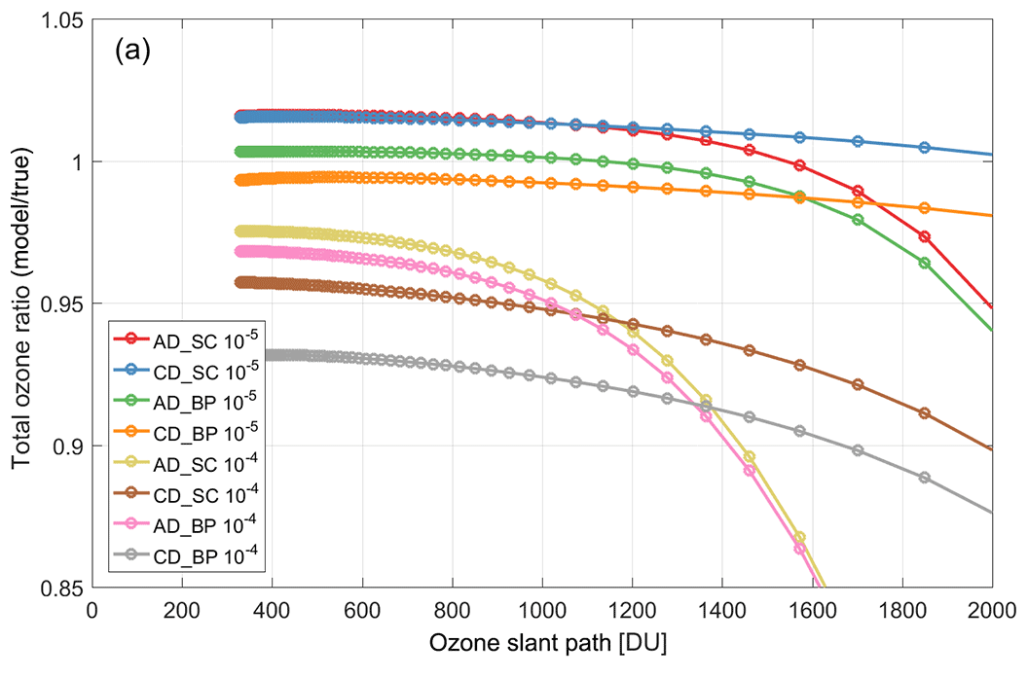
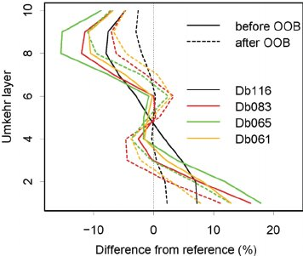
Umkehr ozone retrieval uncertainties
Dobson Algorithm – Optimum statistical retrieval (Petropavlovskikh et al., 2005), python wrapper for WOUDC centralized processing, WOUDC archival
Stray light correction (Petropavlovskikh et al., 2011) – only in NOAA processing
Selection of Ozone absorption cross sections and temperature correction (Petropavlovskikh et al, 2011) – only in NOAA processing
Brewer Umkehr algorithm - http://www.o3soft.eu/o3bumkehr.html (Martin Stanek)
Dobson/Brewer stray light comparisons and impact on Total ozone (Moeni et al, 2019)

Slide 4
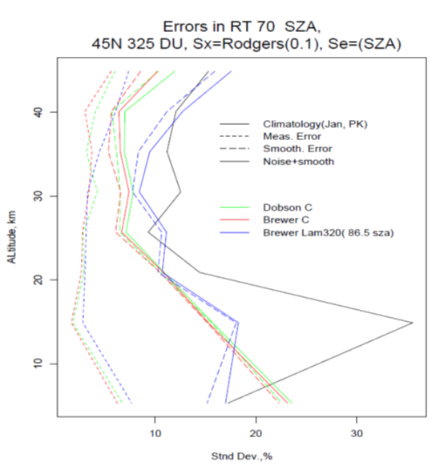
Umkehr ozone retrieval uncertainties reporting and metadata
Vertical resolution – AKs, lower layer has a contribution of stratospheric information to tropospheric column (TOAR studies, Hassler et al., 2014) – needs further evaluation
Assessment of measurement and smoothing errors (Petropavlovskikh et al, 2011)
No reporting of errors, a priori profiles or AK information, but it can be provided for NOAA data
Climatology
Measurement error
Smoothing error
Total error
Approx. Altitude, km
Approx. Altitude, km
0 10 20 30 40 50
Dobson
Brewer
10 20 30
Standard deviation, %
0 5 10 15
Averaging Kernel
0 20 40 60 80
Fractional change, %

Slide 5
Traceability and network consistency
Dobson and Brewer network are traceable to the world and regional standards (i.e. Brewer triads and traveling standards)
To transfer the calibration: Langley plots side by side with the standard
Dobson uses Standard lamps (i.e. NIST calibrated) – tracking spectral stability of the optical system and standardised band-passes for network (only 3 Dobsons were individually scanned to determine their band-pass)
Brewer uses dispersion tests to determine instrument optical stability and bandpass (i.e. tunable laser) specific for each instrument
Lab-measured absorption cross sections and it’s temperature dependence – the same of the network

