Slide 1
Thoughts on interactions between HEGIFTOM and the Tropospheric Ozone in Global and Regional Atmospheric Chemistry Models (TOGARACM) Working Group
David Plummer, Lee Murray and Alex Archibald
March 25, 2021

Slide 2
Where we fit
Chemistry Climate Model Initiative
- sponsored by IGAC and SPARC
Aerosols and Chemistry MIP (AerChemMIP)
- CMIP-endorsed MIP
Hemispheric Transport of Air Pollution (HTAP)
- sponsored by UNECE
Modelling Groups
plus regional AQ modelling projects like AQMEII
Modelling Groups
Modelling Groups
before any analysis is done, we all rely on asking a lot from groups that develop and run models

Slide 3
The CCMI-1 timeline
January, 2013
Description of expts published
April, 2014
CMOR tables for data conversion
July 2016 – mid-2020
Multi-model analysis in peer reviewed literature
Continued use of CCMI simulations
May, 2012
Davos Workshop
August, 2013
Data request finalized
January 2015 – March 2016
Data submission
e.g. specified dynamics simulations, idealized tracers
Data Volume / Utility
Initial request for experiments and variables
Unforeseen and continued use of outputs
Modelling groups select scenarios and variables they have capability, resources and time to provide
Representativeness of scenarios / variables can become an issue

Slide 4
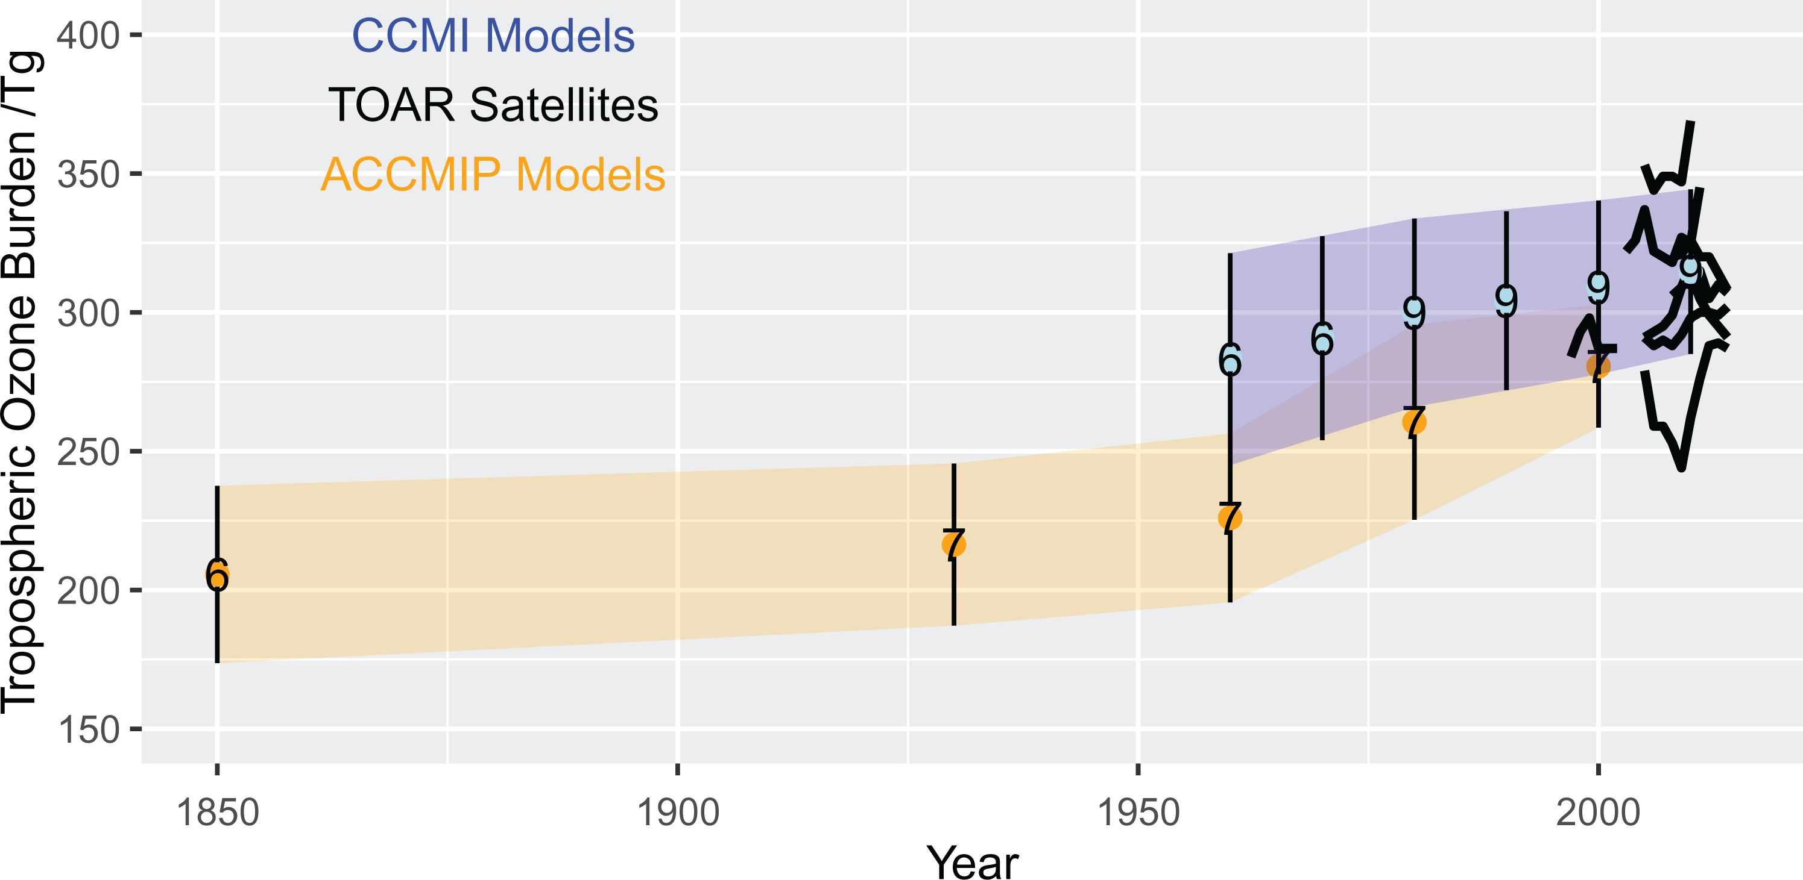
The CCMI-1 timeline
January, 2013
Description of expts published
April, 2014
CMOR tables for data conversion
July 2016 – mid-2020
Multi-model analysis in peer reviewed literature
Continued use of CCMI simulations
May, 2012
Davos Workshop
August, 2013
Data request finalized
January 2015 – March 2016
Data submission
Examples of use in TOAR phase 1:
Data uploaded to BADC and analysed as part of the TOAR Ozone-budget chapter.
Focused on global quantities and diagnostics (burden, production, loss, etc)
Lots of data un-analysed!
But lots of “important” data un-available
→ Developing ideas for analyses and co-ordinating with modelling groups early is very important. Model output can often be provided (which is not uploaded to BADC) but modellers need a carrot (or stick!)
Archibald et al., 2020 Elementa (TOAR-Budgets)

Slide 5
CCMI-2022 – support for 2022 Ozone Assessment
January, 2021
CMOR tables for data conversion
April 2021
Specifications for two scenarios released
May, 2022
Literature cutoff date for Assessment
September, 2020
Initial hindcast experiment and data request released
March – April 2021
Hindcast data submission
July – August, 2021
Scenario data submission
Modelling groups select scenarios and variables they have capability, resources and time to provide
Unforeseen and continued use of outputs
Data Volume / Utility
Initial request for experiments and variables

Slide 6
Possibilities for modelling support within TOAR-II
scope of possible activities limited by the timeline for TOAR-II
on-going CCMI experiments and long time needed to organize and perform experiments makes it unrealistic
existing simulations from CCMI-1, CCMI-2022 and AerChemMIP simulations
CCMI-1 has free-running historical and ‘nudged’ simulations but they only go to 2010
CCMI-2022 has free-running historical simulations to 2018
dominant data available in archives are monthly average fields
possibilities to ask modelling groups for
additional outputs from existing simulations?
short, nudged simulations?

