Slide 1
Consistency of global tropospheric ozone observations made by aircraft (IAGOS) and ozonesonde observations
Honglei Wang

Slide 2
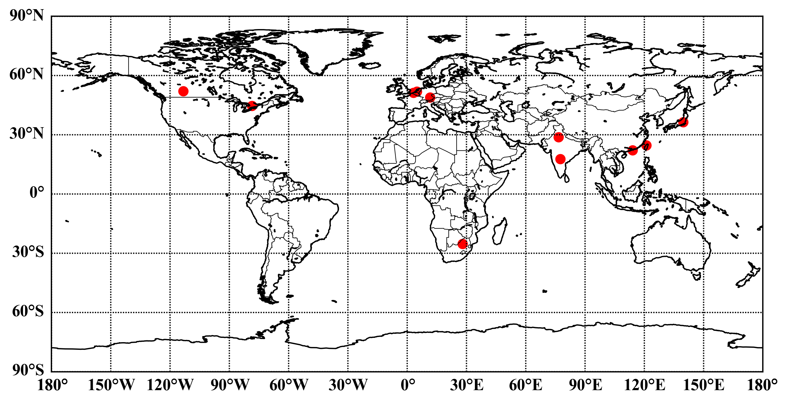
1. Selection of observation sites
11 stations, 6 regions
1. North America:
Calgary and Toronto
2. Europe:
Brussels, Dusseldorf and Munich
3. South Africa:
Johannesburg
4. South Asia (India):
Delhi and Hyderabad
5. Southeast Asia:
Hong-kong and Taipei
6. Northeast Asia:
Tokyo

Slide 3
1. Selection of observation sites
Table 1 Sites Information
Station | MOZAIC-IAGOS |  |  | WOUDC |  |  | Regional
 | Lon | Lat | number | Lon | Lat | number
Calgary | -113.25 | 52.03 | 169 | -114.10 | 53.55 | 102 | North America
Toronto | -78.50 | 44.58 | 490 | -79.78 | 44.23 | 218
Tokyo | 139.73 | 36.33 | 960 | 140.13 | 36.05 | 676 | North-east Asia
Hongkong | 114.11 | 22.10 | 788 | 114.17 | 22.31 | 242 | Southeast Asia
Taipei | 121.08 | 24.59 | 641 | 121.48 | 25.02 | 38
Delhi | 76.65 | 28.73 | 162 | 77.18 | 28.63 | 65 | South Asia
Hyderabad | 77.54 | 17.66 | 130 | 73.85 | 18.53 | 24
Brussels | 3.24 | 51.21 | 1799 | 4.36 | 50.80 | 713 | Europe
Dusseldorf | 4.96 | 51.82 | 297 | 5.18 | 52.10 | 234
Munich | 11.63 | 48.84 | 1637 | 11.01 | 47.80 | 973
Johannesburg | 28.07 | -25.32 | 172 | 28.22 | -25.91 | 115 | South Africa

Slide 4
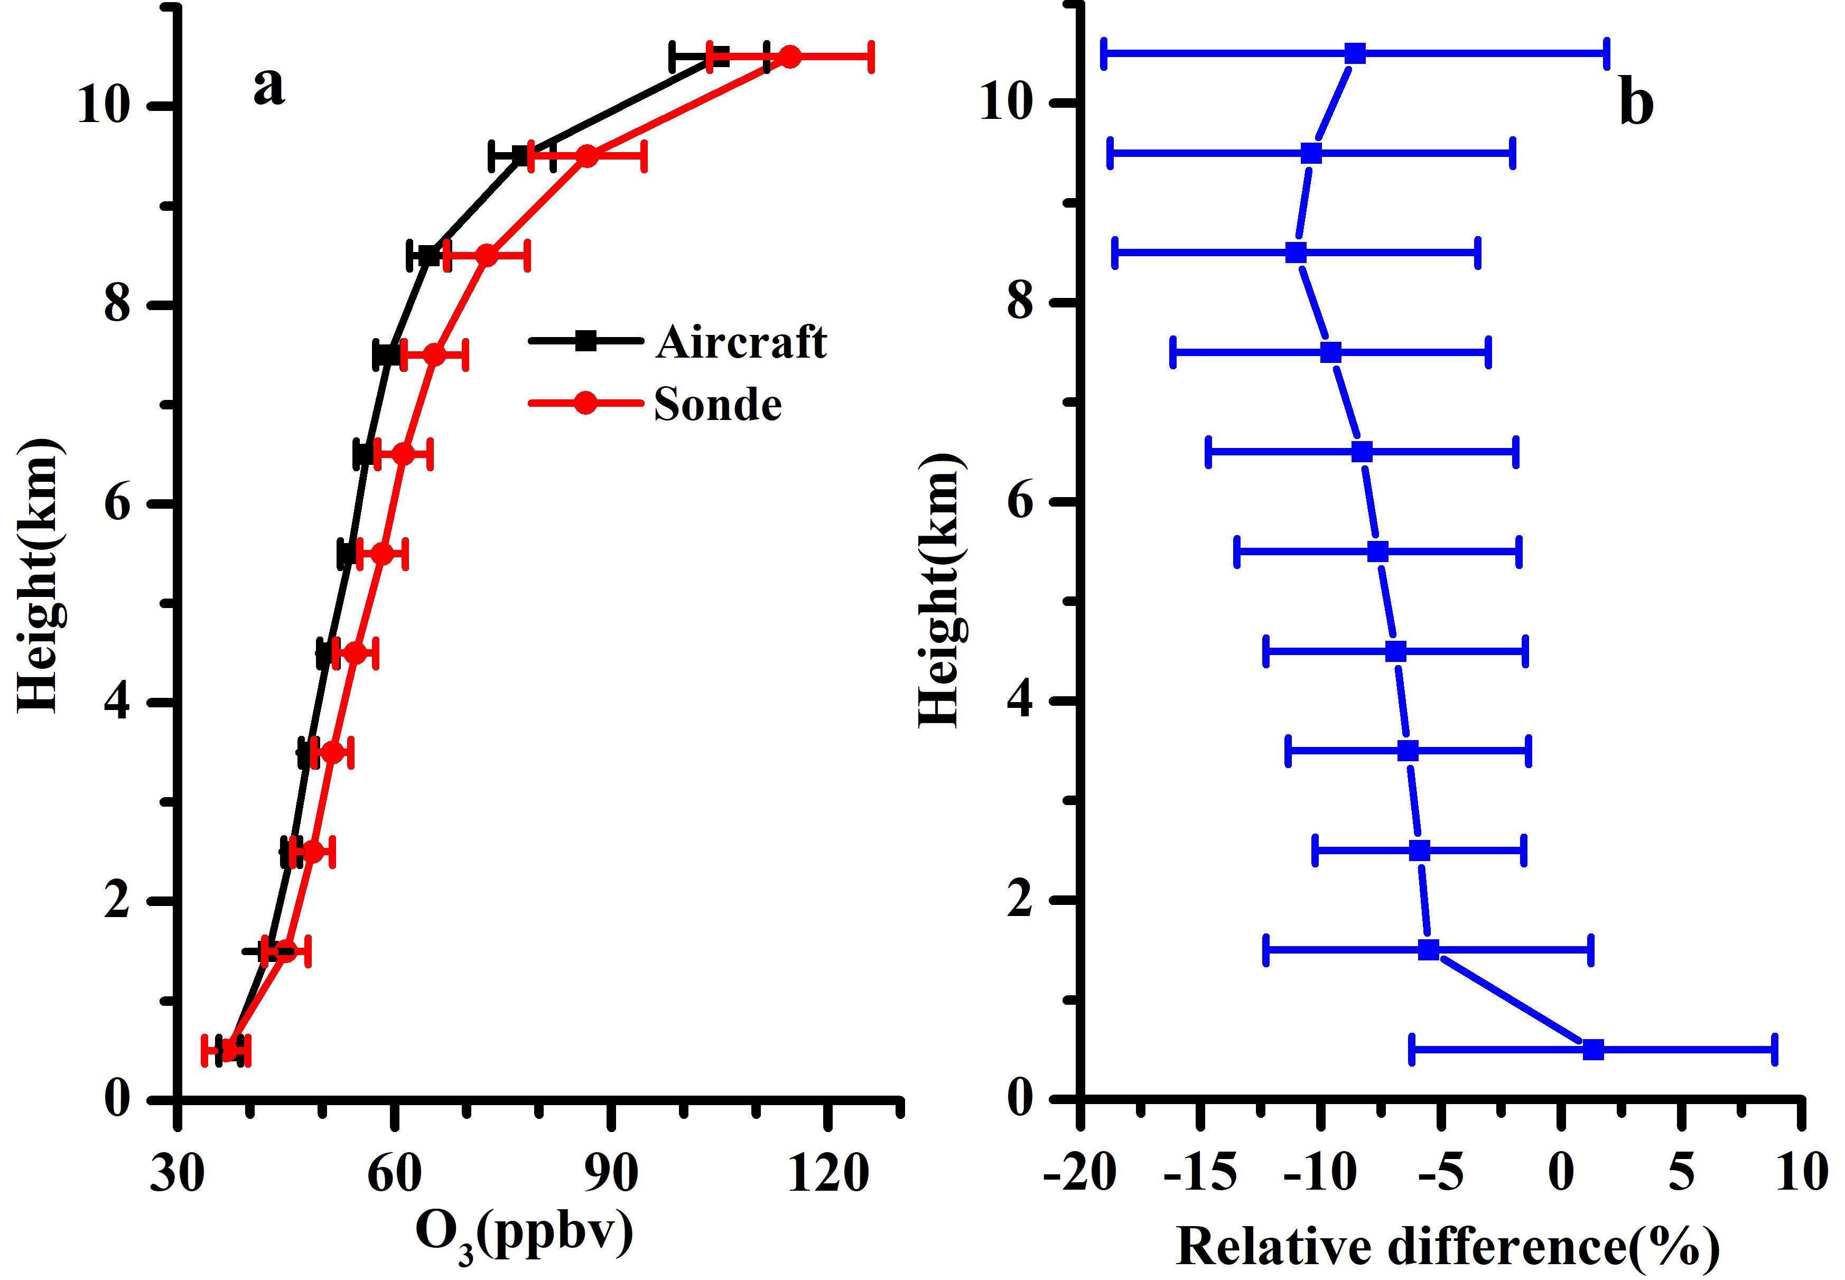
2.Total differences
The O₃ concentration observed by sonde is higher than that observed by aircraft, and the relative difference increases with altitude at 1-9km.
Reasons:
observation instrument differences
rising speed differences
geographic location of observation sites observation time differences
Figure 2: Vertical distribution and aircraft-sonde ozone percent difference, (aircraft-sonde)/sonde*100%. Error bars are 2SE

Slide 5
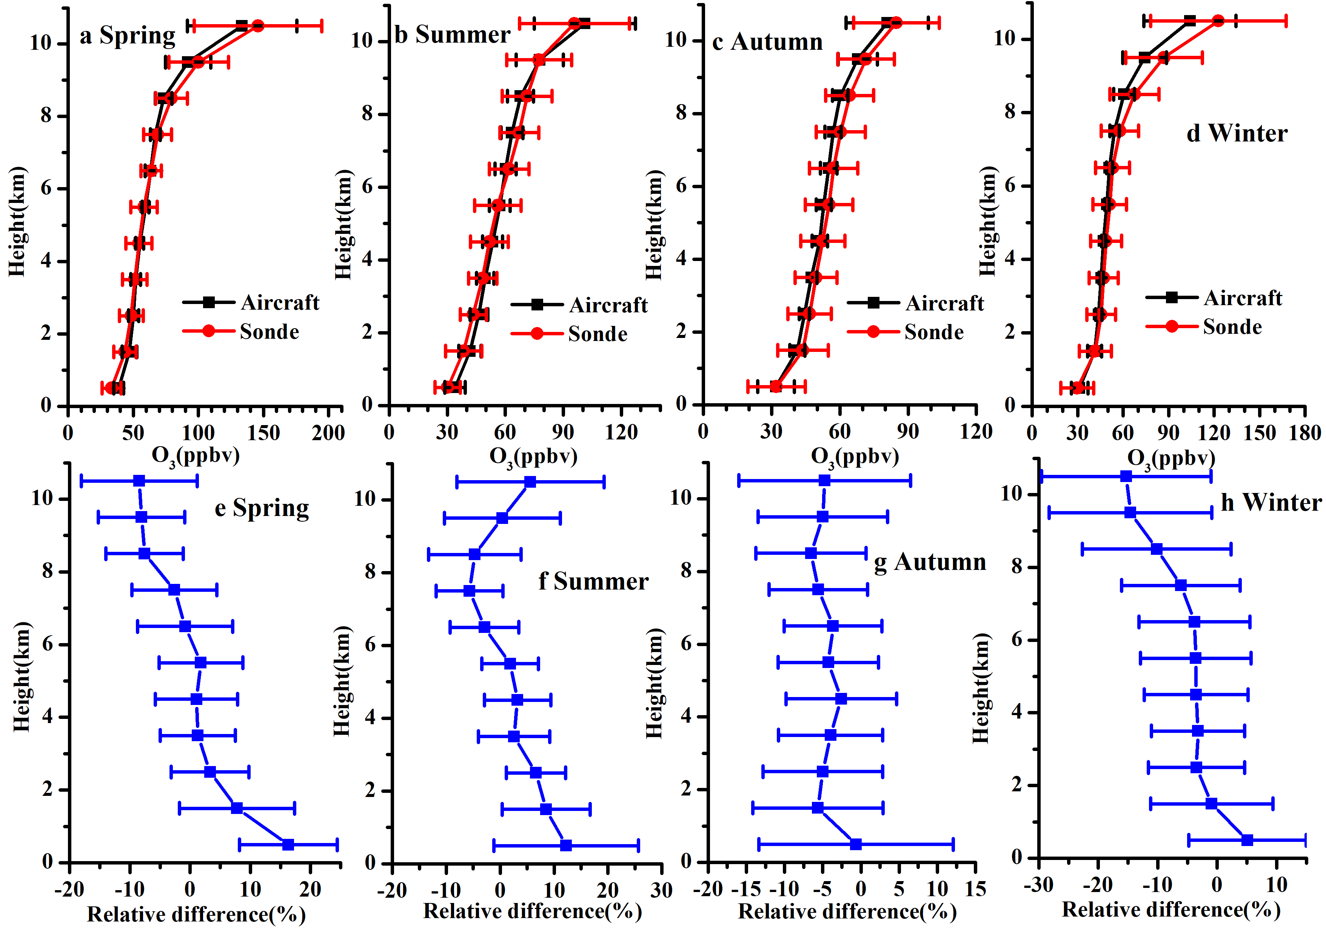
3. Seasonal differences
The vertical distribution of the two data types over four seasons has good consistency. Correlation coefficients vary from 0.582 to 0.751.
The variation of relative differences with height of the two data types is different in different seasons.
Figure 4: Vertical distribution and aircraft-ozonesonde percent differences for the four seasons. Error bars are 2SE

Slide 6
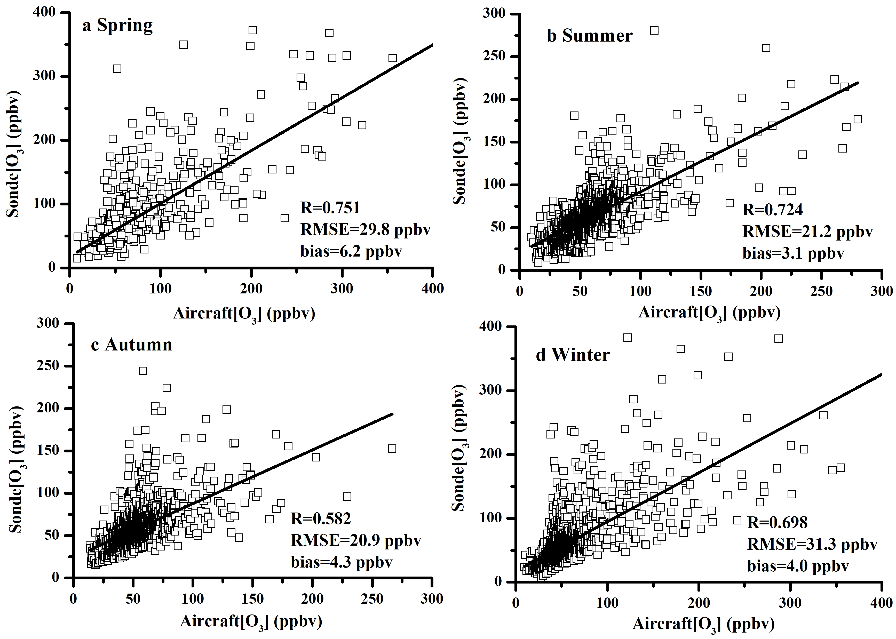
3. Seasonal differences

Slide 7
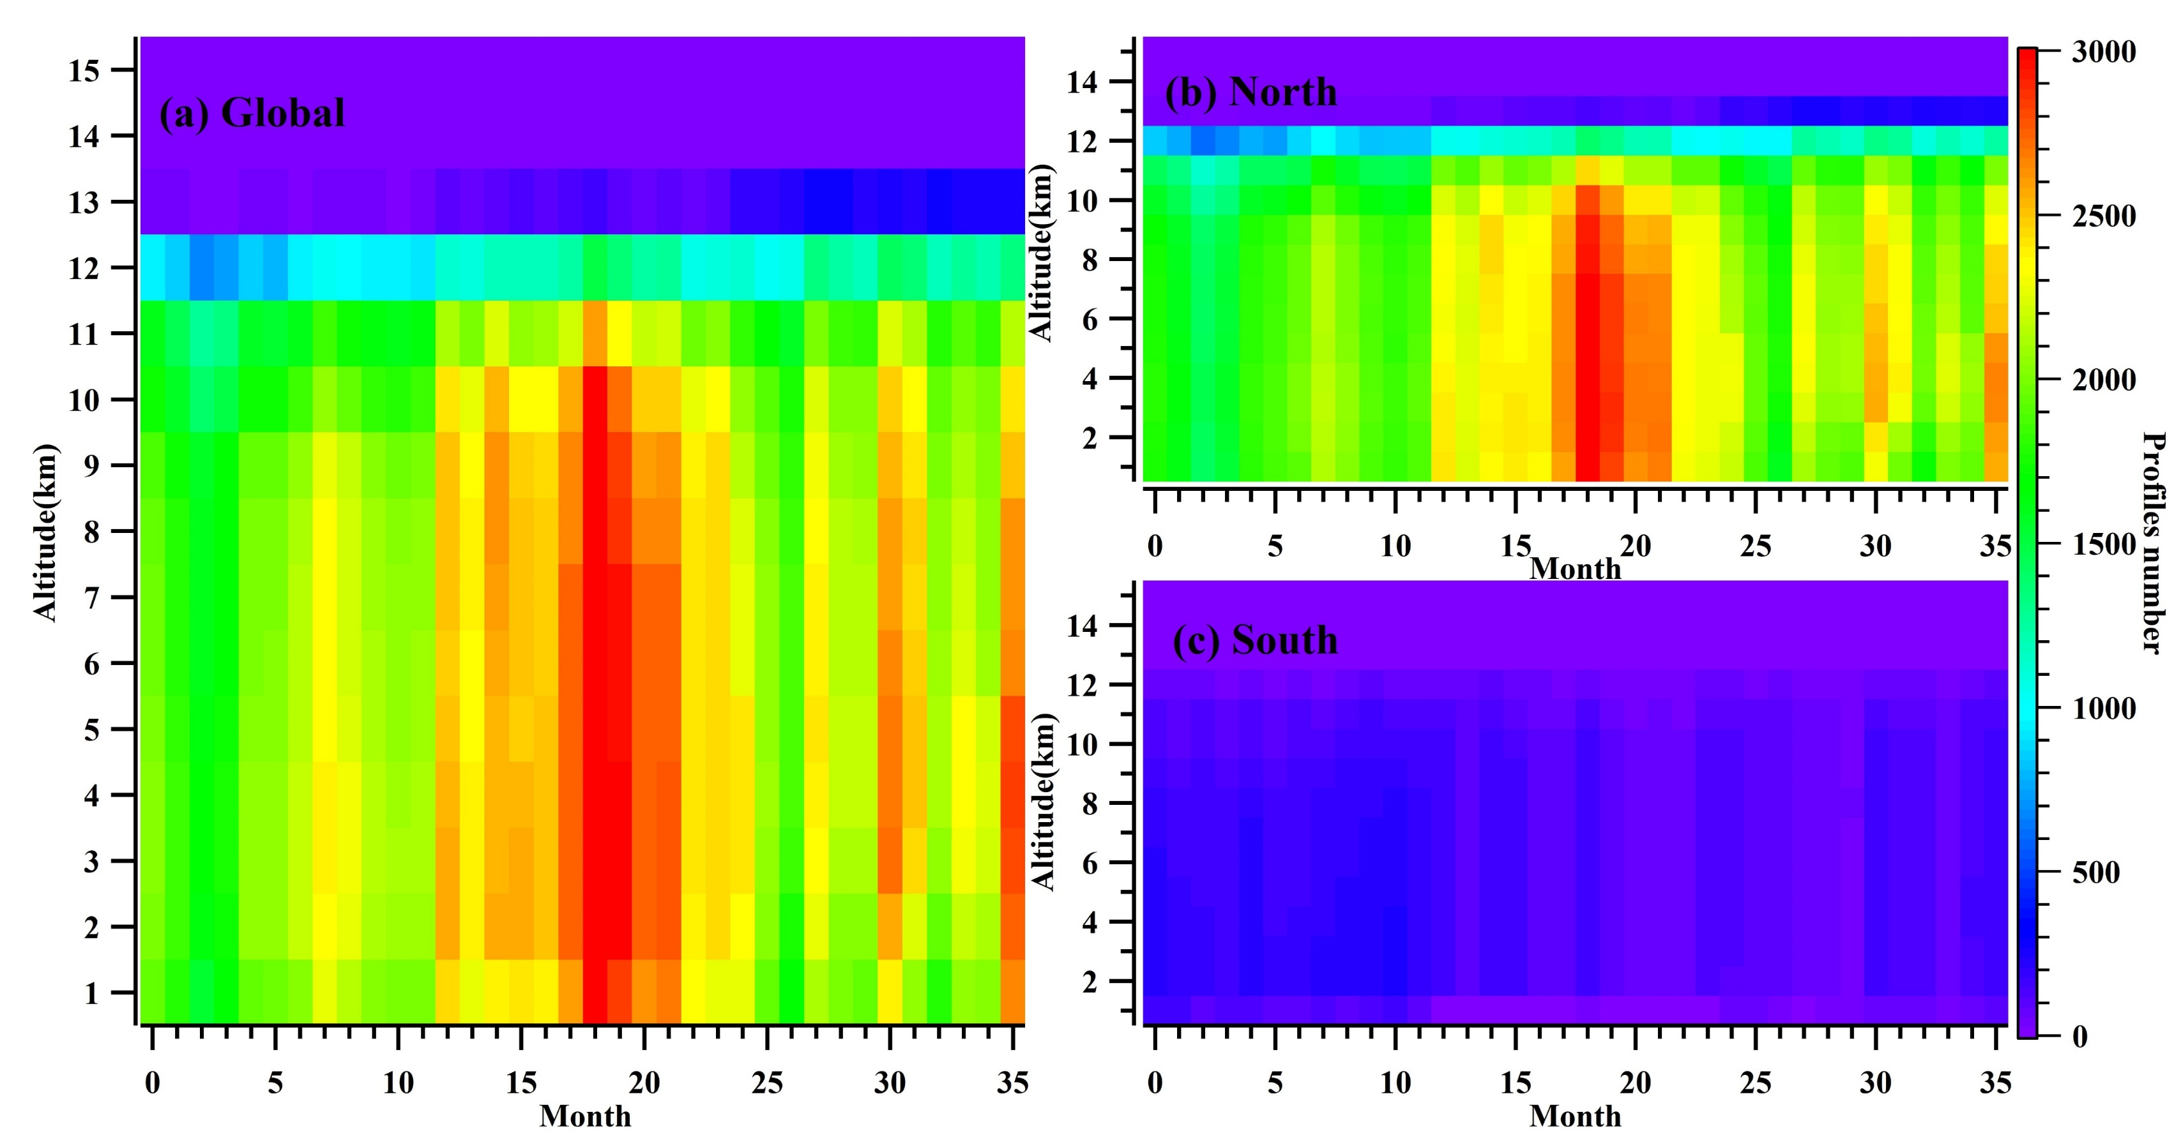
1. Number of profiles difference (main reason)
Above layer 12:
Number of profiles is small, especially in layer 14 and 15 the number of profiles is 0.

Slide 8
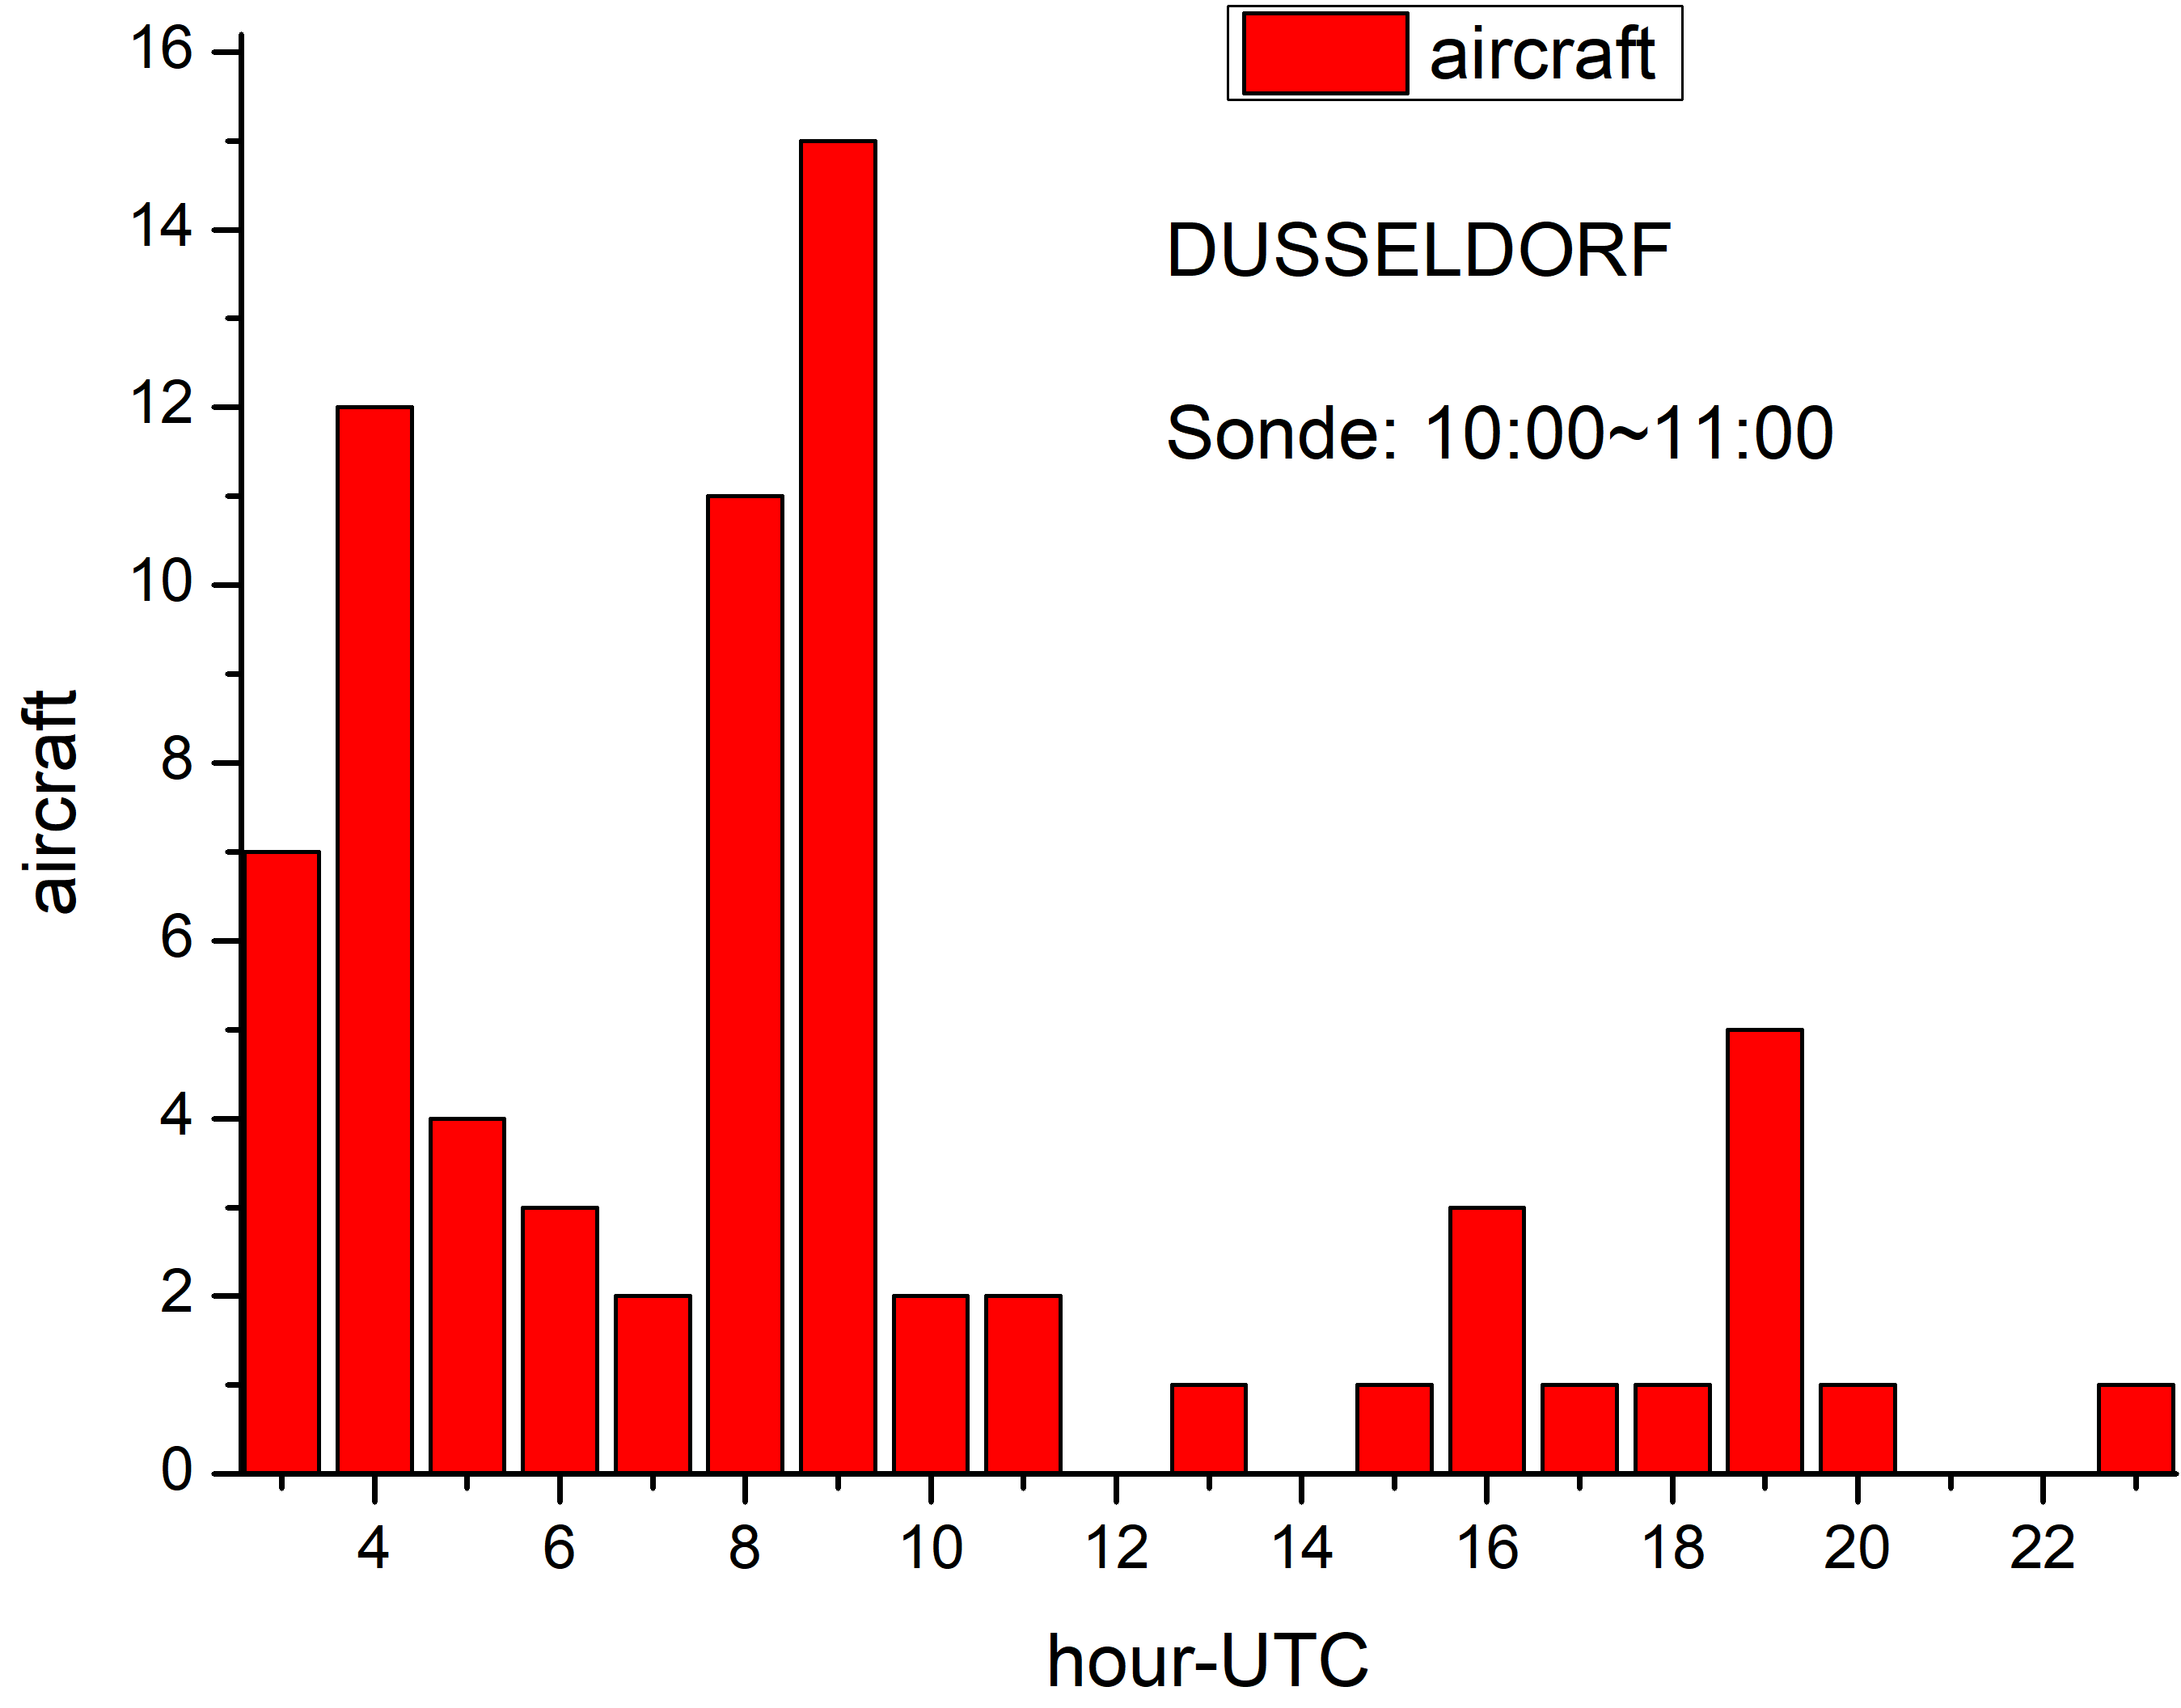
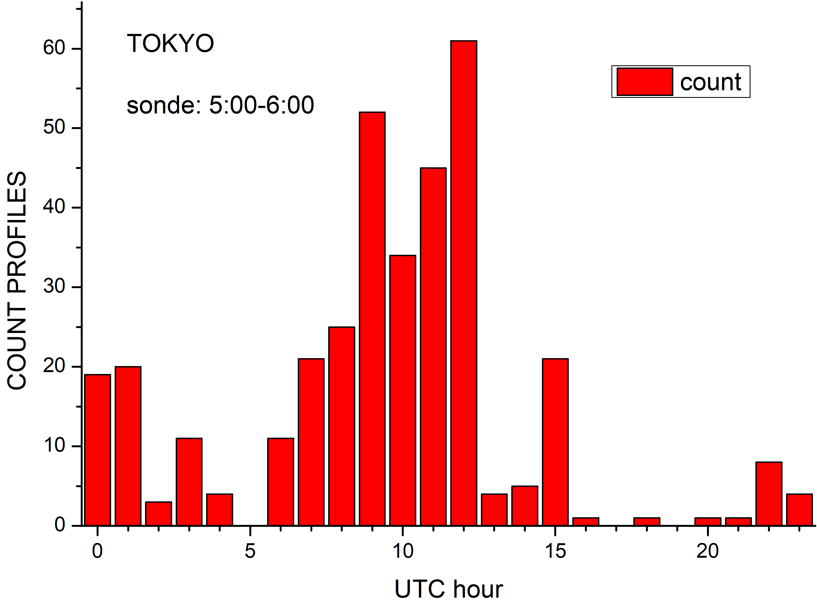
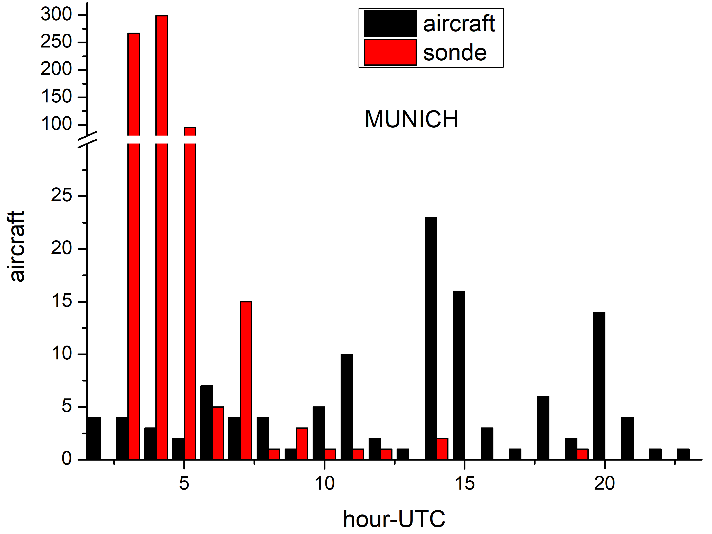
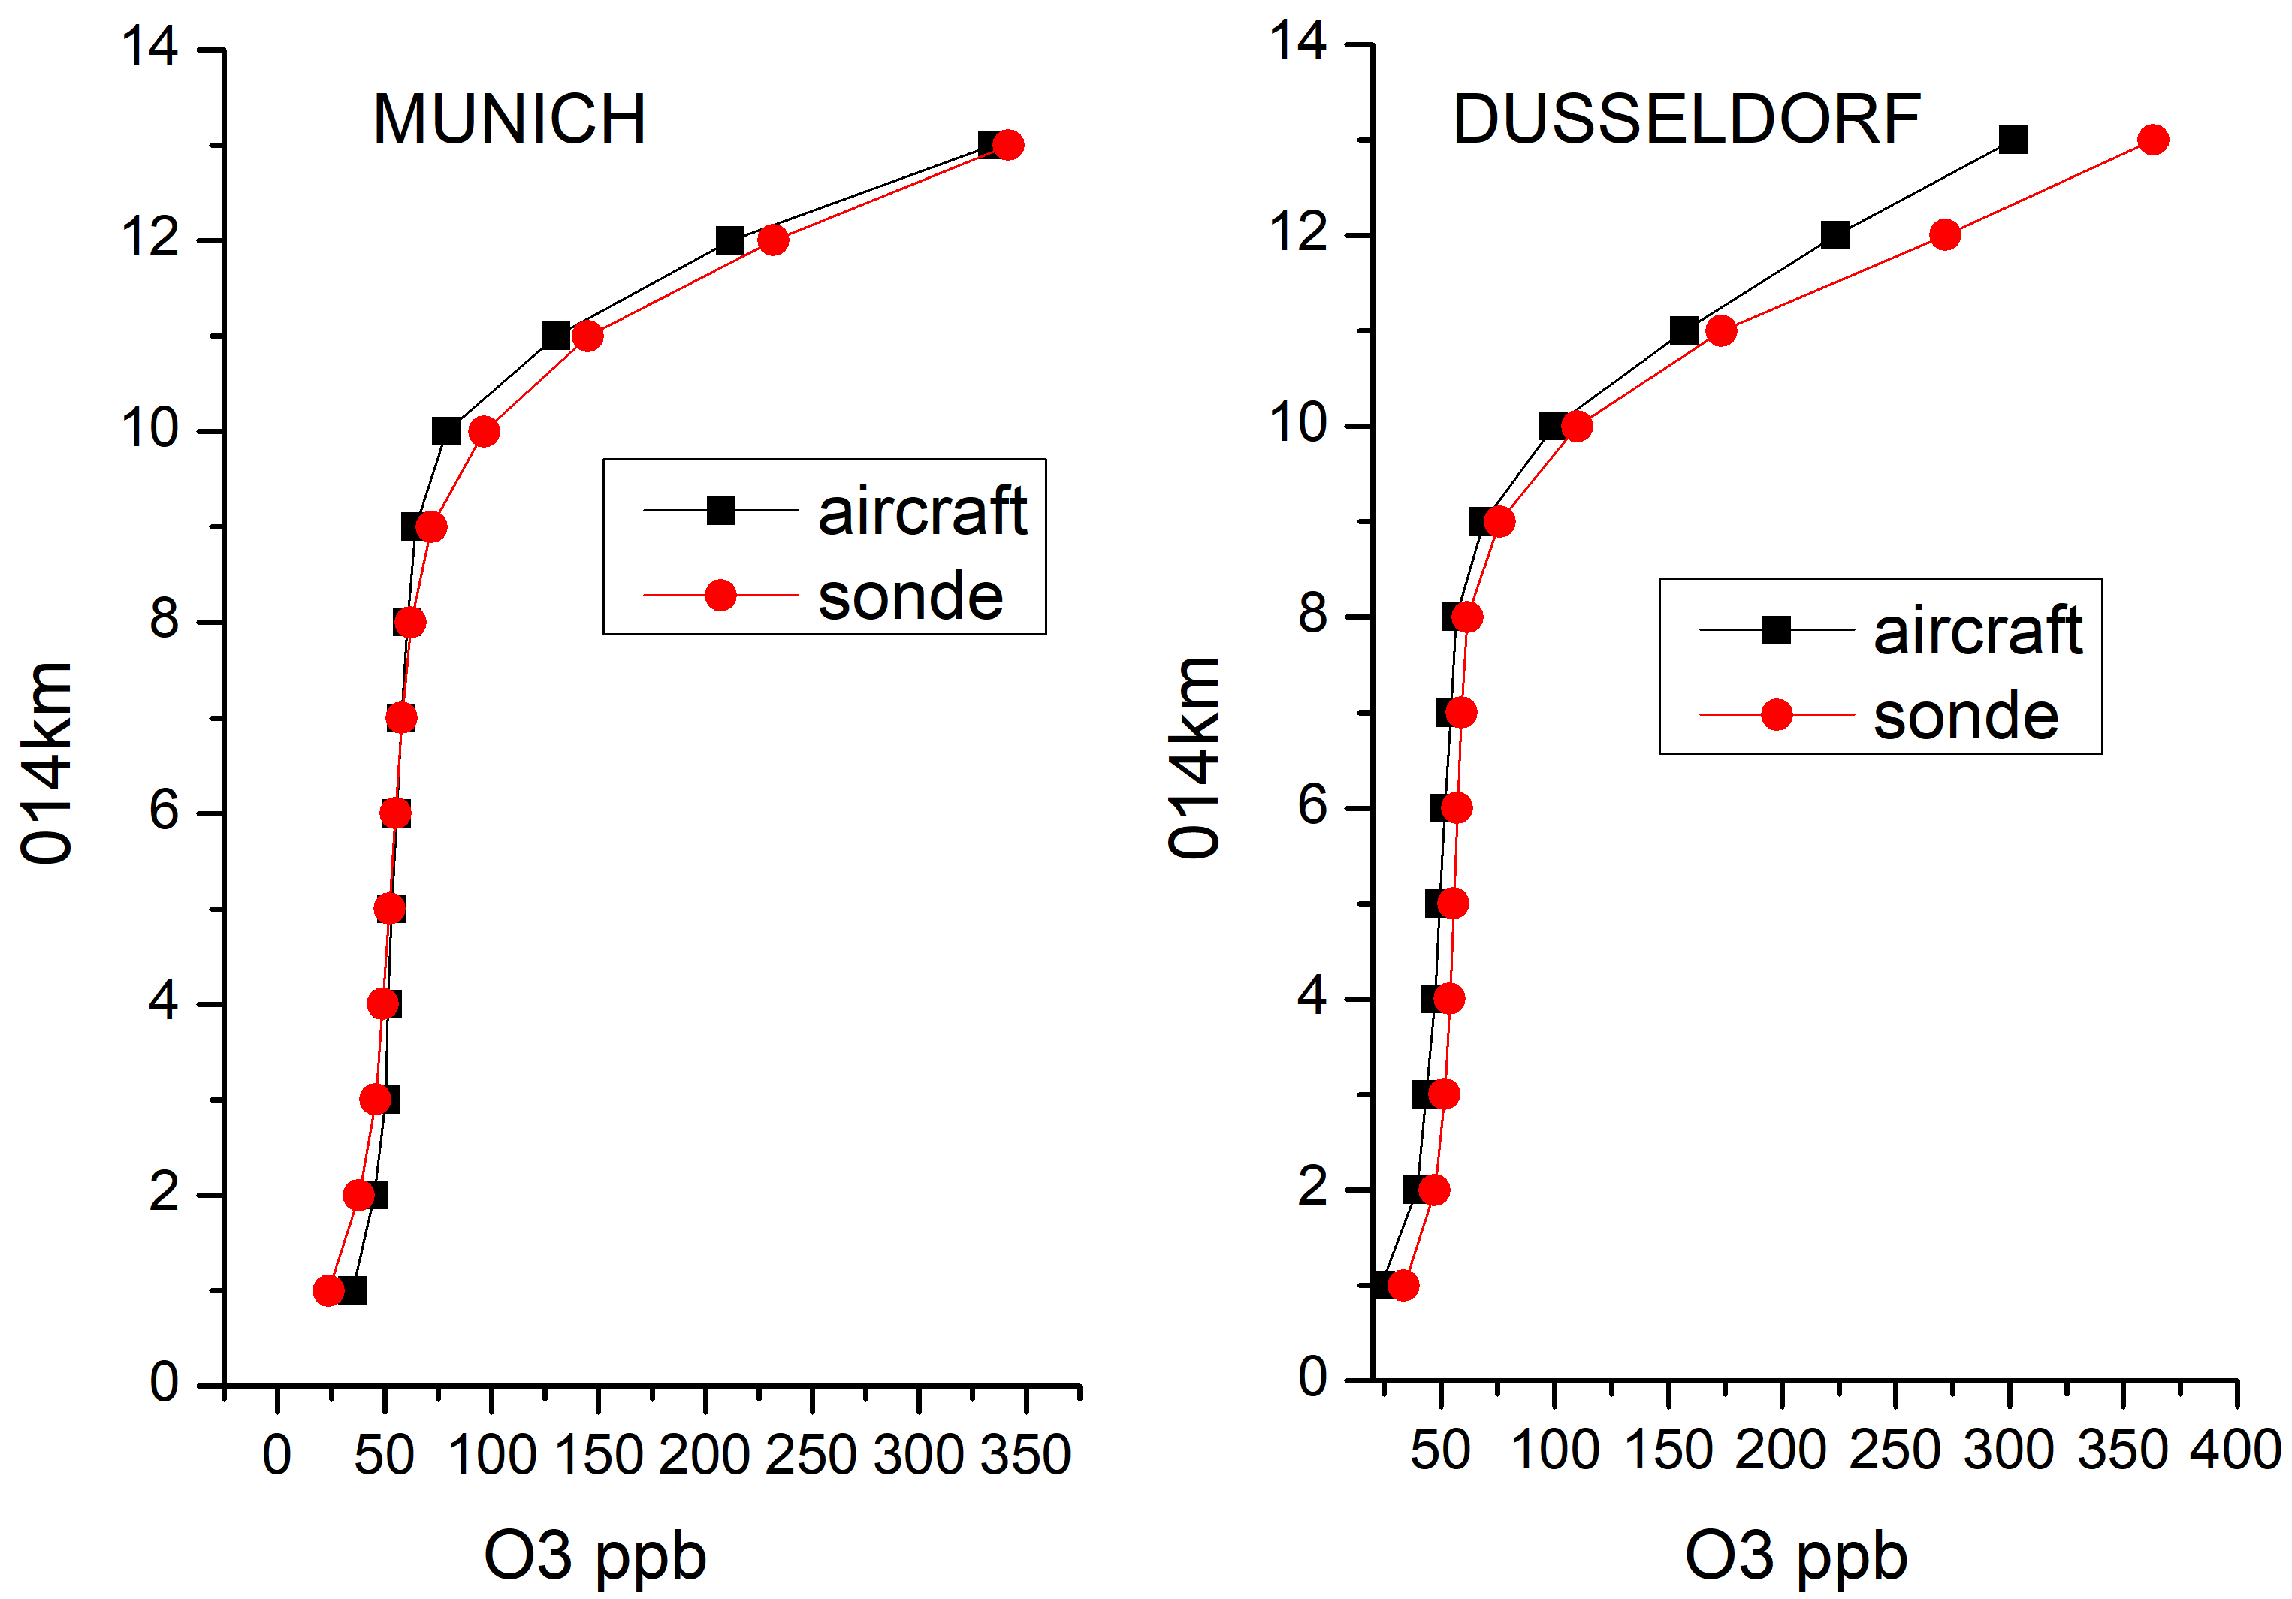
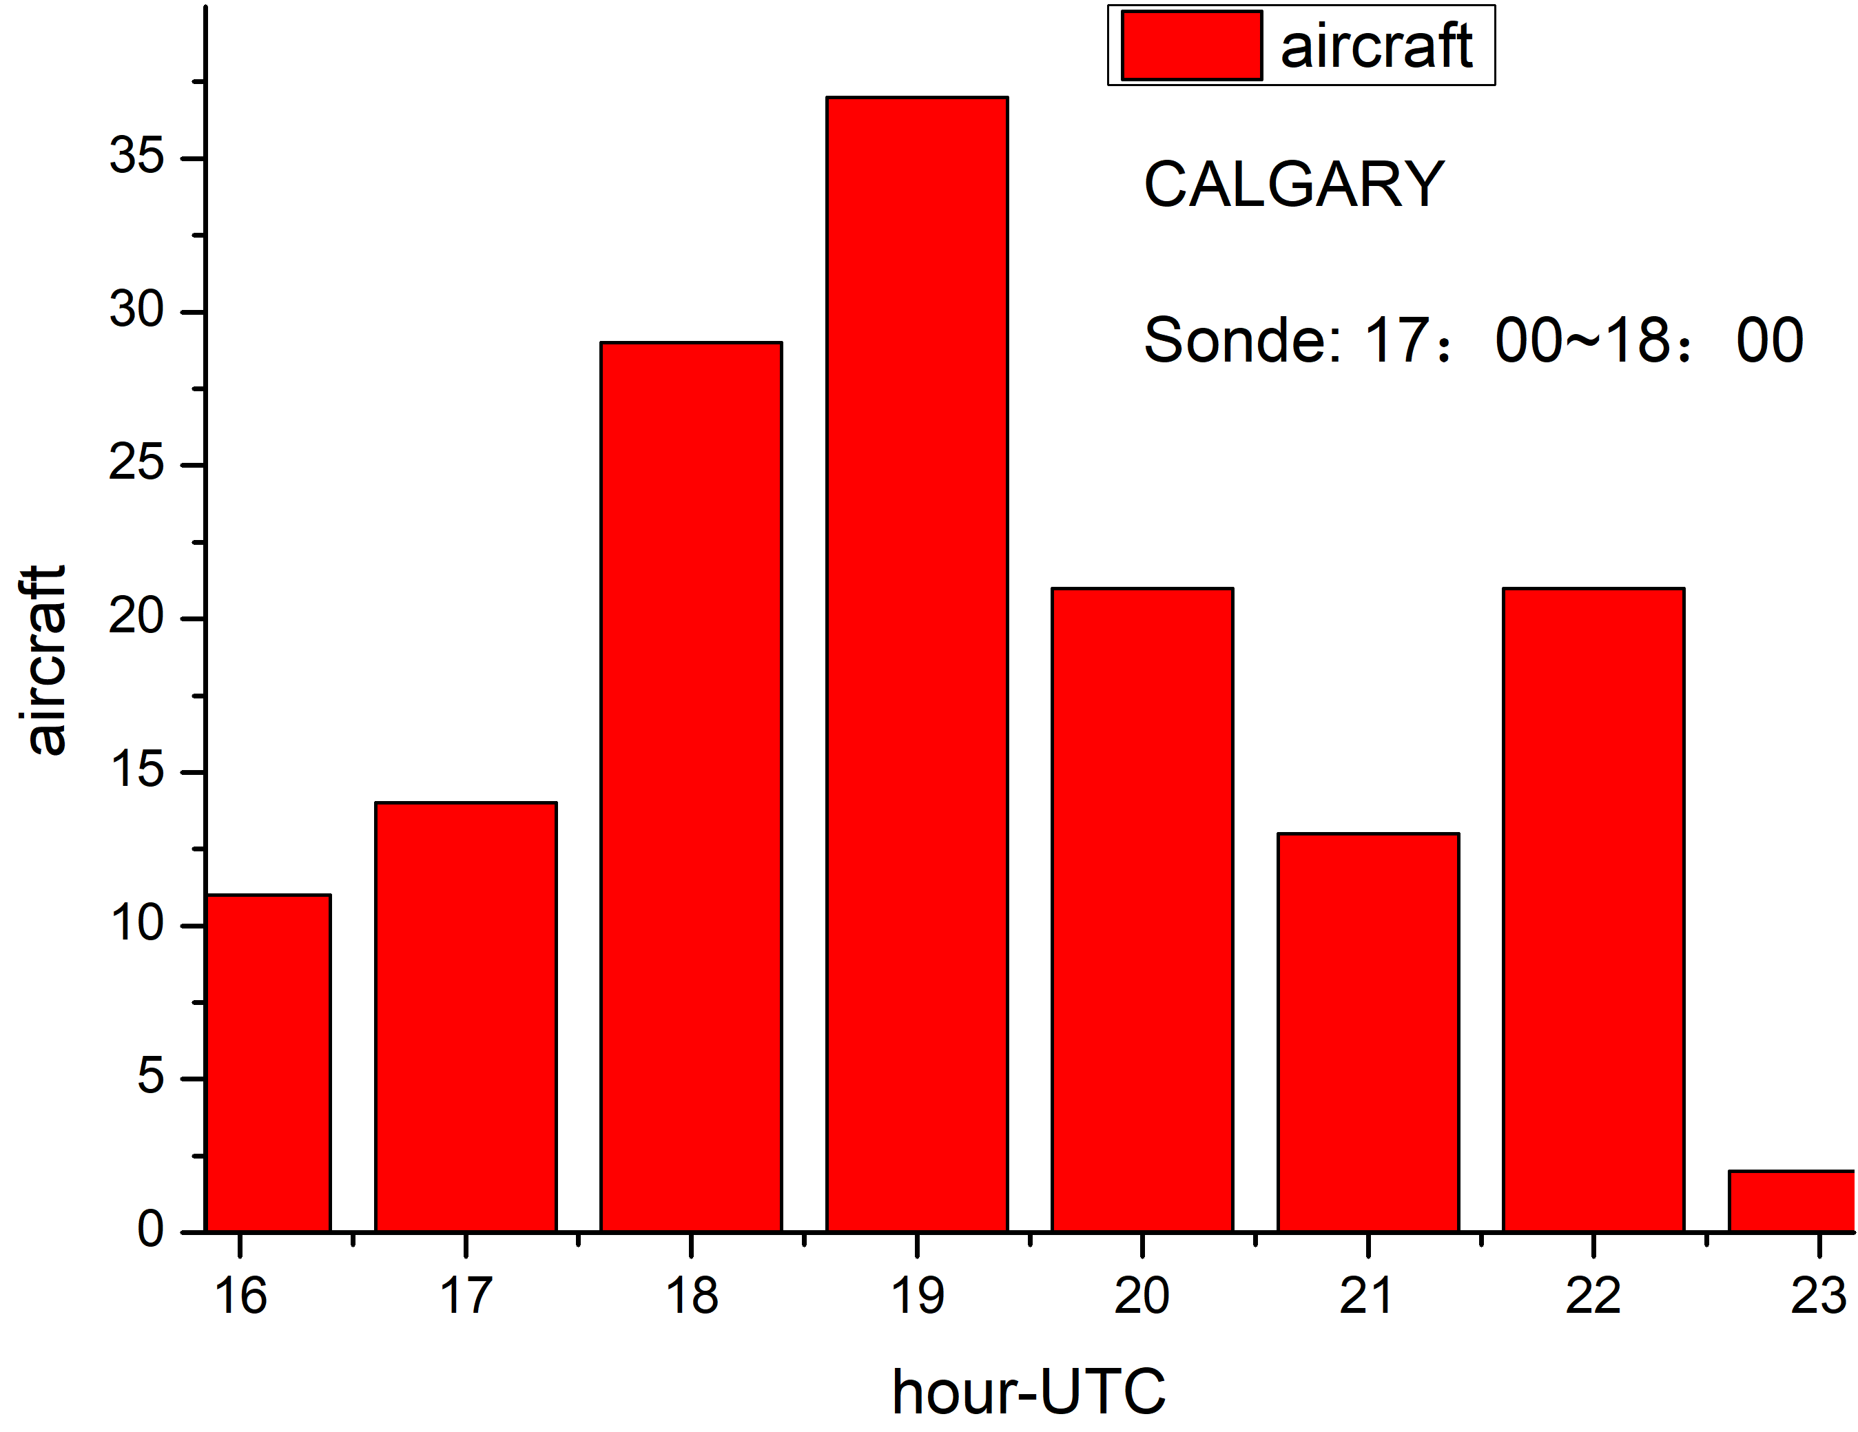
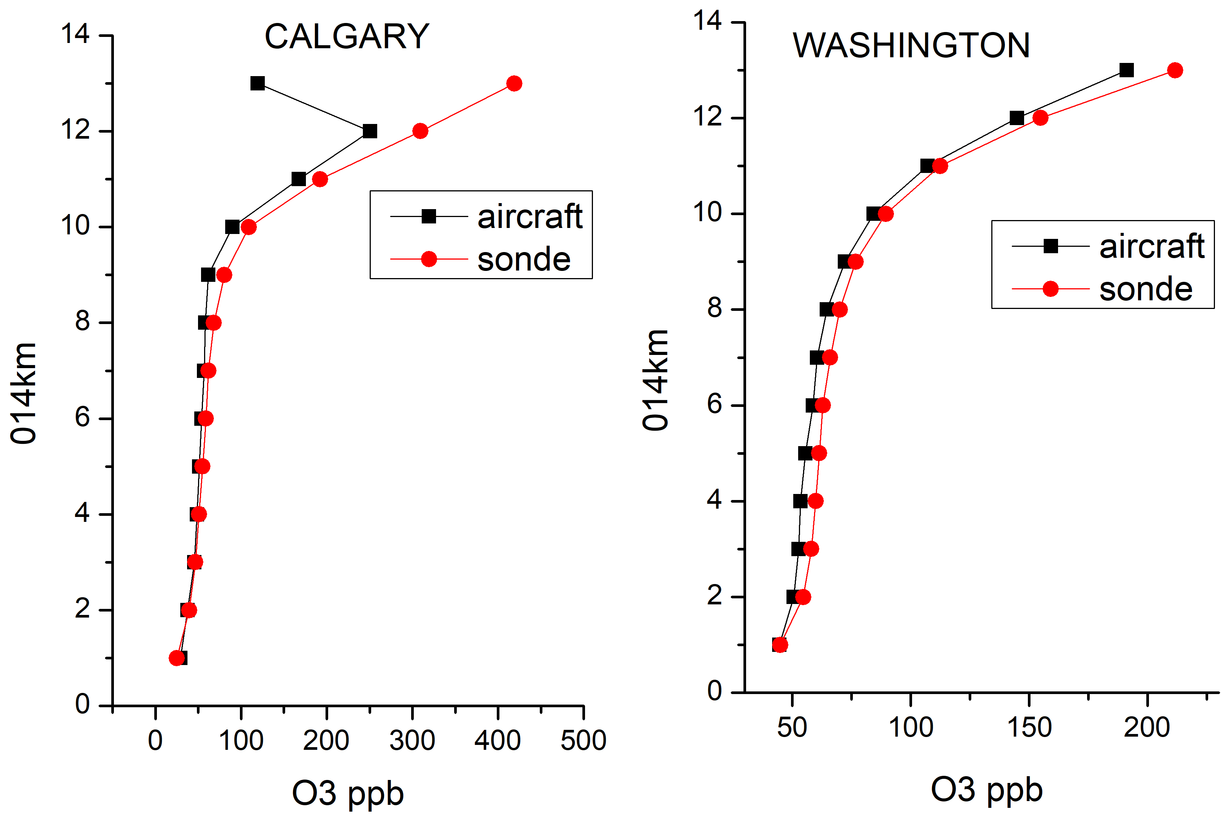
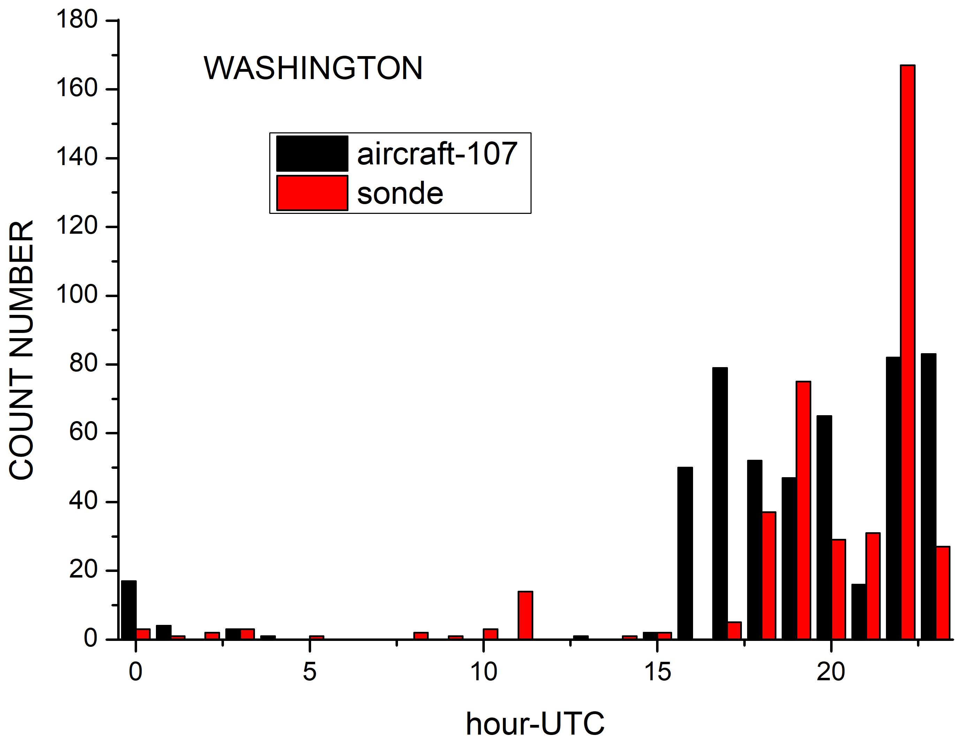
2. Measurement time difference
Munich and Washington: sonde and aircraft measurement time are similar, so concentrations are similar.
Dusseldorf and Calgary: aircraft mostly daytime, sonde in morning or afternoon, so differences are small.
Tokyo: aircraft measurement times are mainly in night, so the aircraft measurement concentration is low.

Slide 9
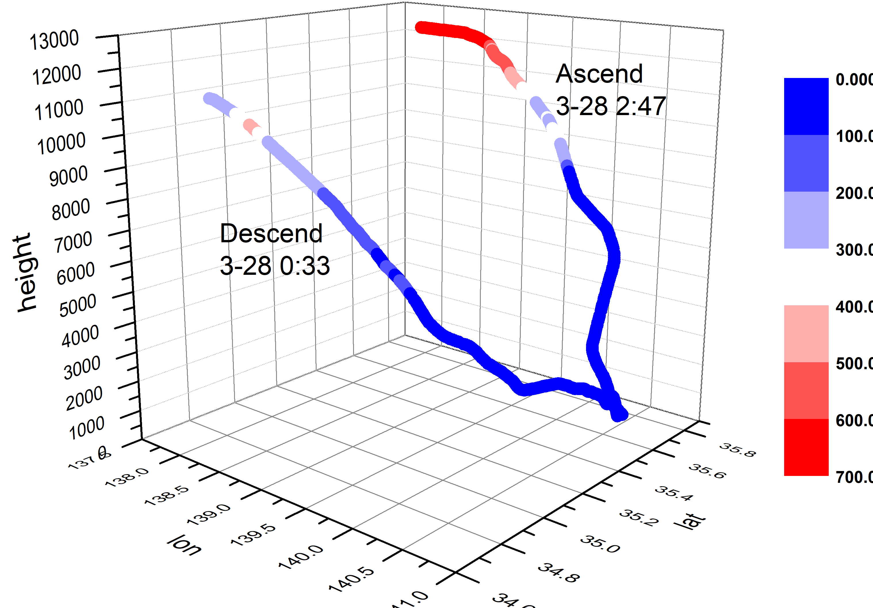
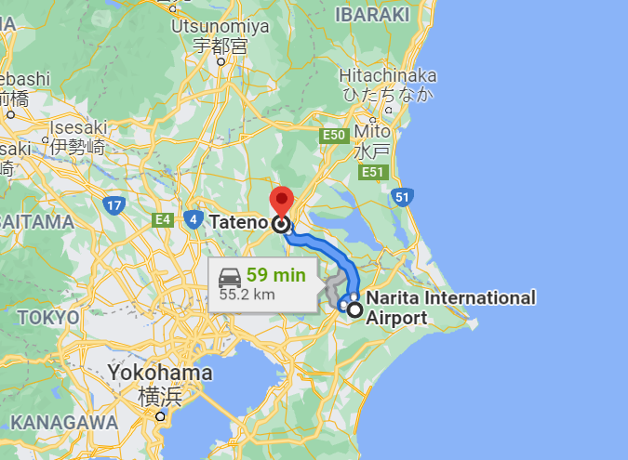
3. Flight trajectories are different
Sonde site
Tokyo
aircraft site
Tokyo: City impact is small.
The larger differences at higher altitudes height are not due to the influence of the city.
Trajectories are different, so concentrations may be different.

Slide 10
Consistency of trajectory-mapped ozone observations made by aircraft (IAGOS) is similar

Slide 11
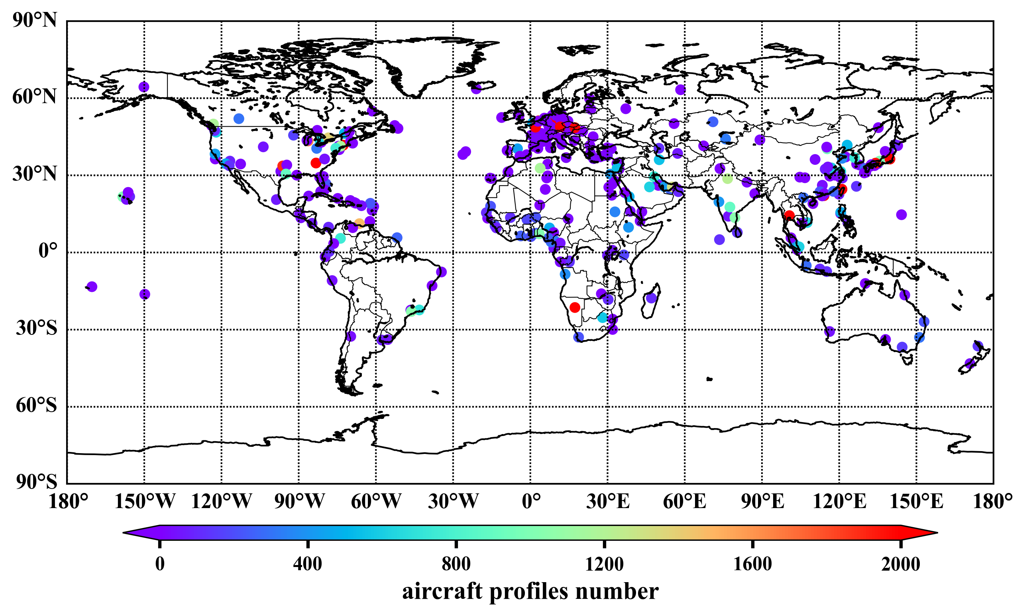
Map of sites (airports)
1994/08 to 2021/03
310 stations
122574 profiles

Slide 13
Validation: MOZAIC-IAGOS climatology vs ozonesondes
Eight regions:
Europe
Asia
North America
South America
South Africa
Arctic
Oceania
Pacific

Slide 14
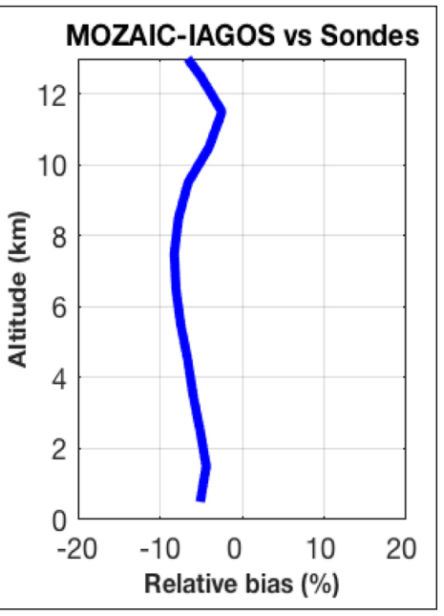
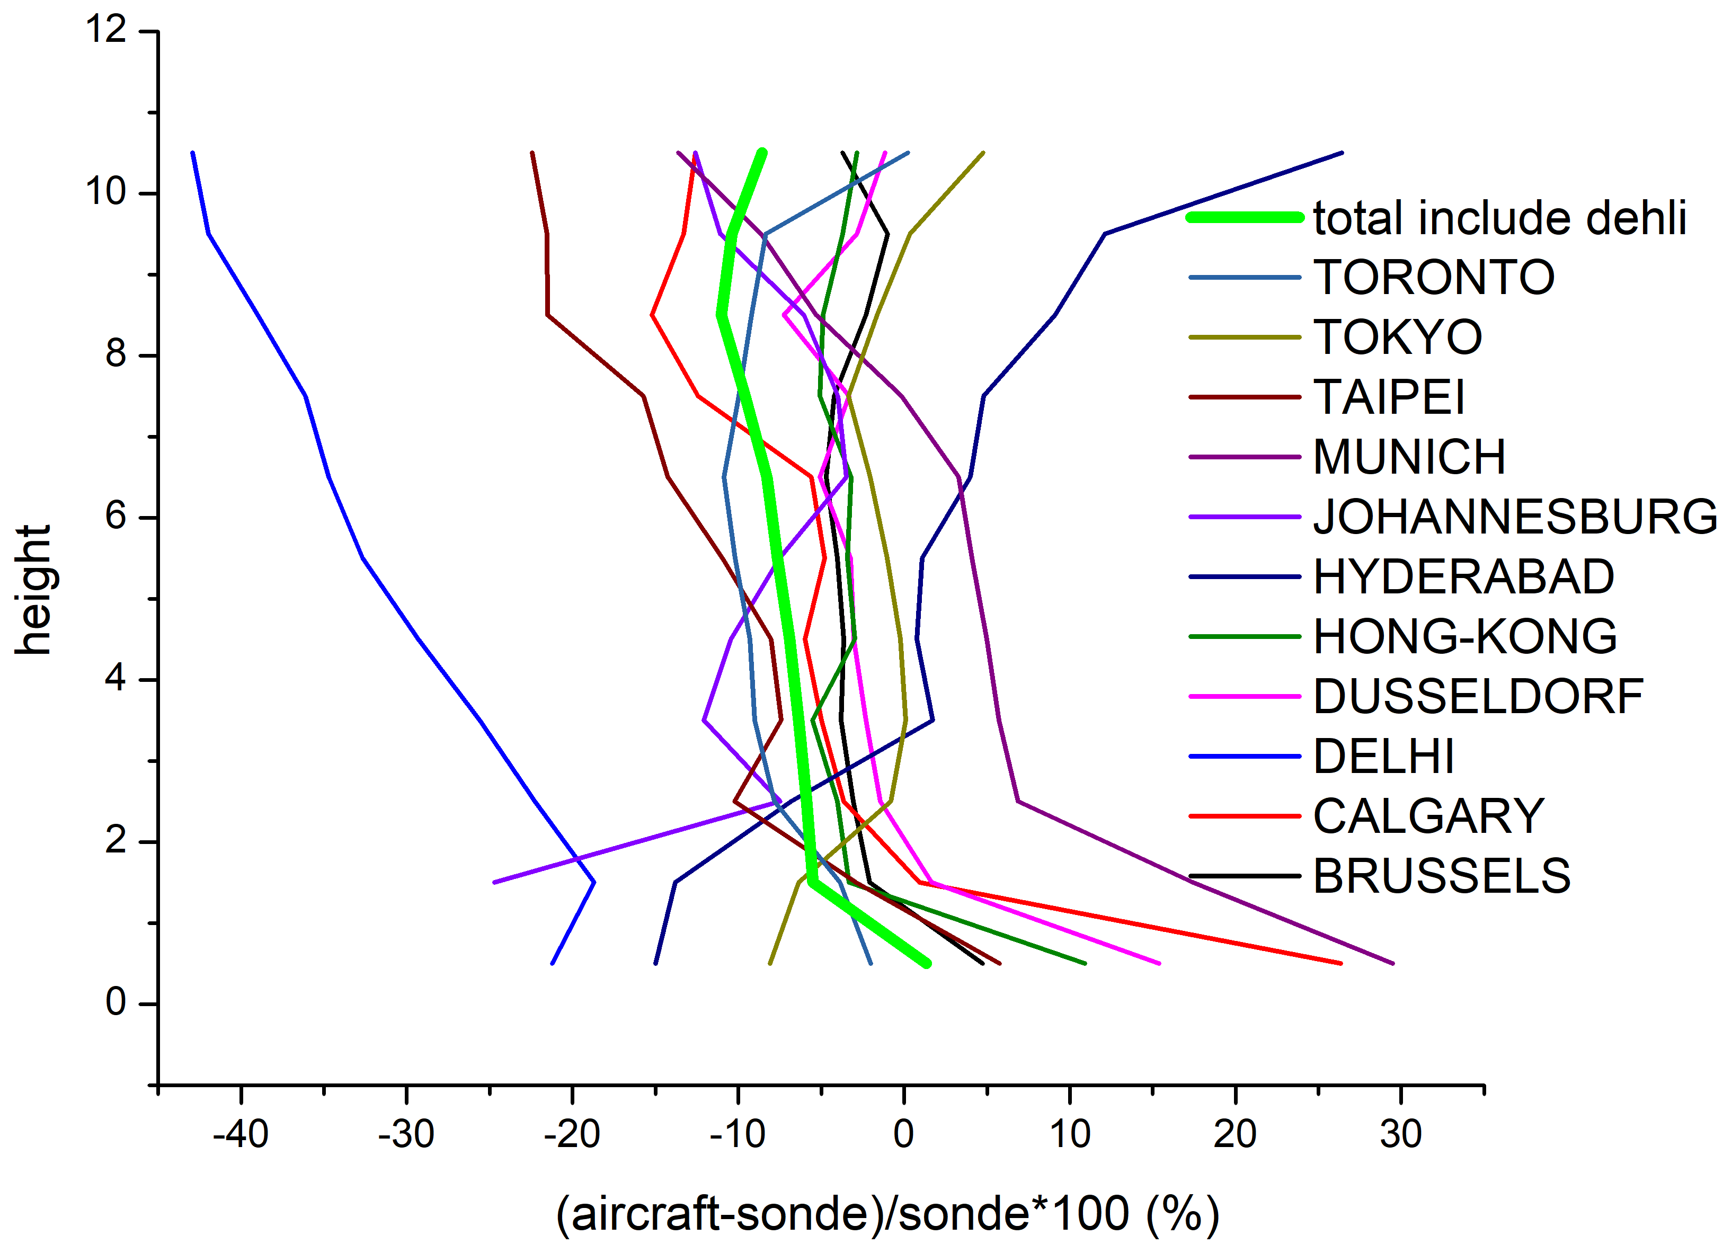
2.Total differences
Hyderabad
Delhi
India is strange:
Delhi is very underestimated (-18.7% - 42.9%), but Hyderabad is overestimated (above 3.5 km, 0.8% - 26.4%).
All stations average difference: Underestimated except 0.5km (+1.3%): -5.5% - 11.0%. Vertical distribution is similar to Osman (right plot) from trajectory-mapped data.

Slide 15
Extras

Slide 16
1. Selection of observation sites
Number of worldwide sites:
MOZAIC-IAGOS: 310 sites
WOUDC: 116 sites
Site selection method:
1.Distance. Sites within the spatial distance of less than 1° in both datasets. To get more data, Calgary and Johannesburg were selected although the distance more than 1° .
2. Time. The observation time of the two datasets is not consistent. In a certain month, if the site has valid vertical profile data in both datasets, it will be retained; if the data in one dataset is missing, the data of the site in that month will be deleted.

Slide 17
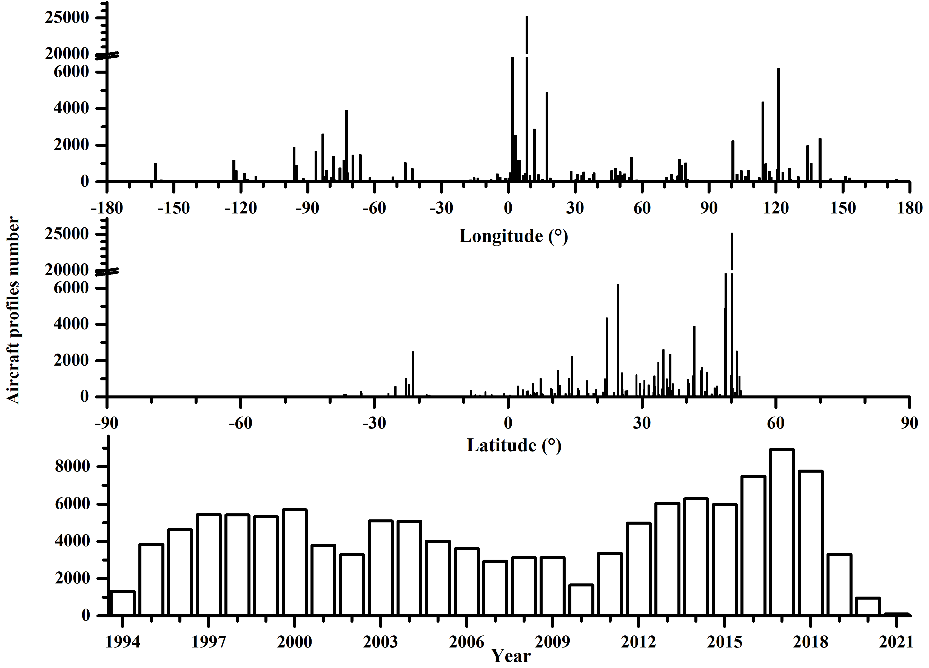
Most sites in northern hemisphere:
0~54°N
4000~6000 profiles every year
Most in 2017： 8930
Least in 2020：965， COVID-19
In 2010： 1662

Slide 18
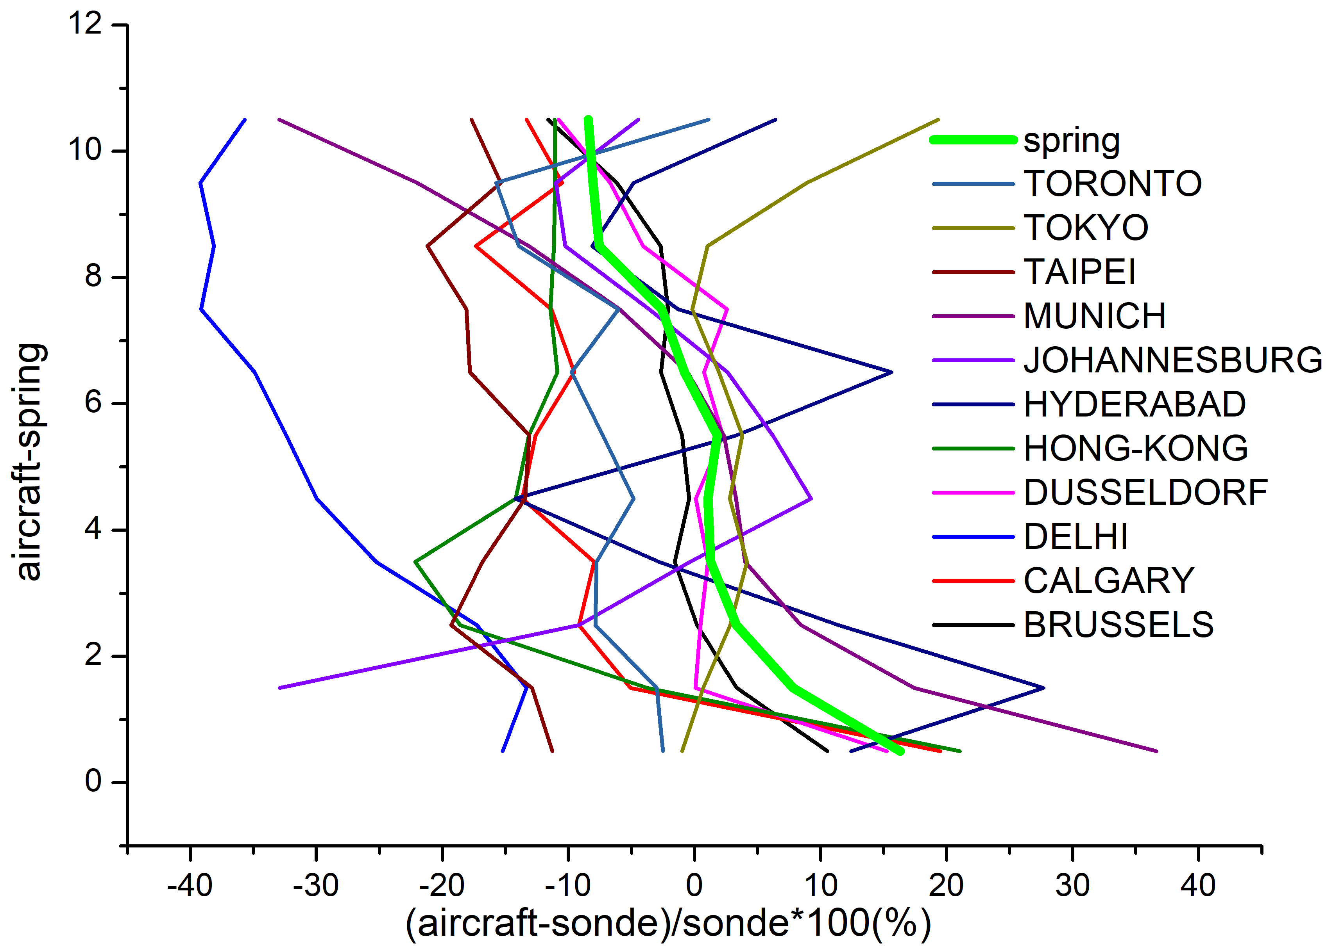
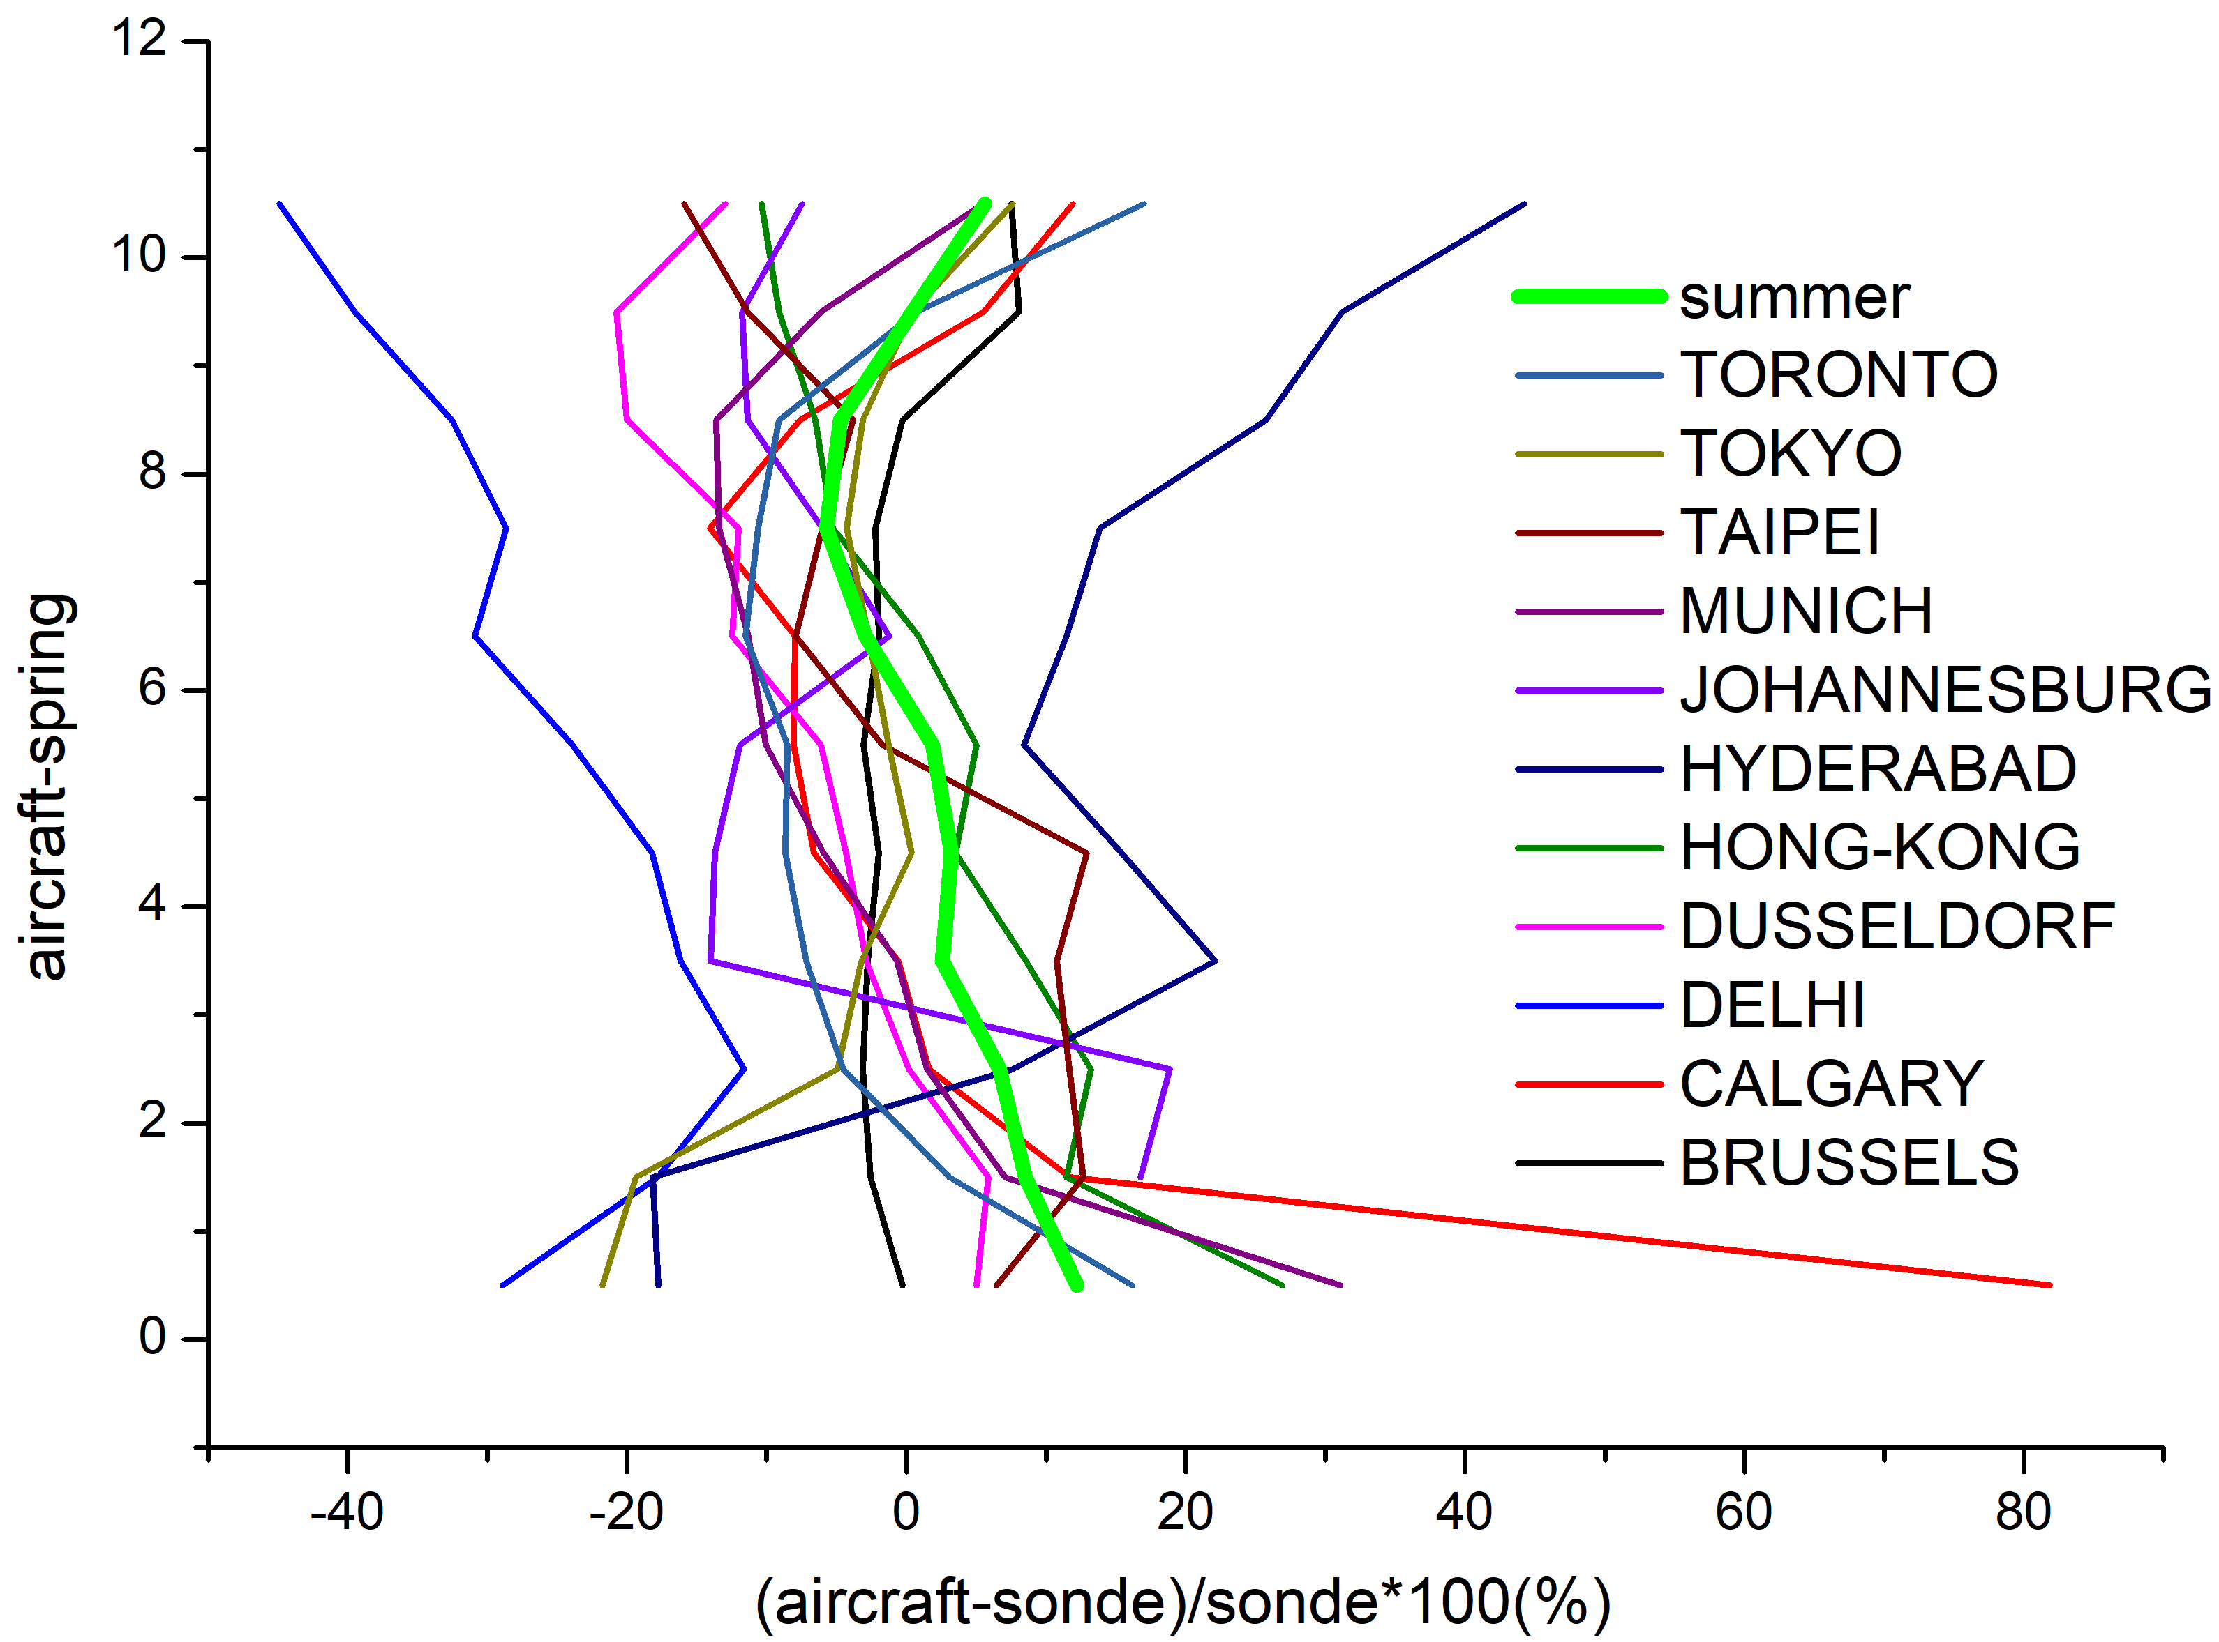
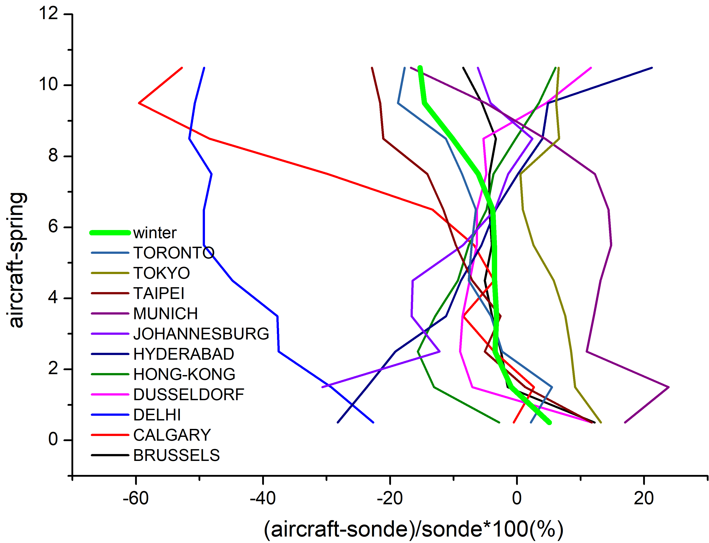
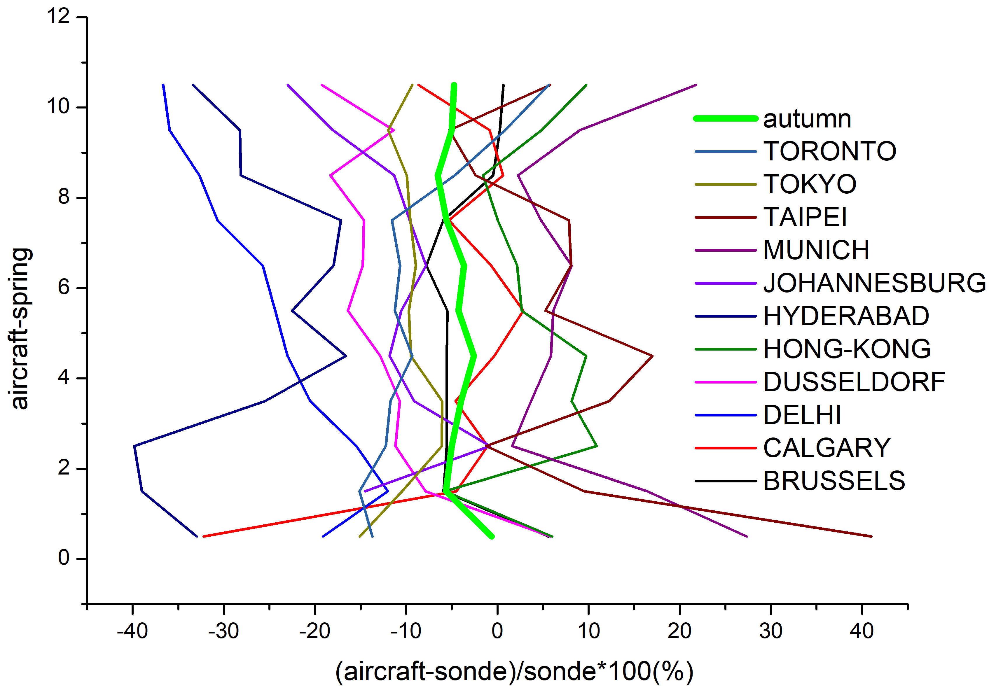
3. Seasonal differences
spring
summer
Autumn & winter:
Underestimate:
-0.6% - 6.5% and
-0.9%-15.3%.
Spring & summer:
Below 5.5km overestimate, and above 5.5km underestimate
autumn
winter

Slide 19
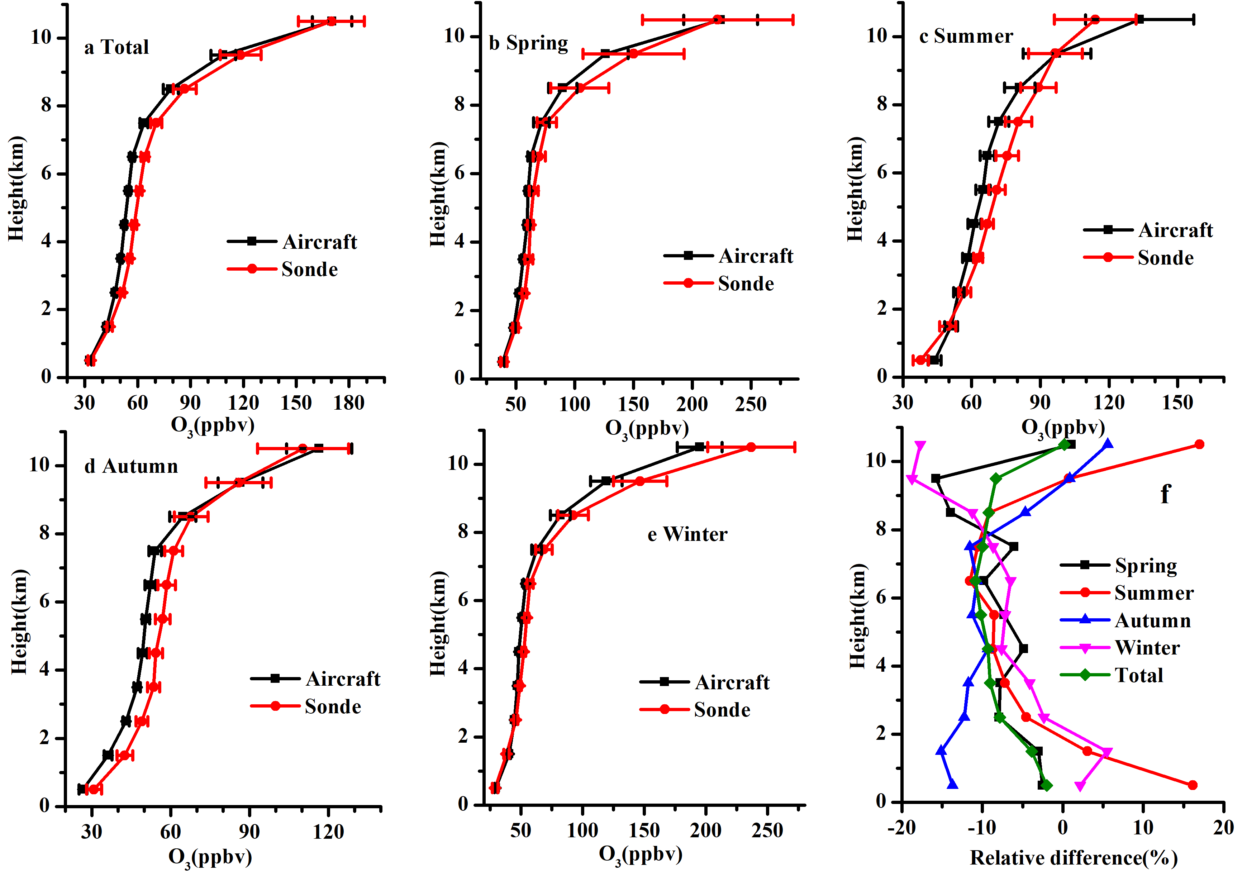
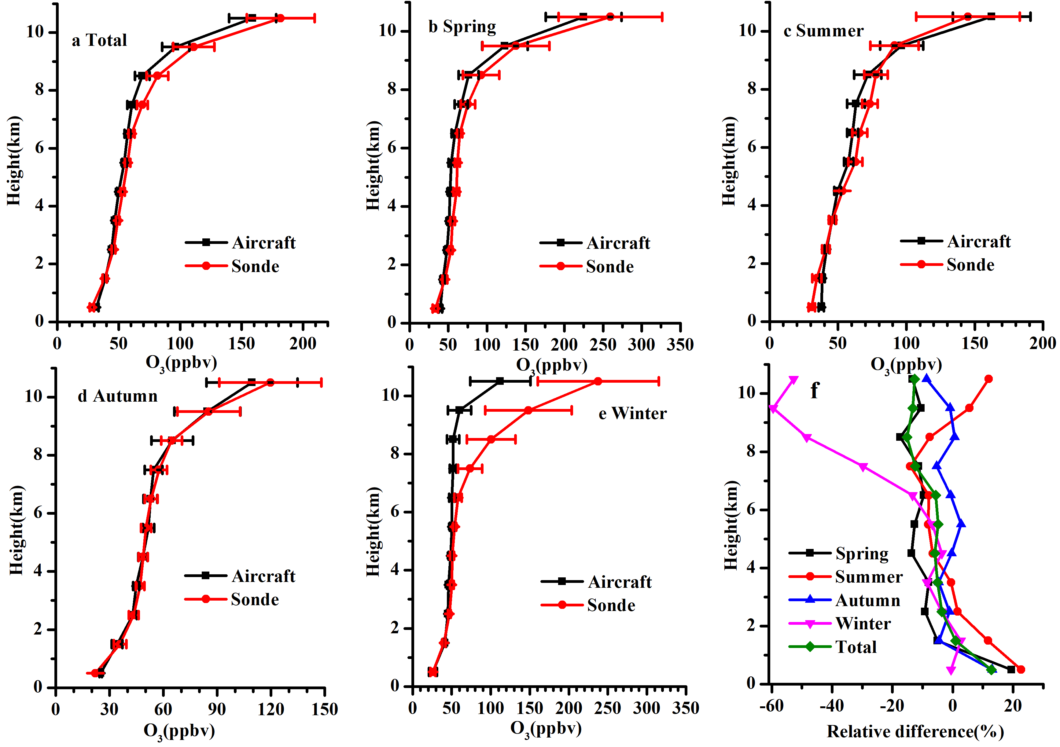
4. Regional difference
North America
Figure 6: Vertical distribution and aircraft-ozonesonde percent differences for the four seasons in Toronto, error bars are 2SE
Figure 7: As Figure 6, but for Calgary

Slide 20
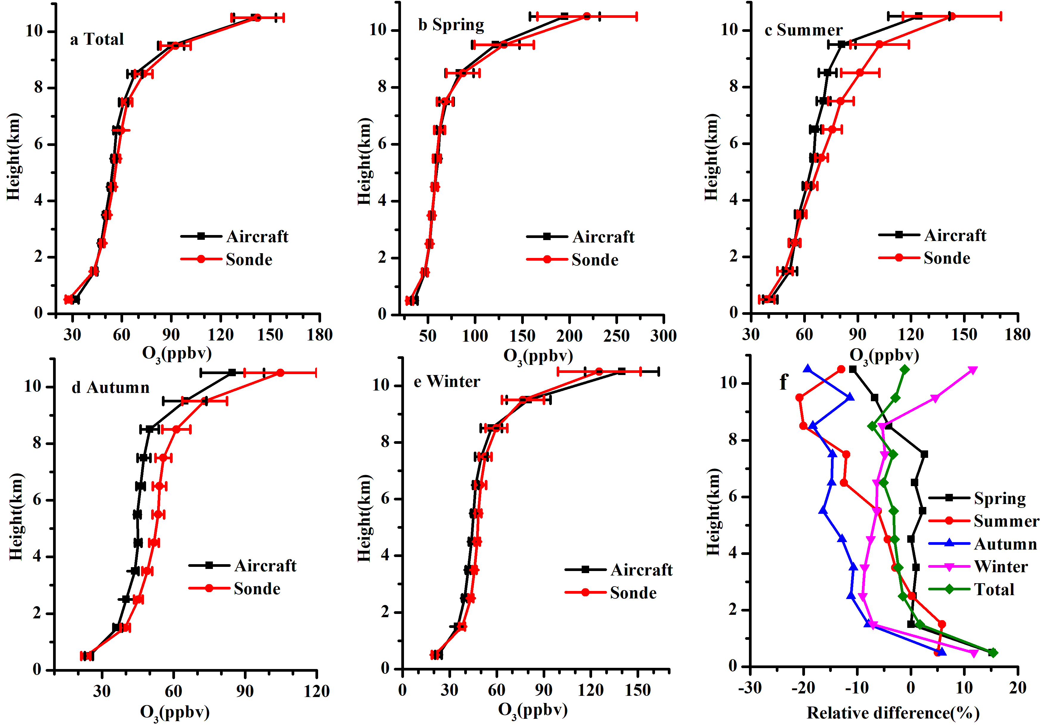
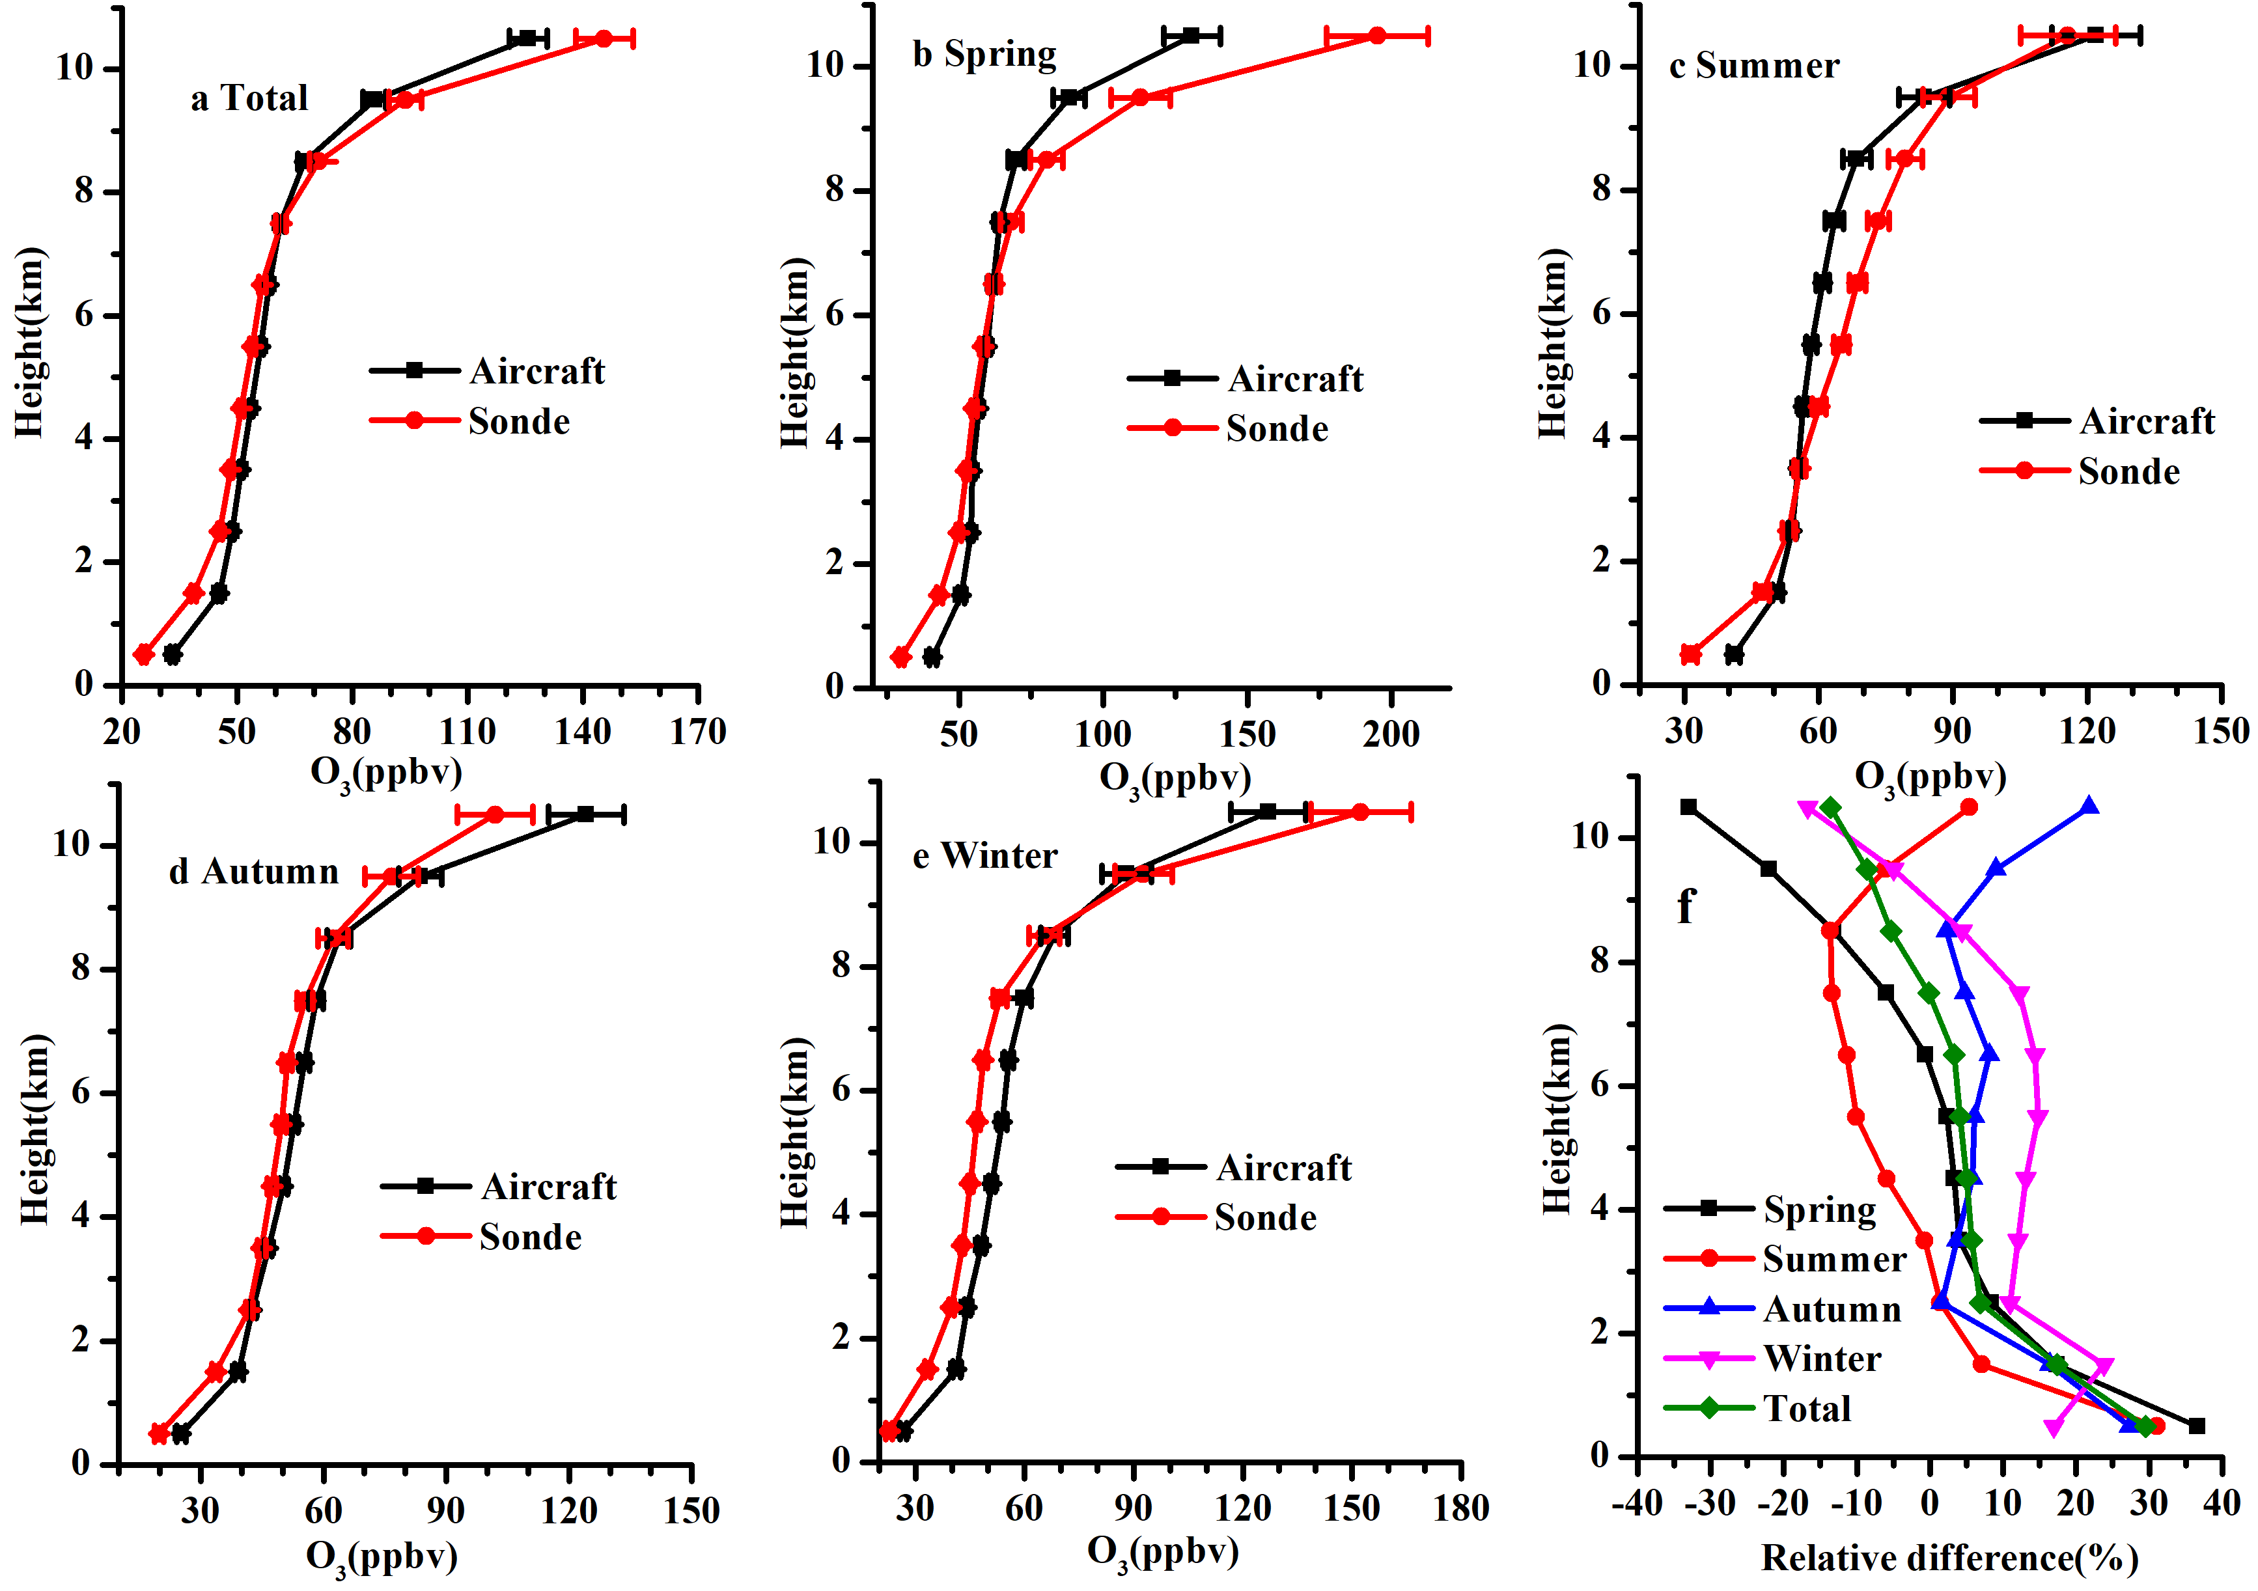
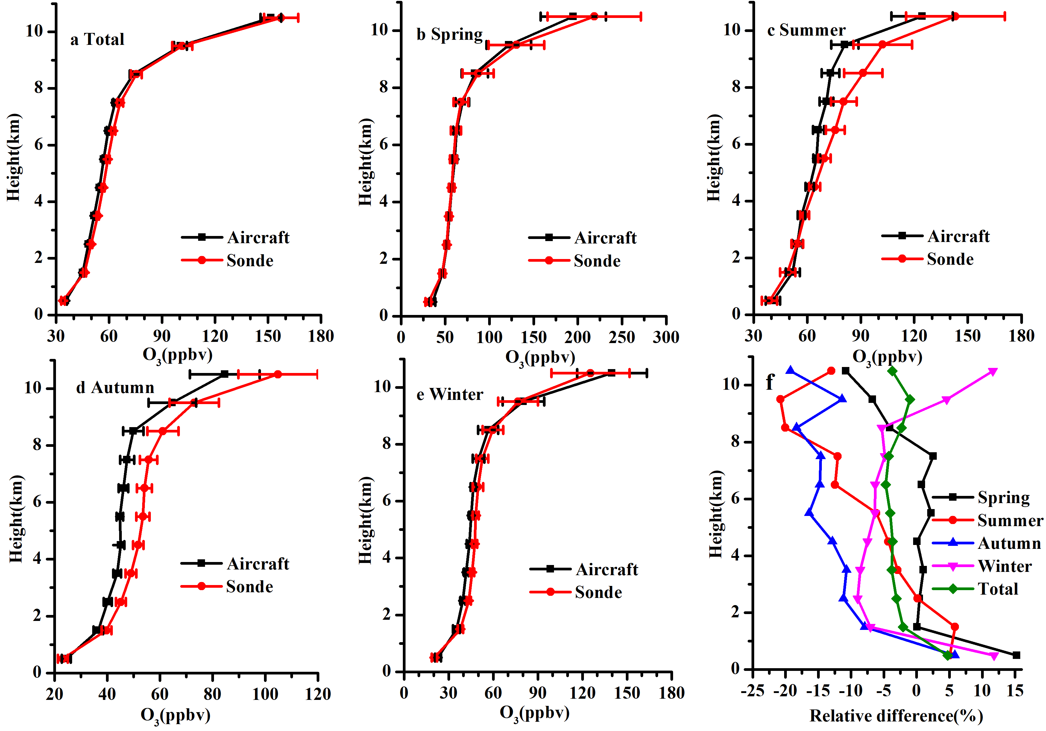
4. Regional differences
Europe
Brussels
Dusseldorf
Munich

Slide 21
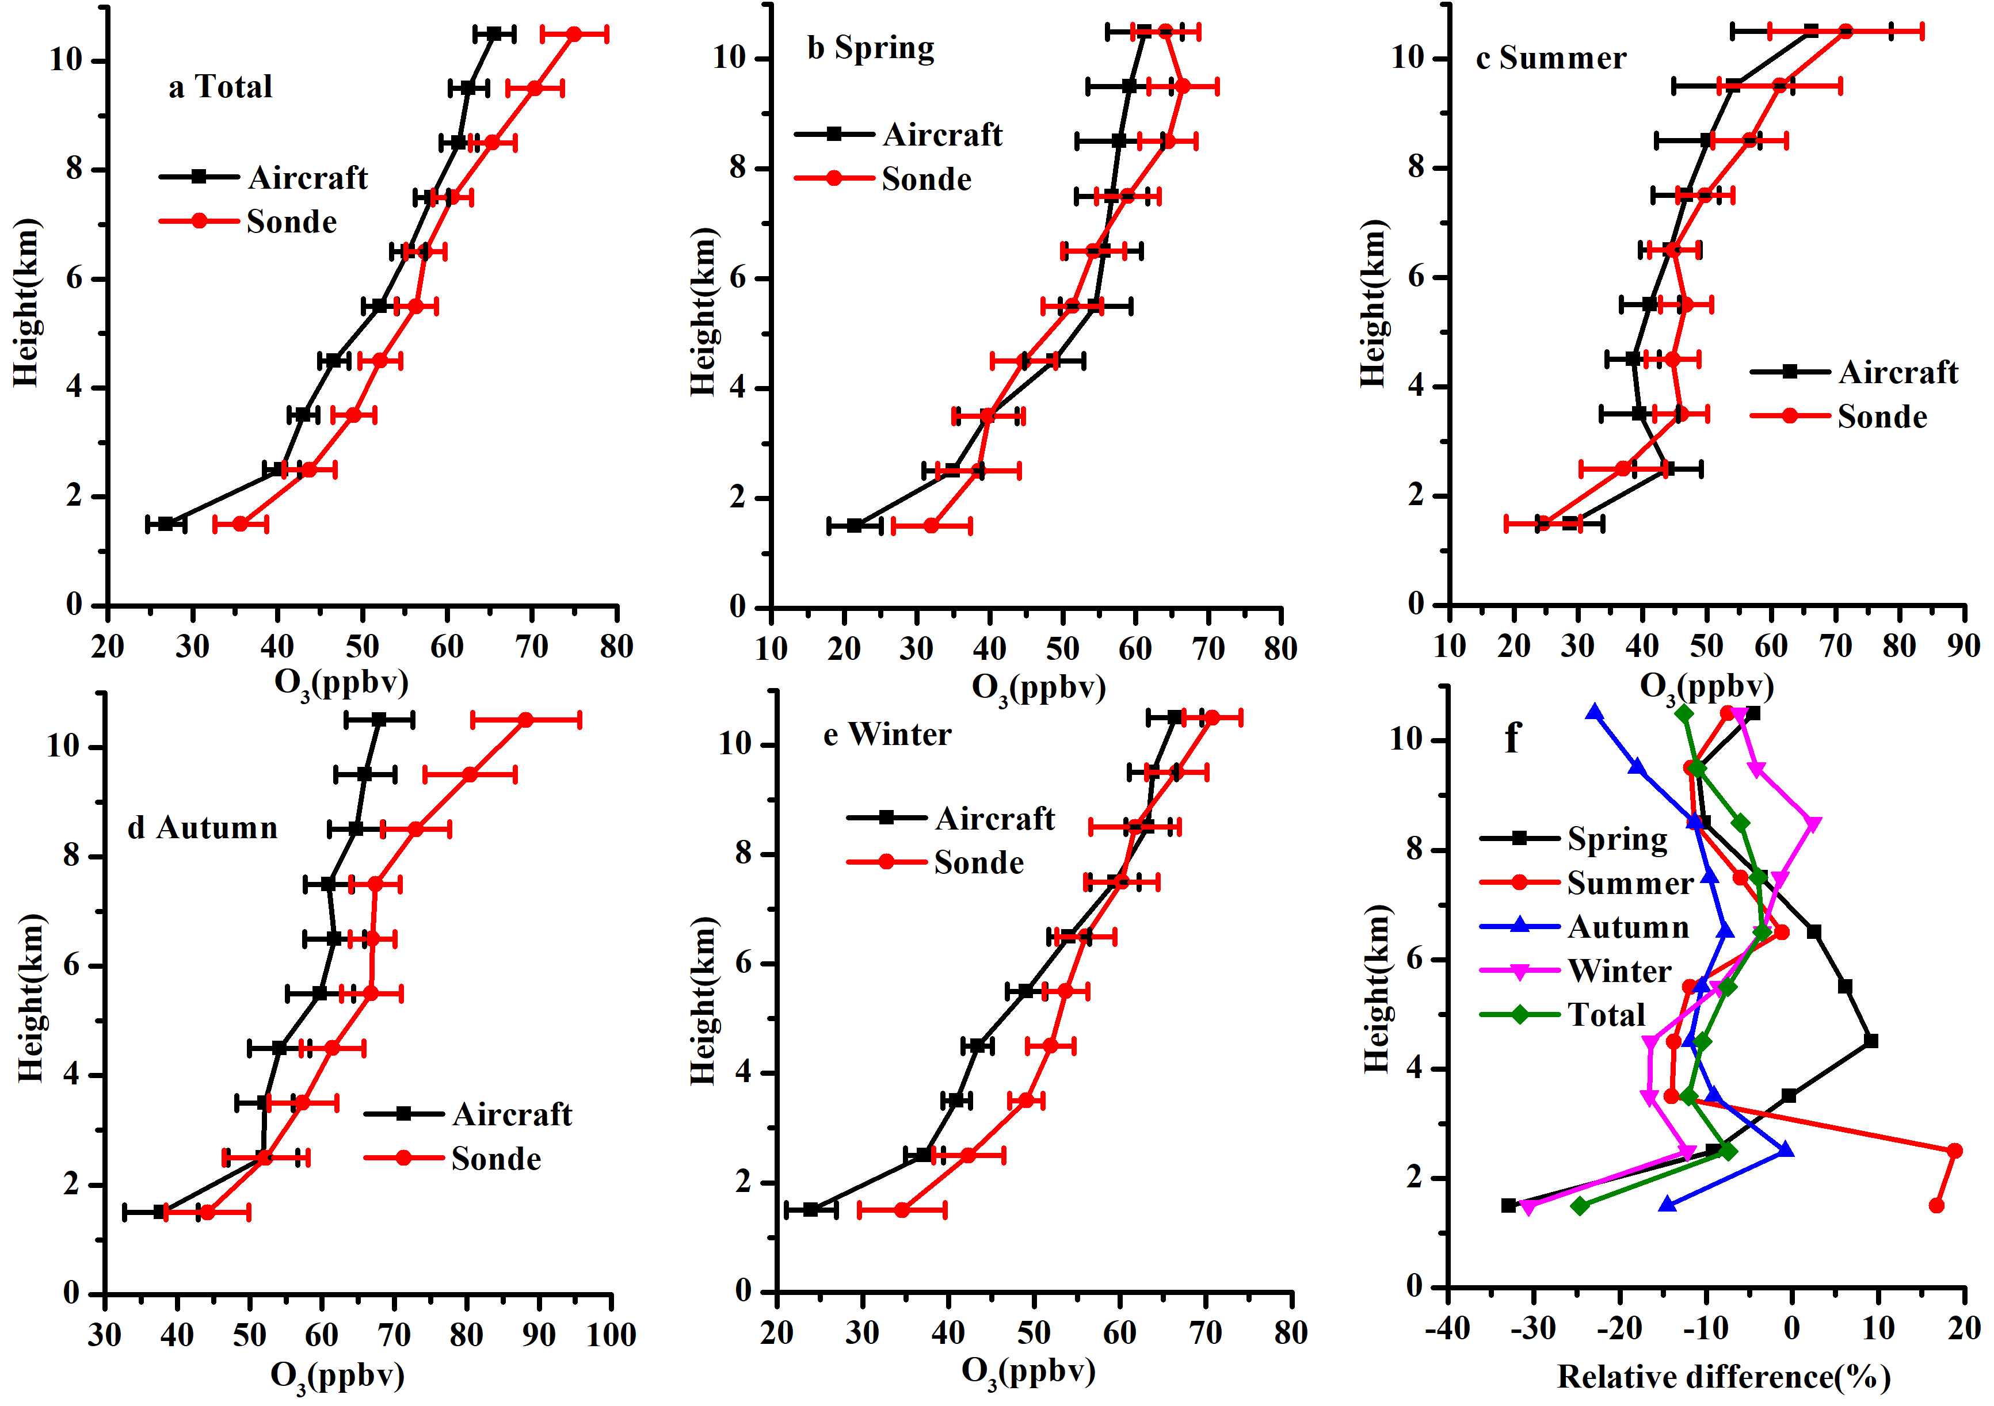
4. Regional differences
South Africa
Johannesburg

Slide 22
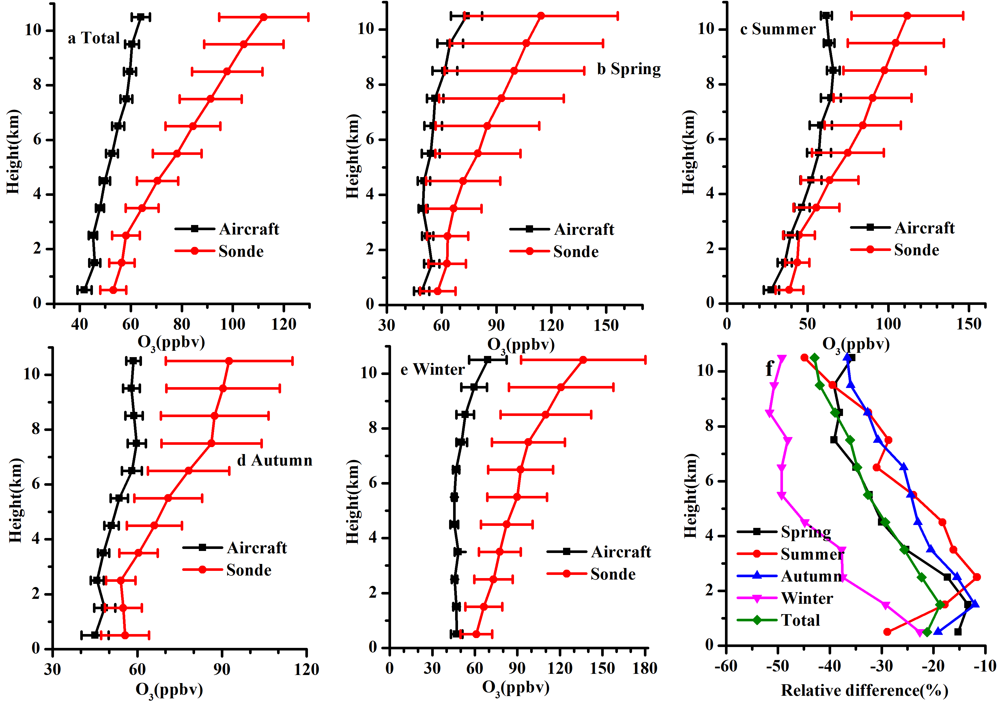
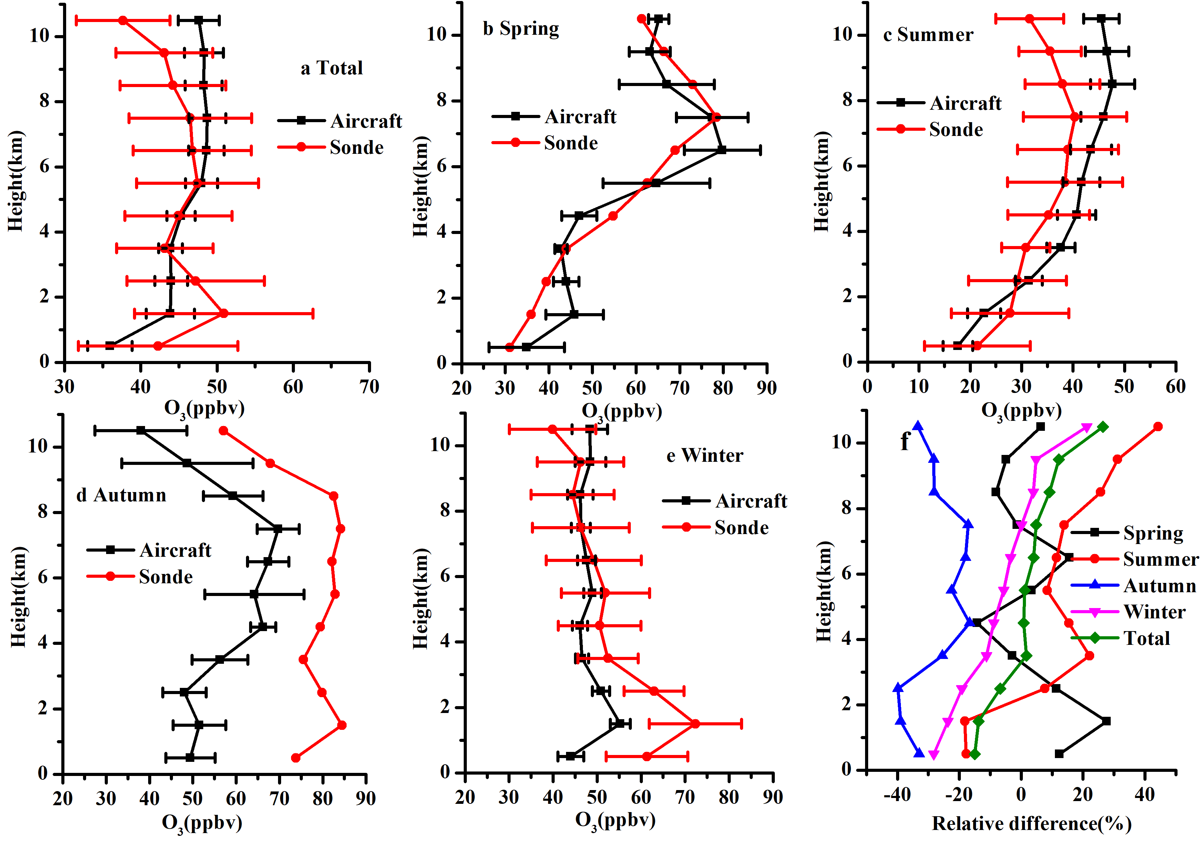
4. Regional differences
South Asia
Delhi
Hyderabad

Slide 23
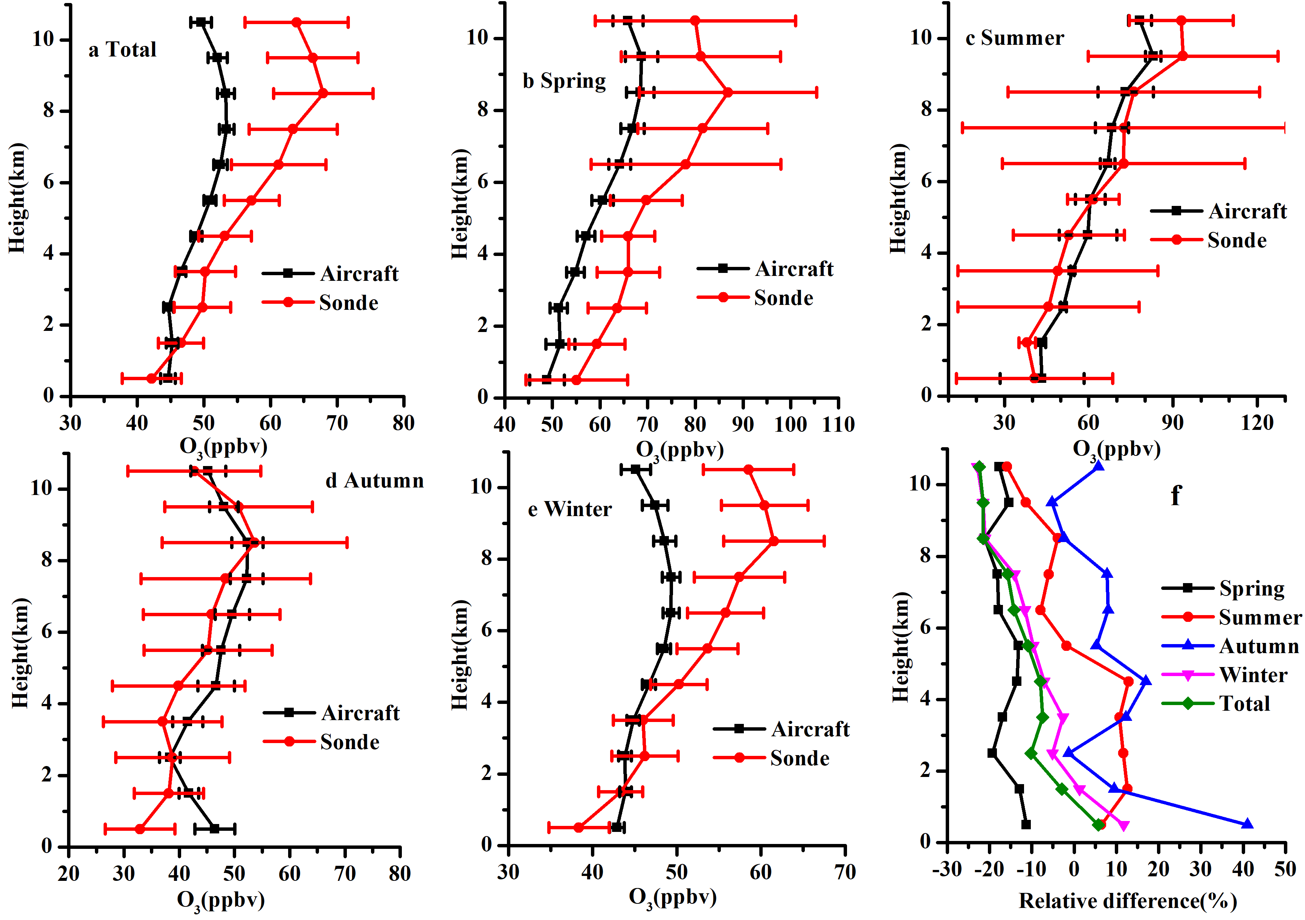
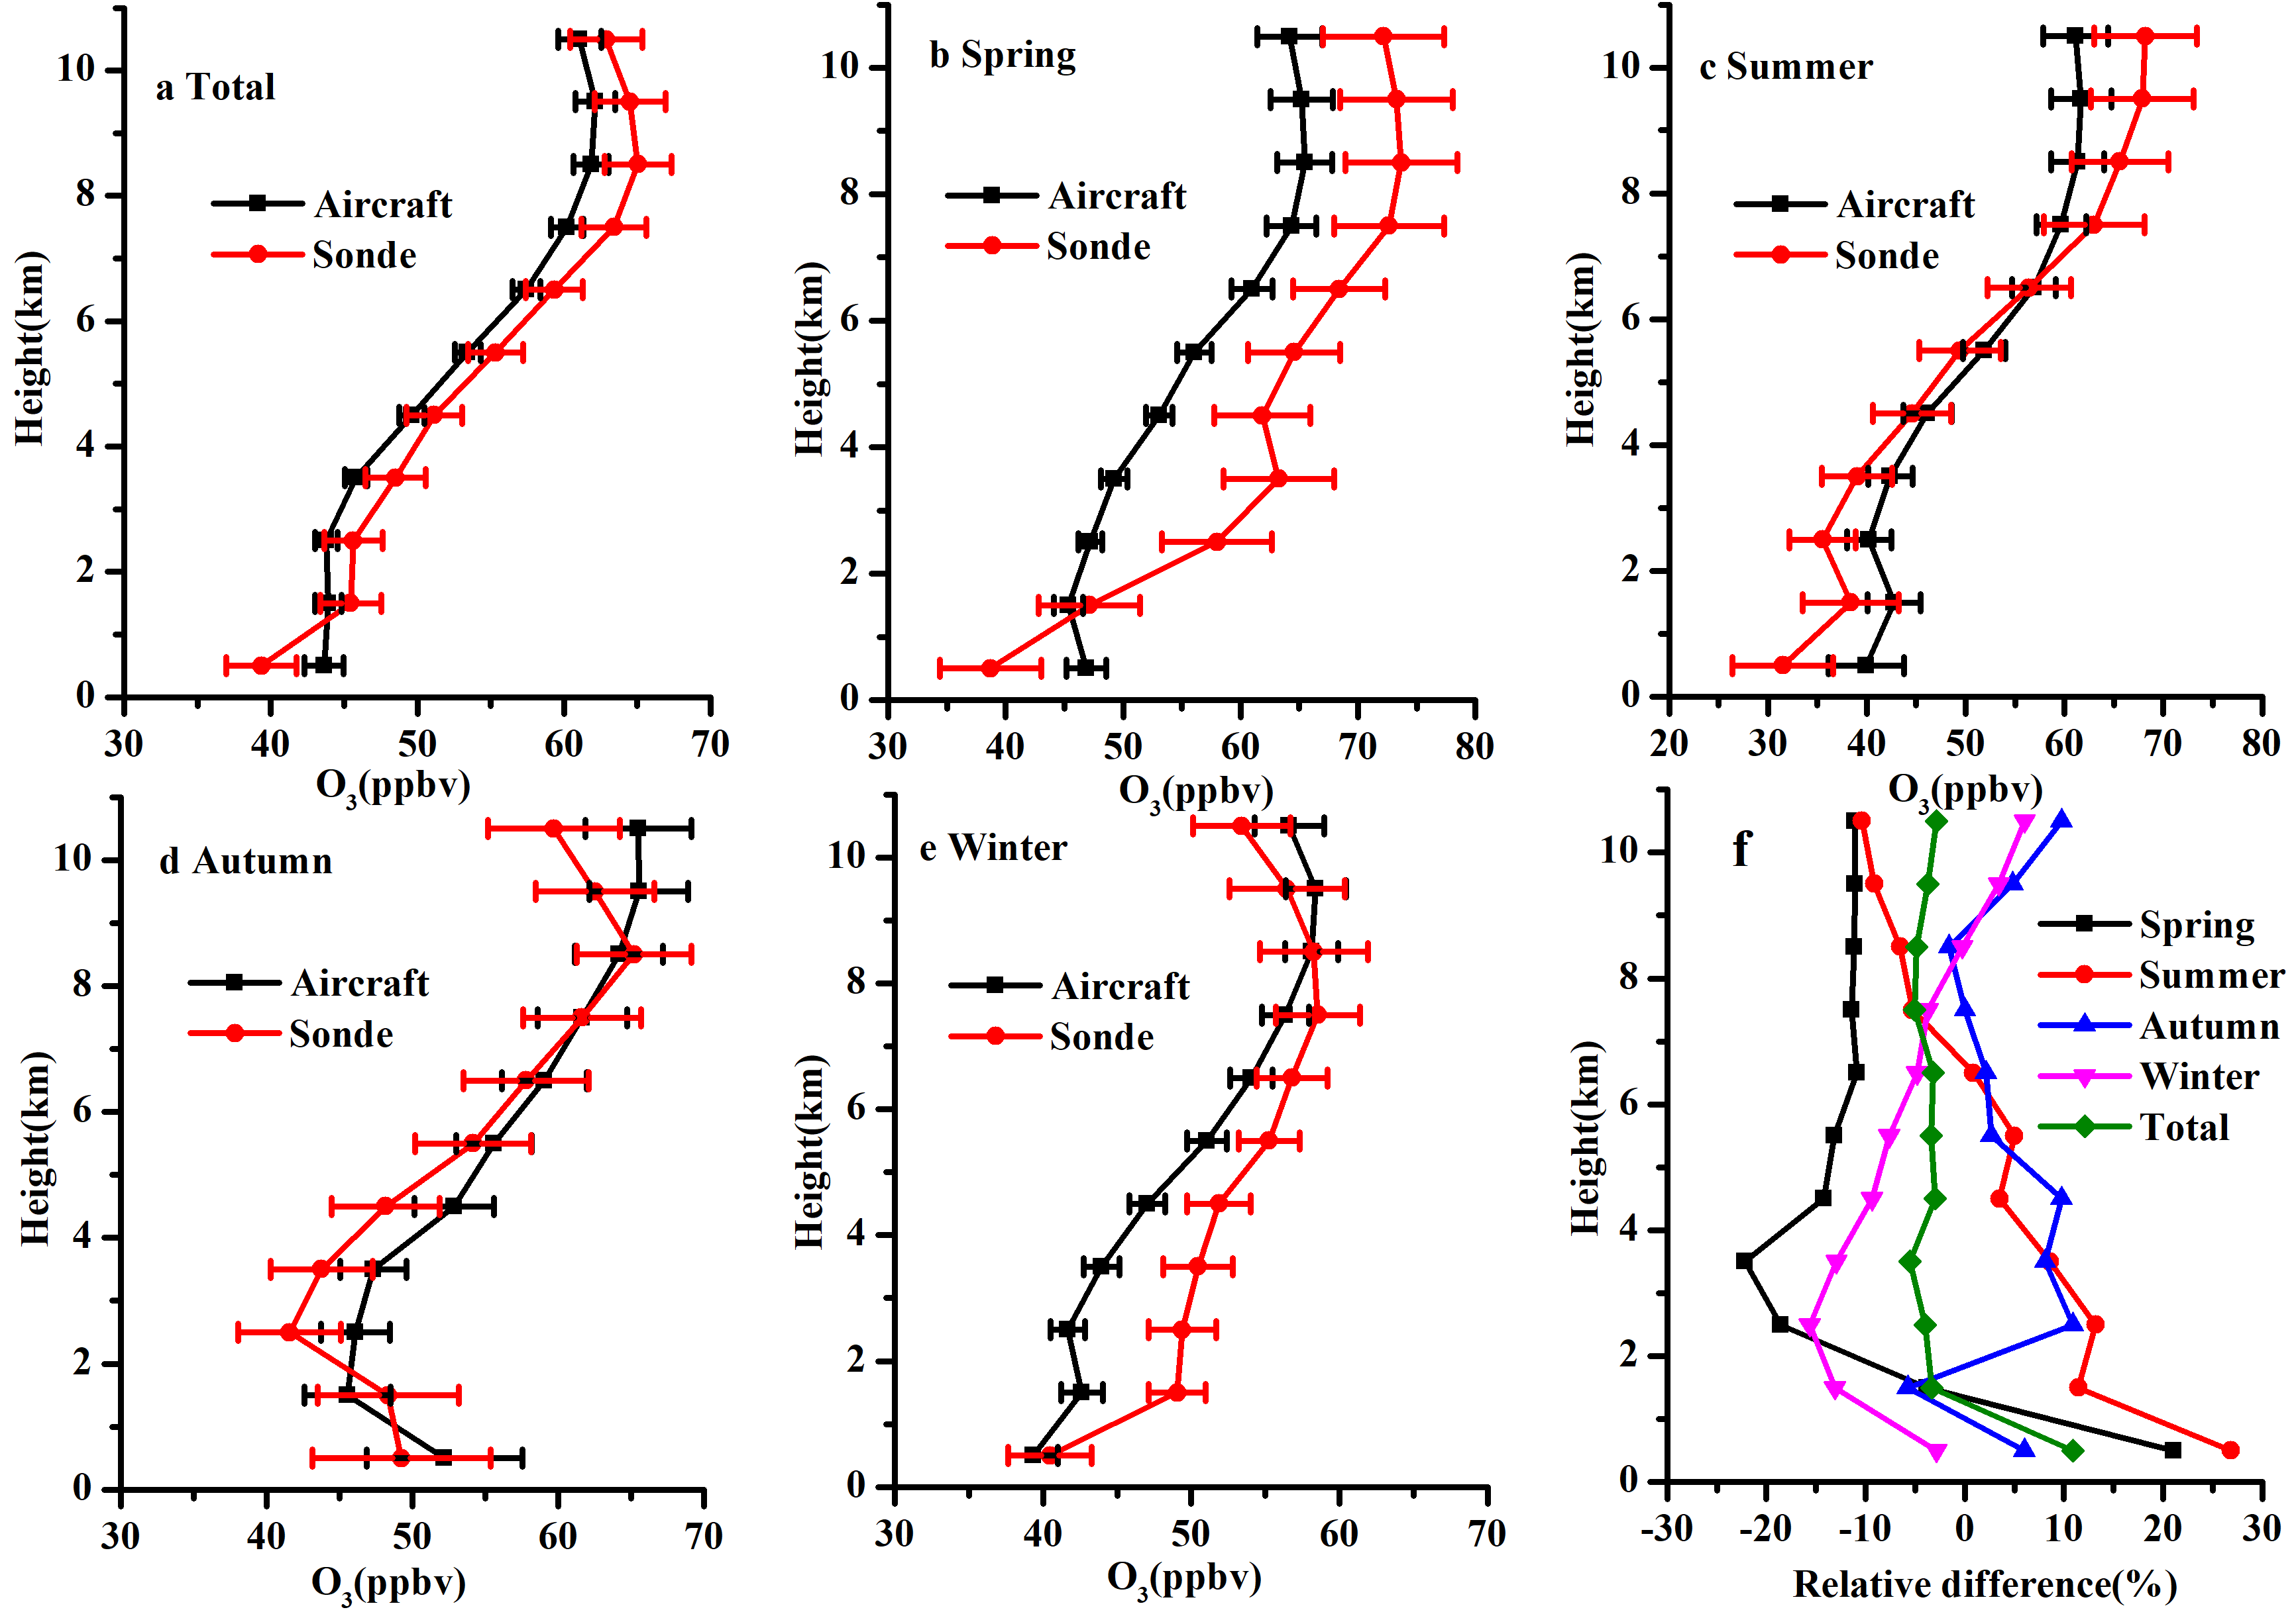
4. Regional differences
Southeast Asia
Hongkong
Taipei

Slide 24
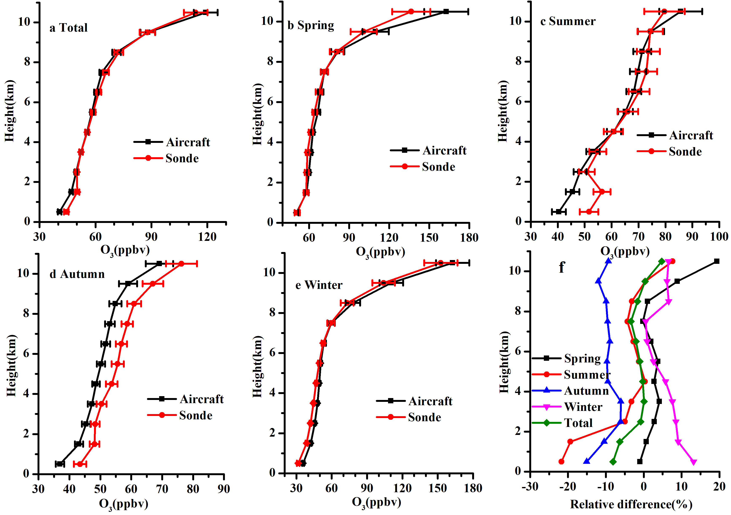
4. Regional differences
North-east Asia
Tokyo

Slide 25
5. Conclusions
O₃ concentrations observed by aircraft and sonde are 37.2 -104.9ppb and 36.7 -114.8ppb, respectively, and the relative difference ((aircraft-sonde)/sonde*100%), is 1.3% -11.0%. The correlation between the two types of data is good, with R of 0.713, RMSE of 26.3ppb, and bias of 4.3ppb.
The O₃ concentration observed by sonde is higher than that observed by aircraft, and the relative difference increases with altitude at 1-9km.
The variation of relative differences with height of the two types of dataset in different seasons is different.
There were also significant differences in the consistency of the two datasets in different regions. The consistency of North America, Europe, North-east Asia and Southeast Asia is good, and the consistency of South Asia and South Africa is poor. The number of samples has a greater impact on the consistency of the two datasets. There are obvious seasonal differences in the vertical distribution of tropospheric ozone observed in the two datasets in different regions. There were seasonal differences in the consistency of the two datasets even at different sites in the same region, or even within the same site.

Slide 26
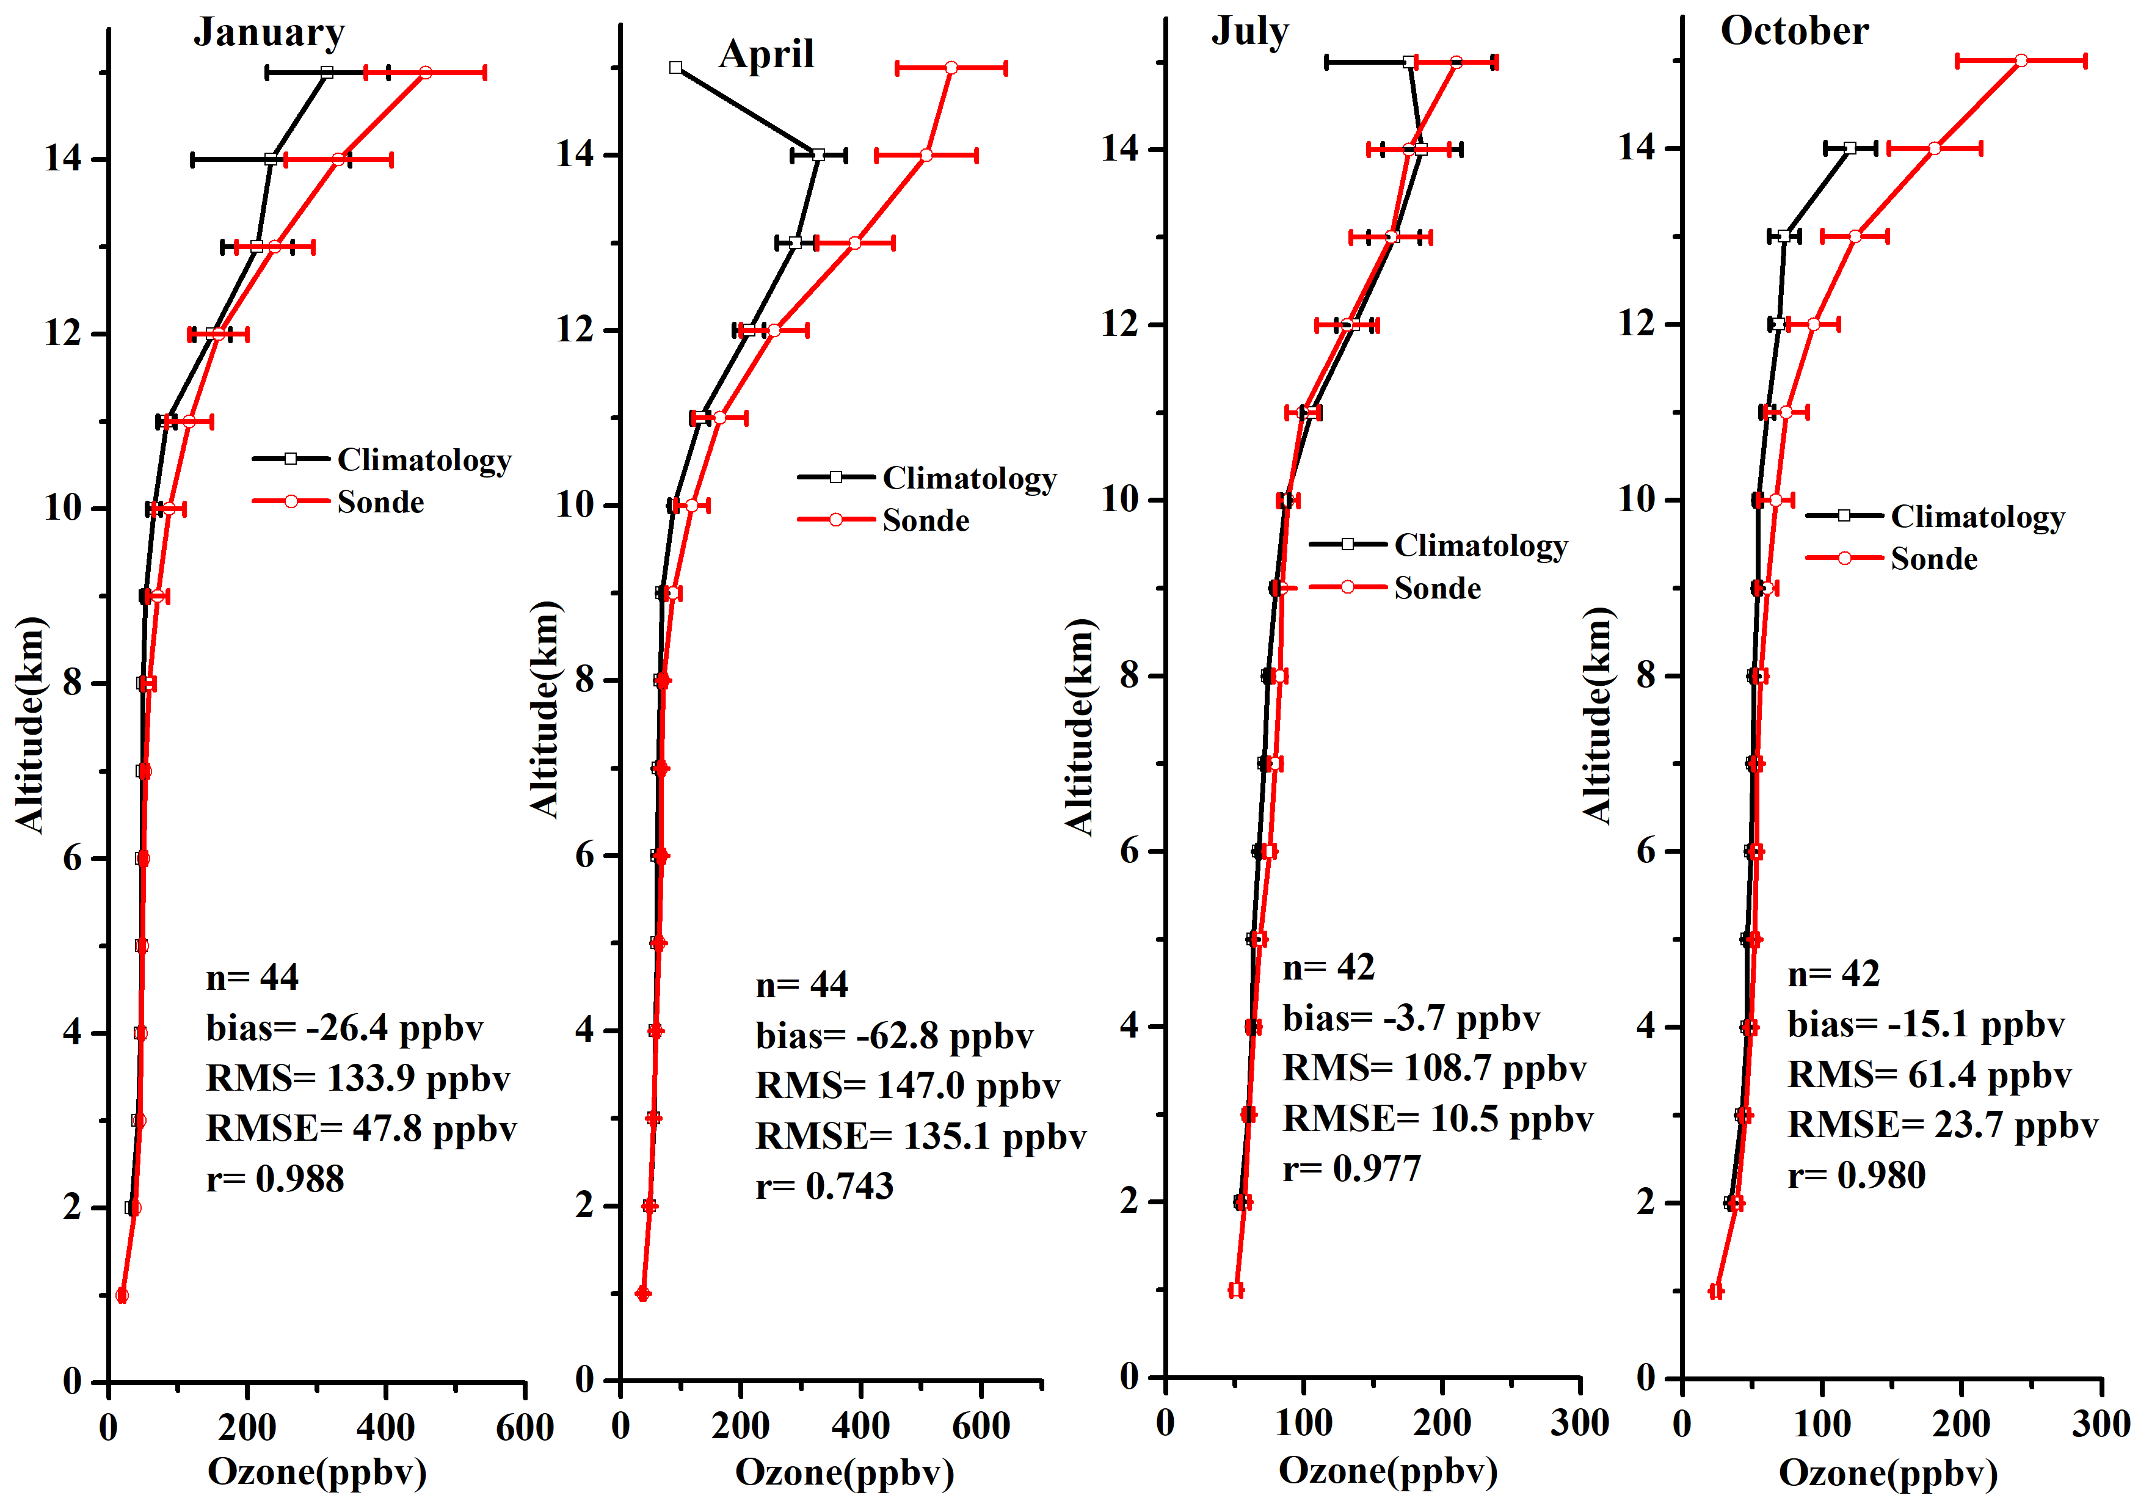
Europe

Slide 27
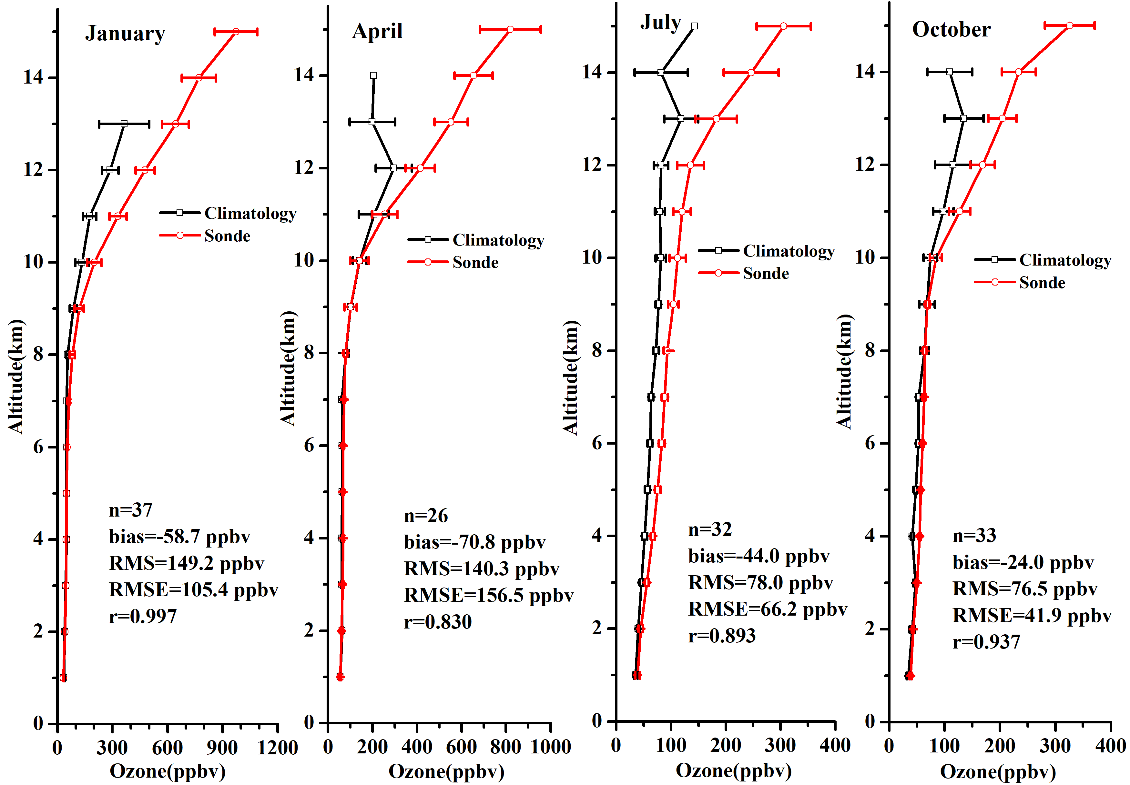
ASIA

Slide 28
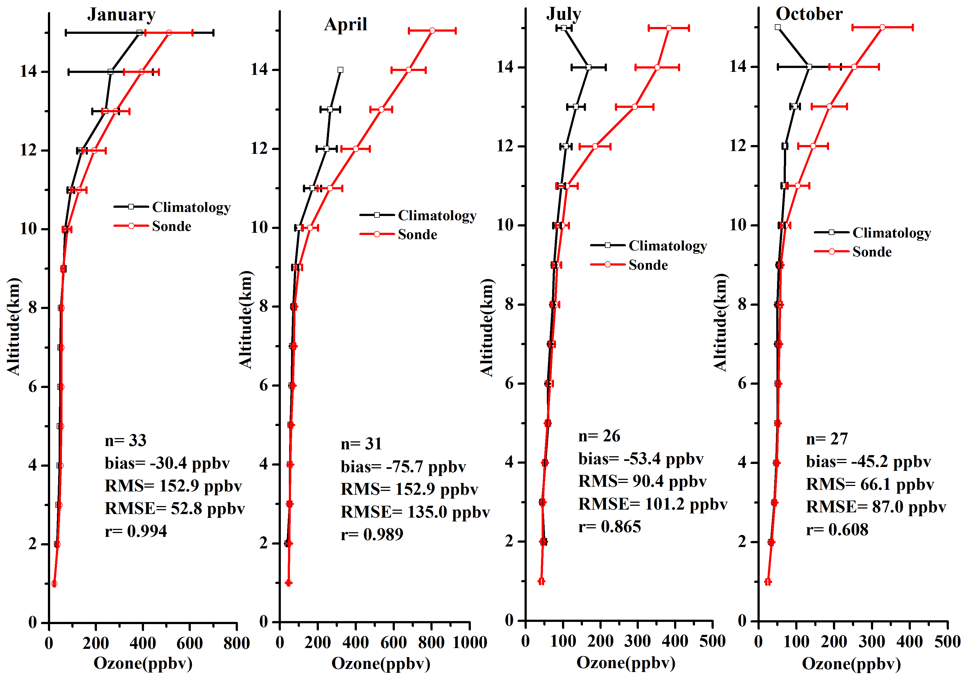
North America

Slide 29
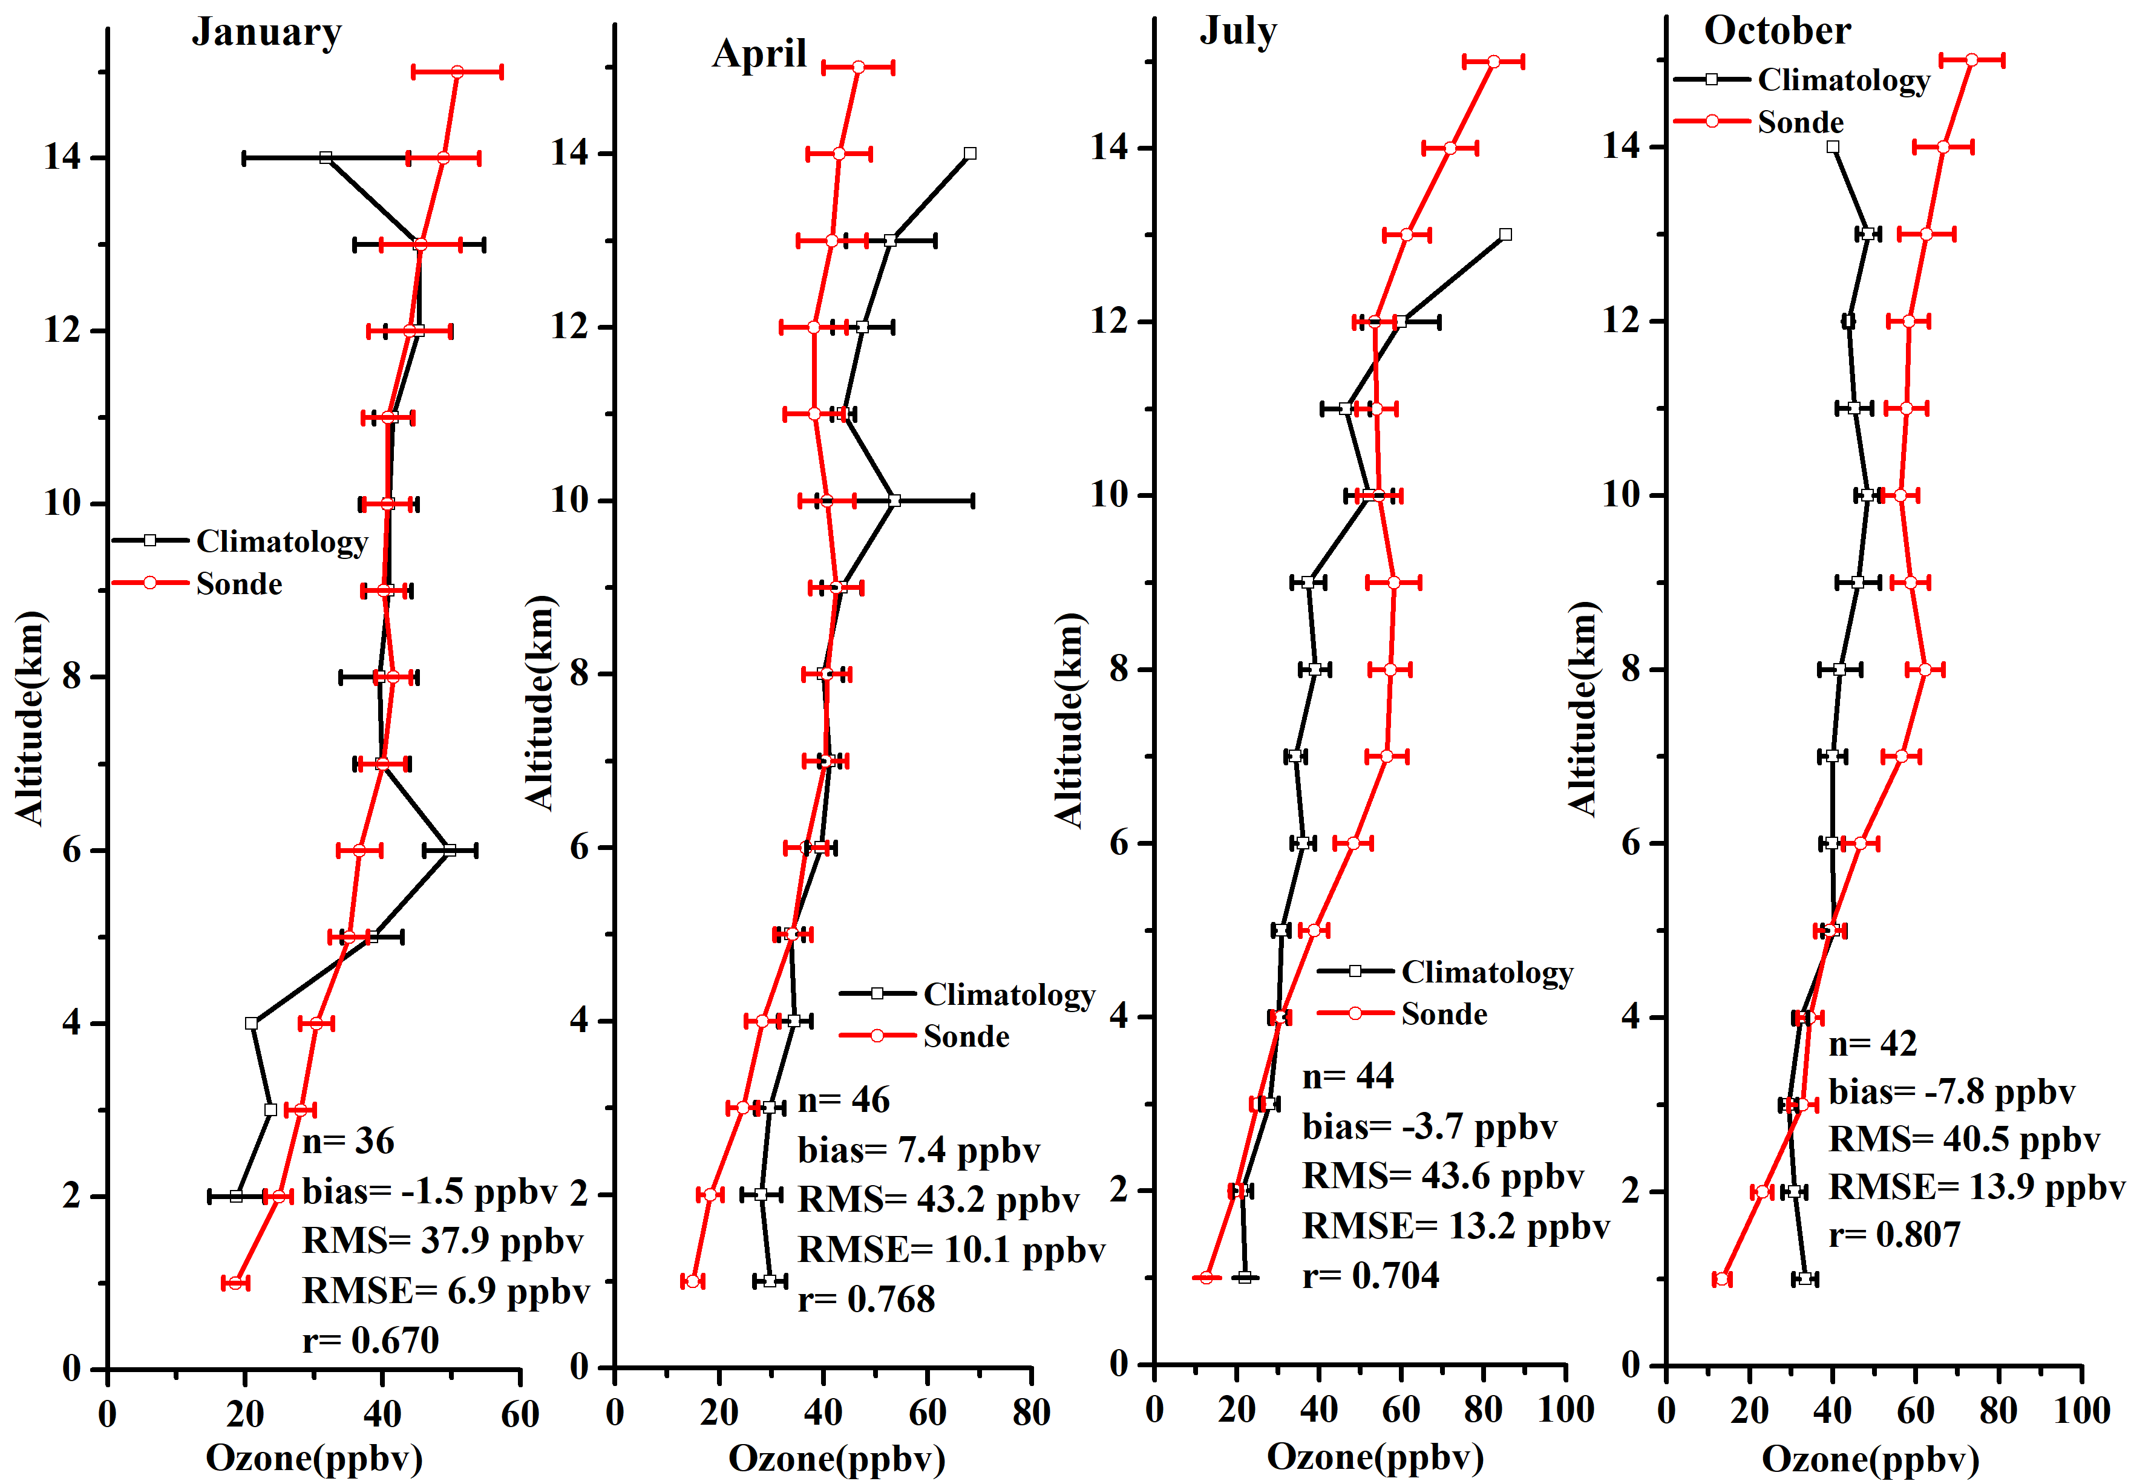
South America

Slide 30
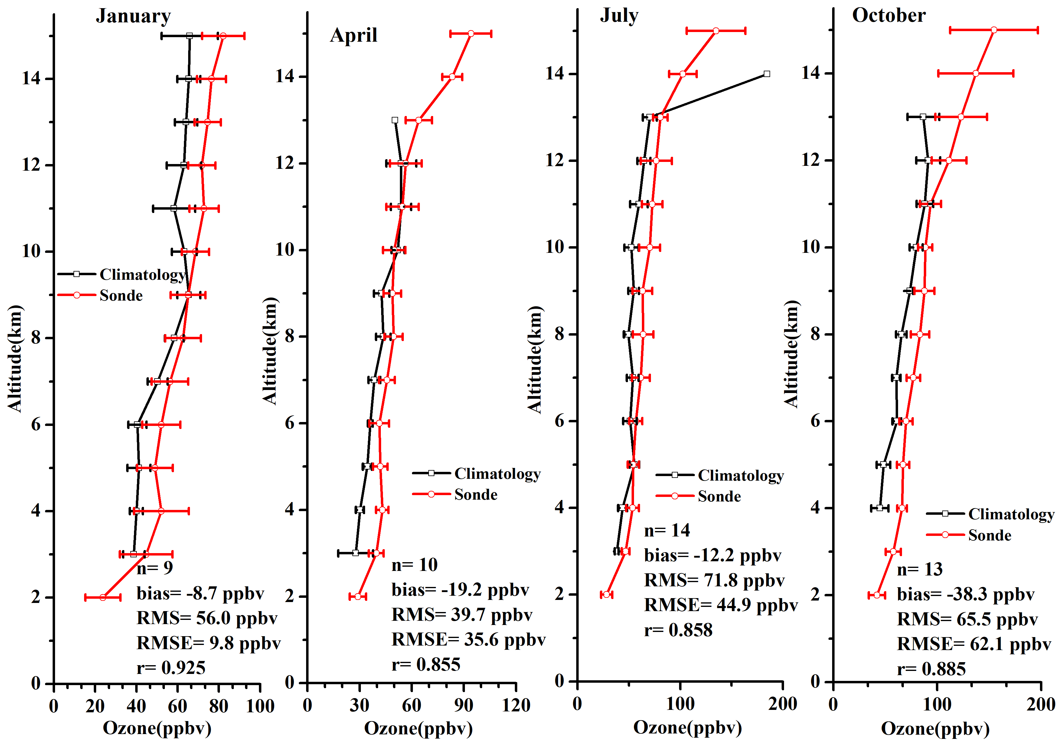
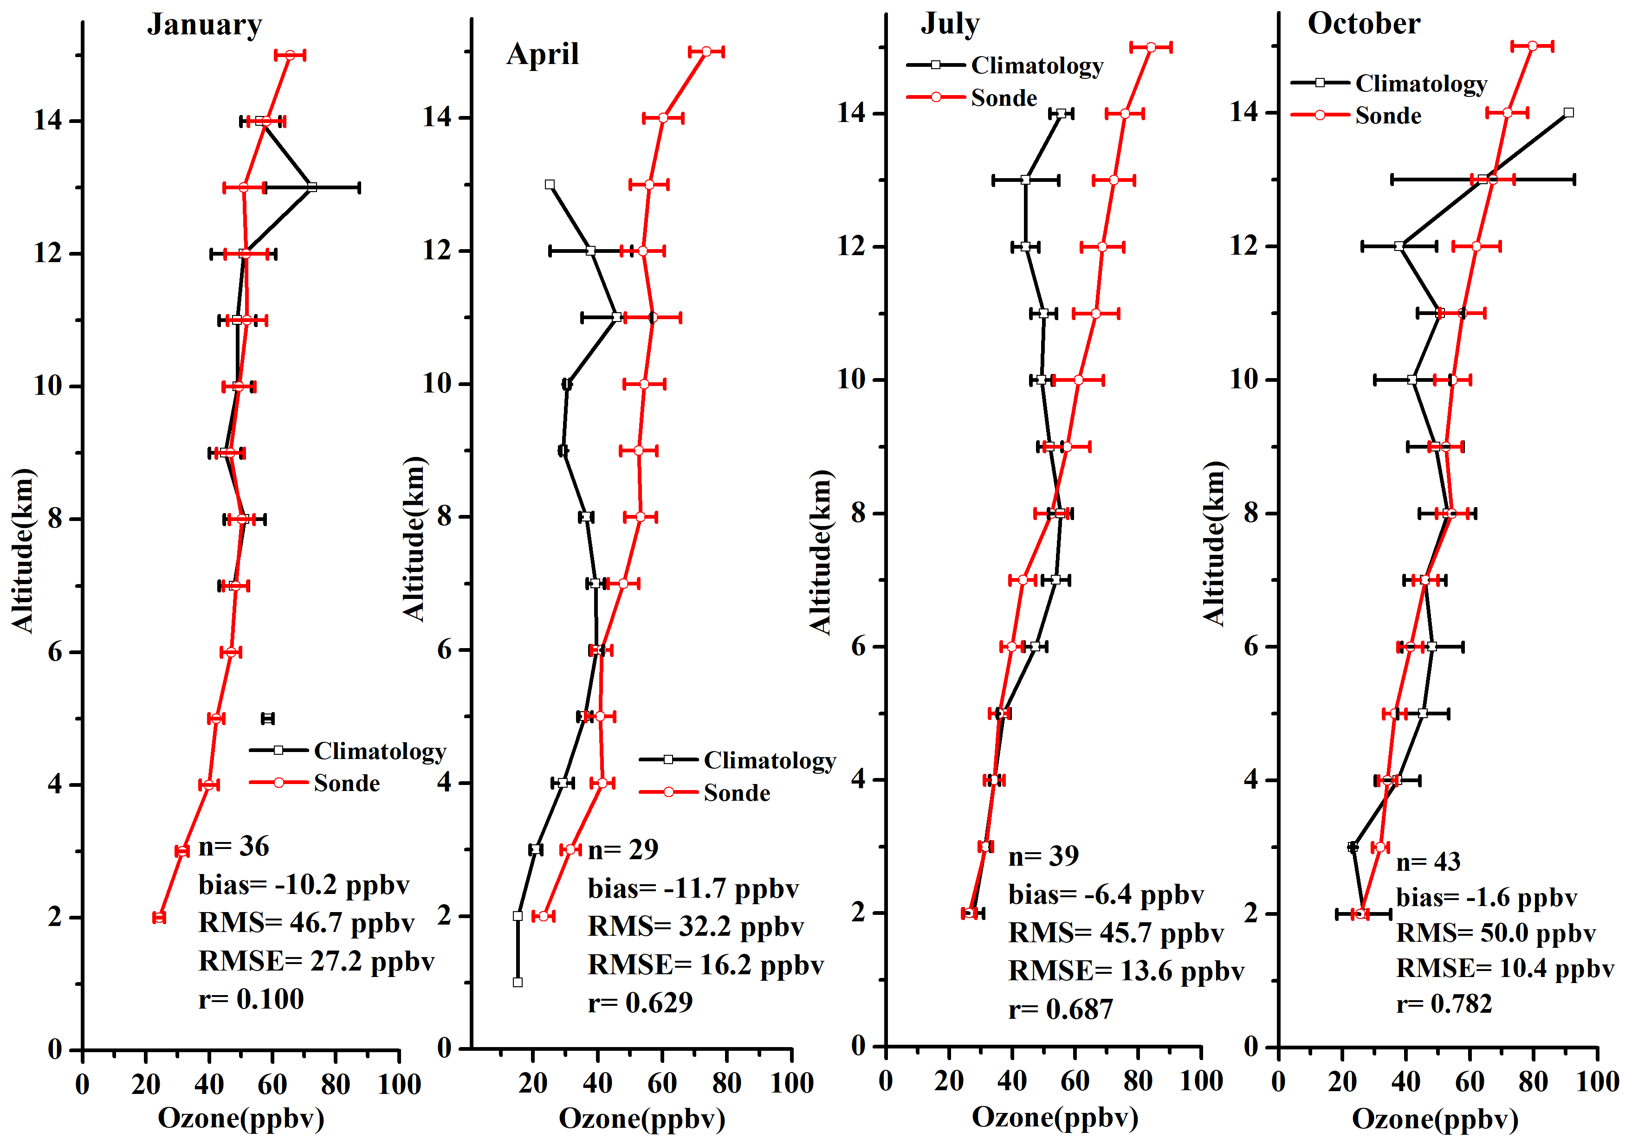
South Africa

Slide 31
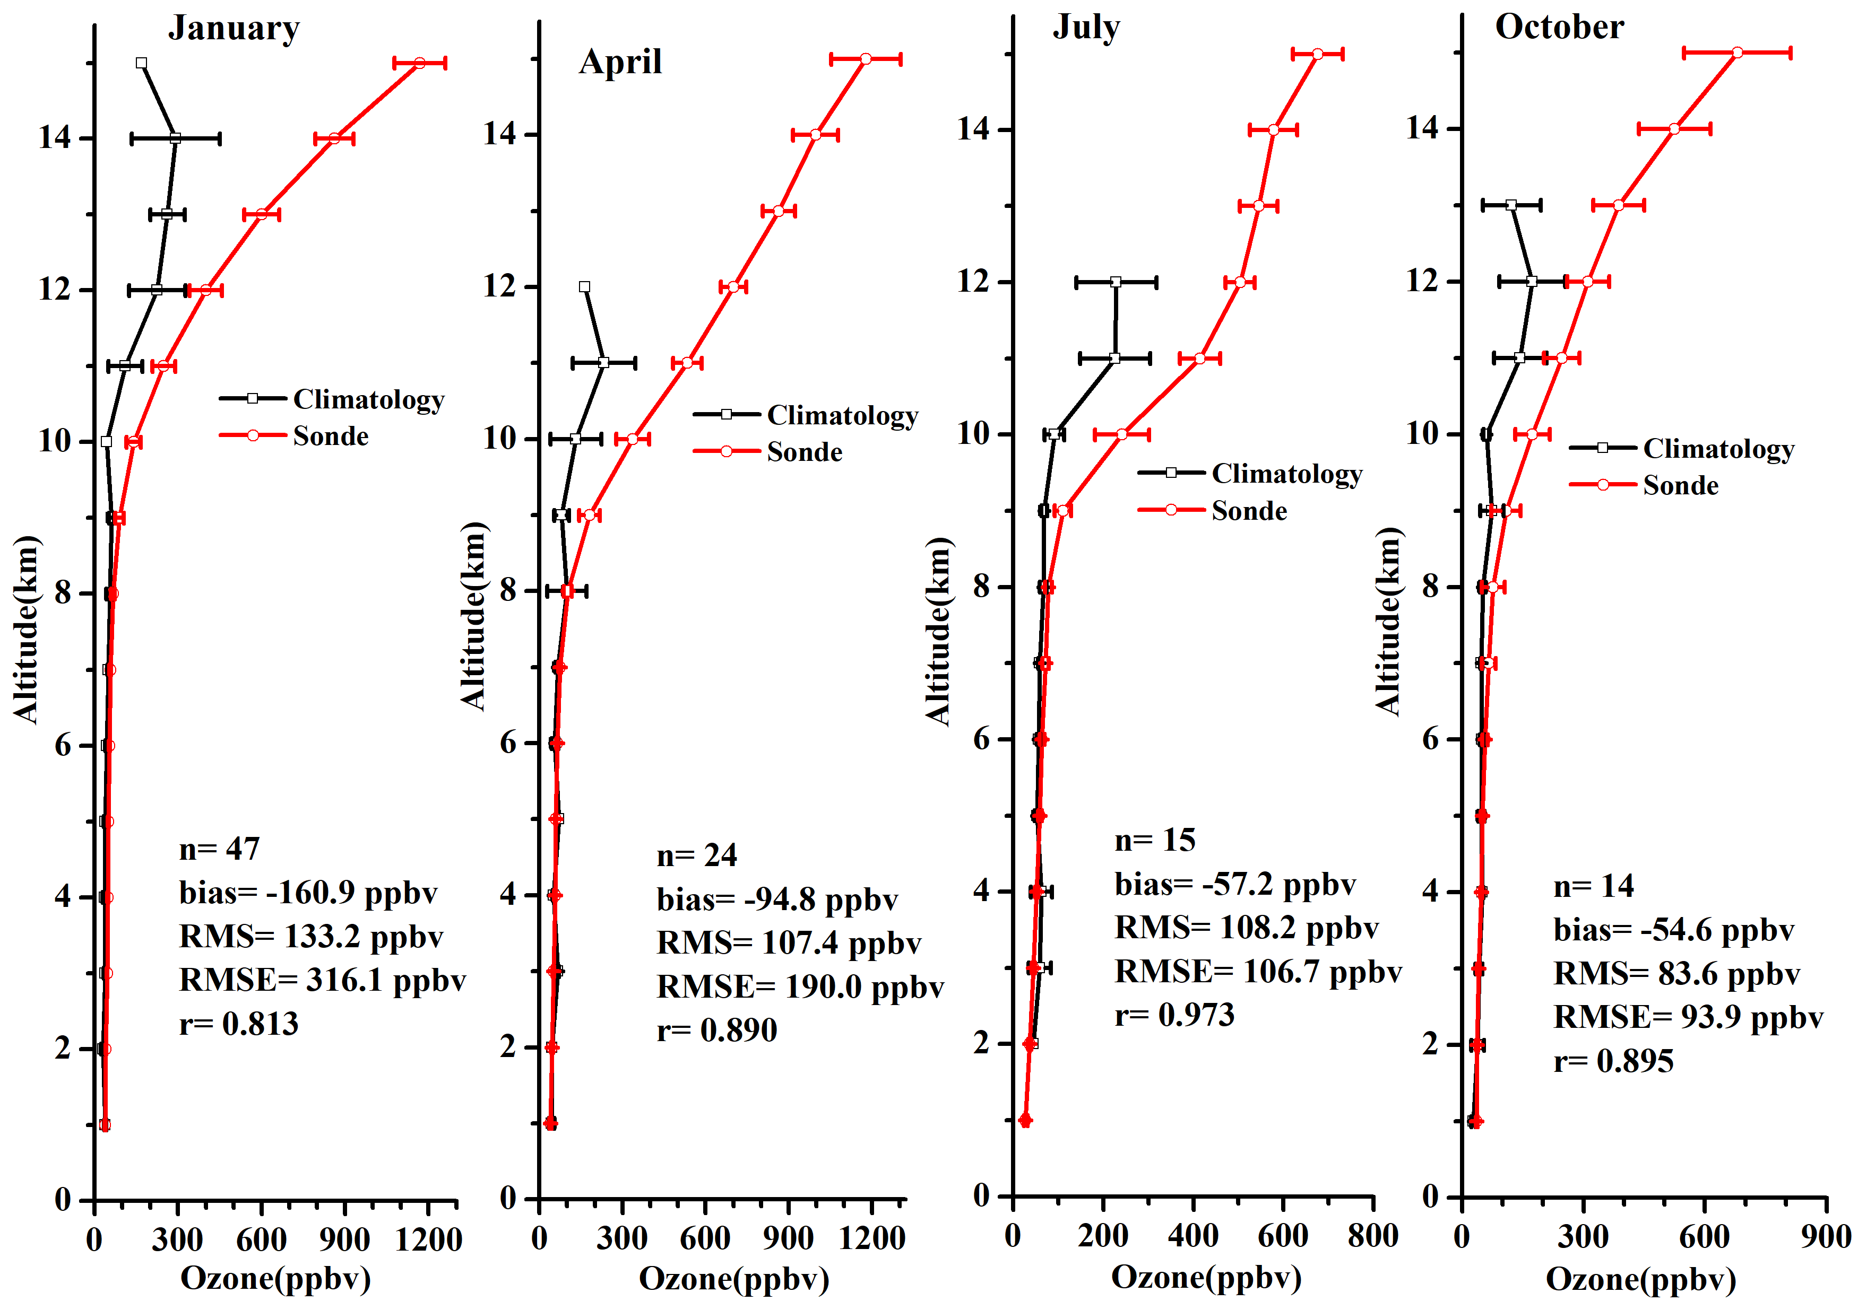
Arctic

Slide 32
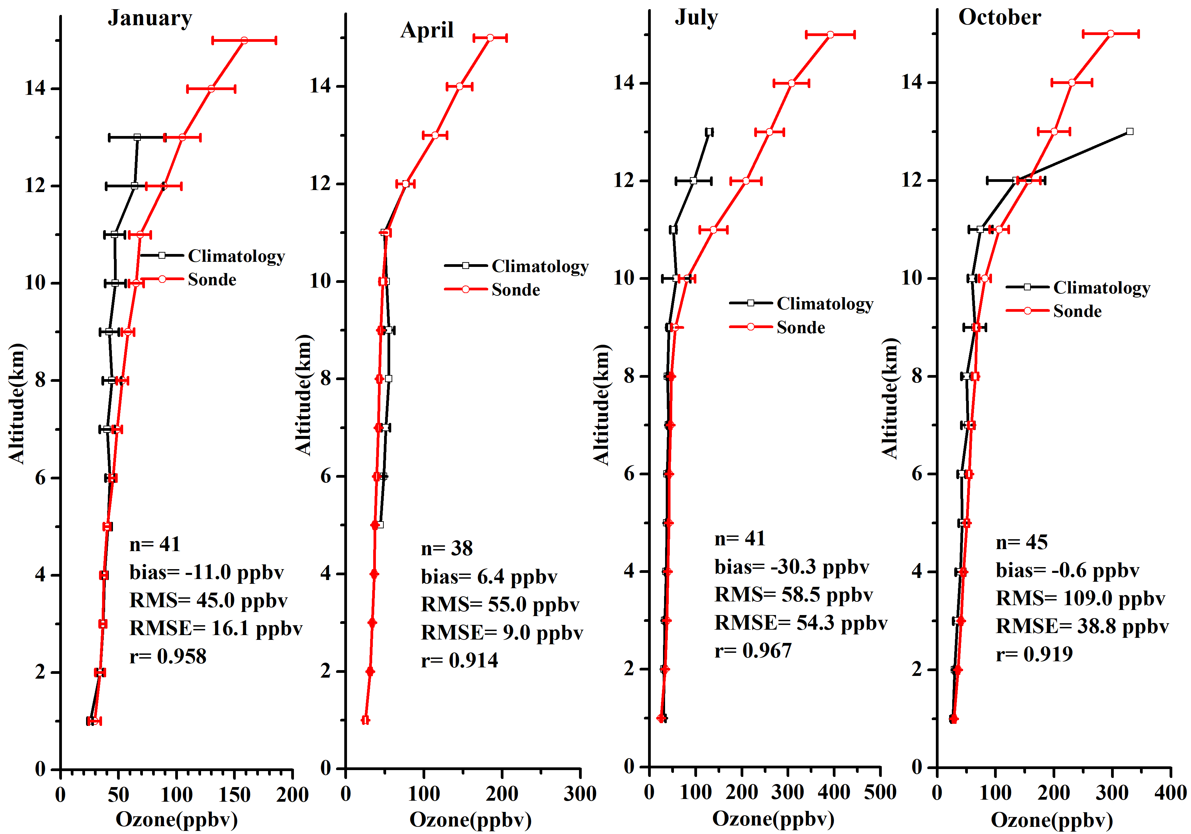
Oceania

Slide 33
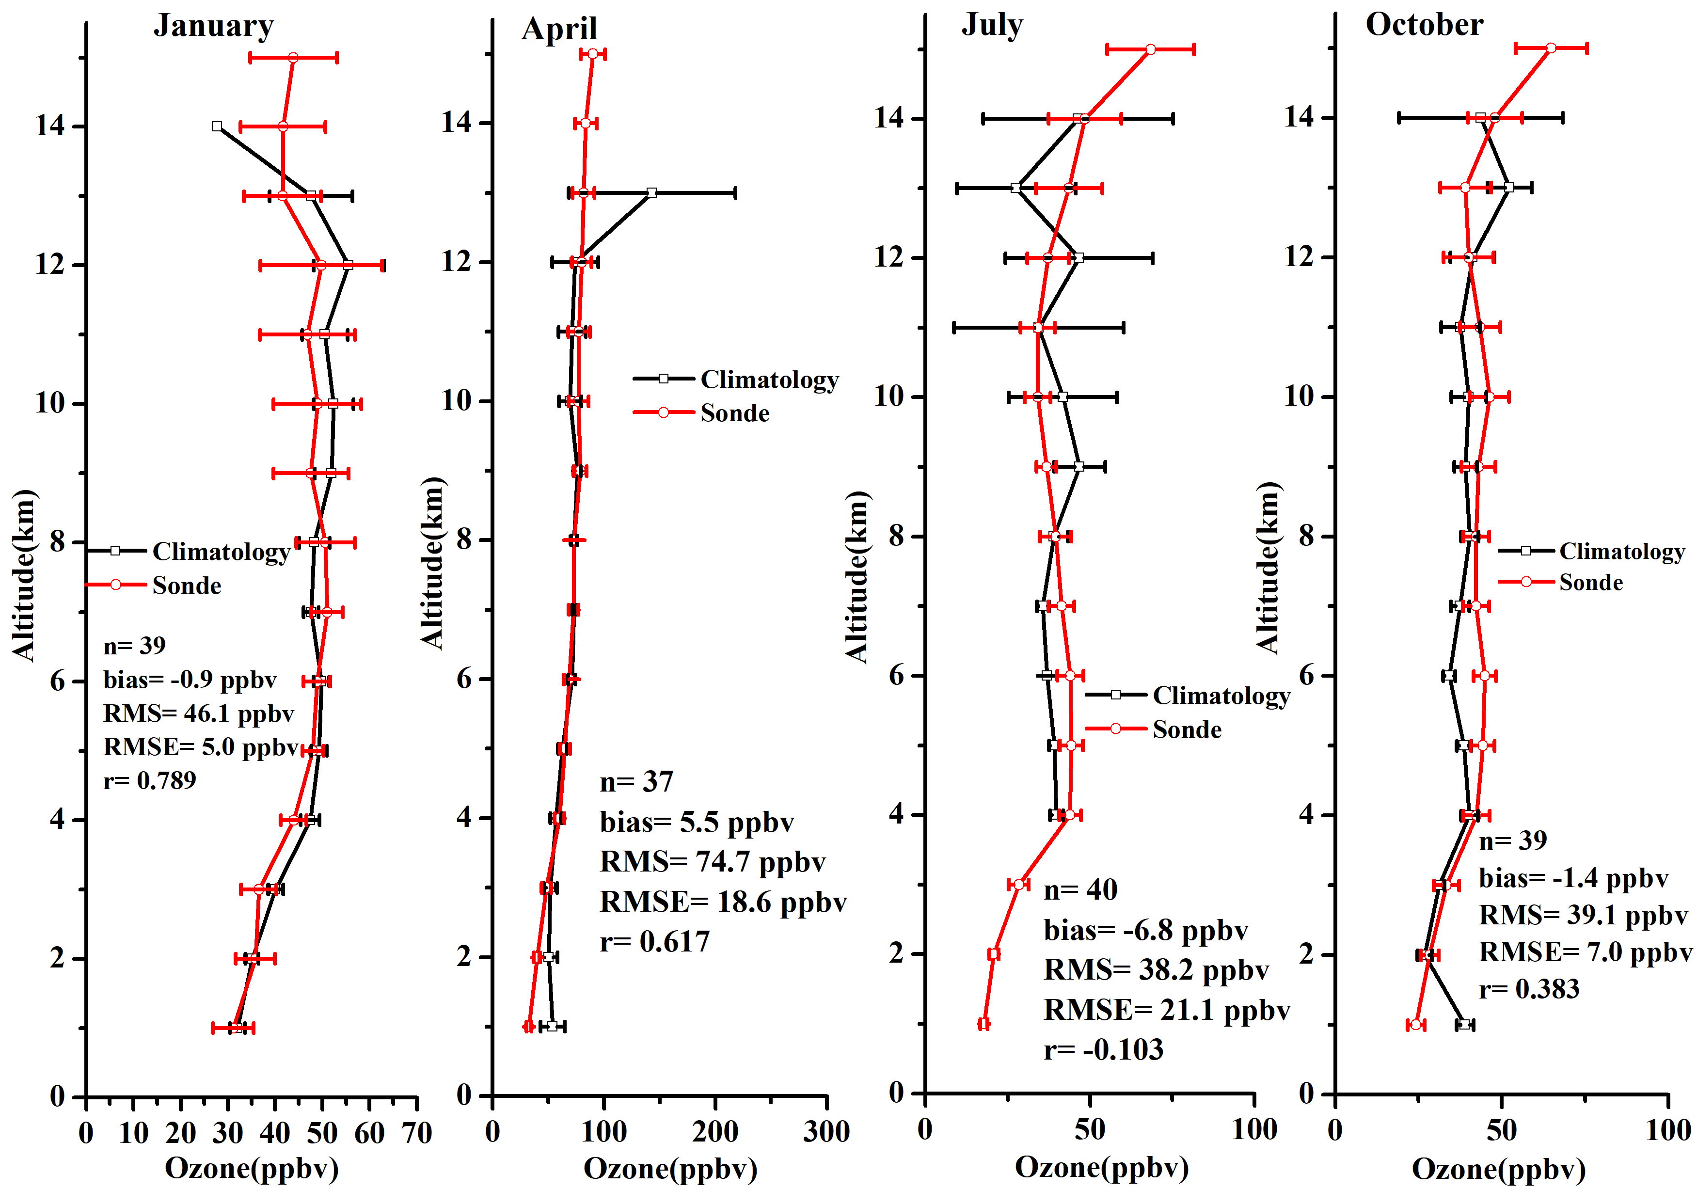
Pacific

Slide 34
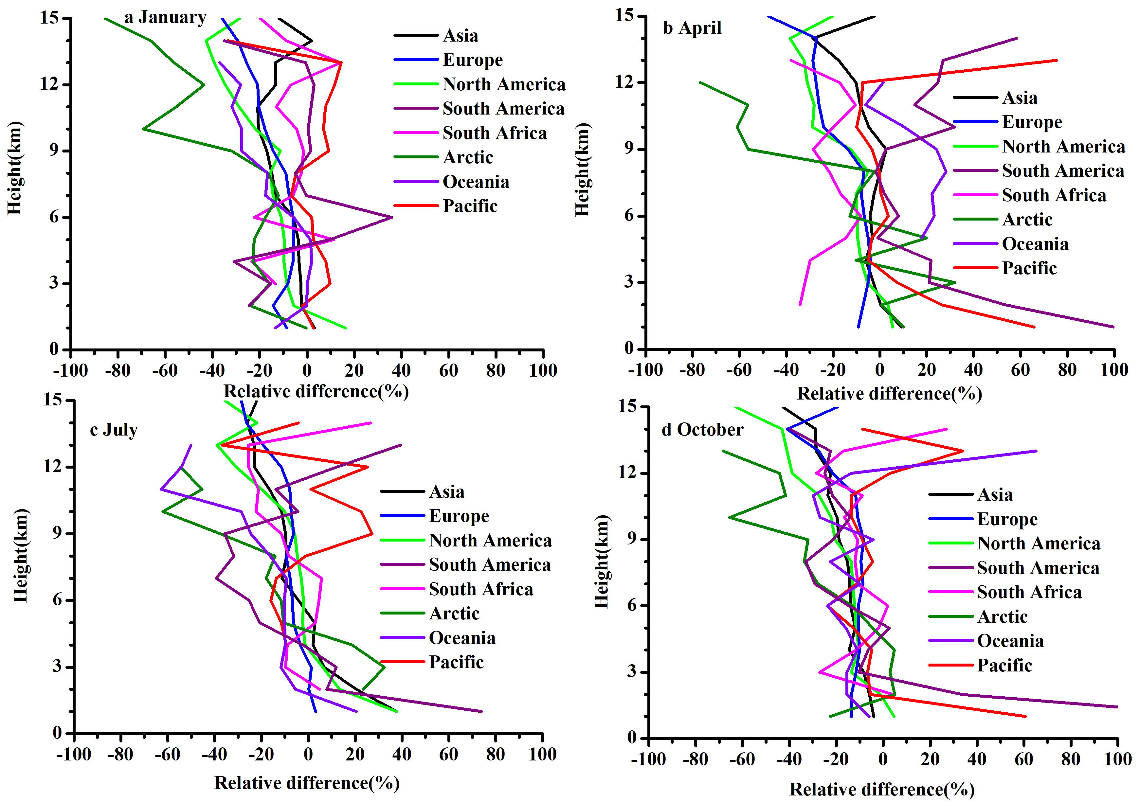
Relative difference((climatology-sonde)/sonde*100)

Slide 35
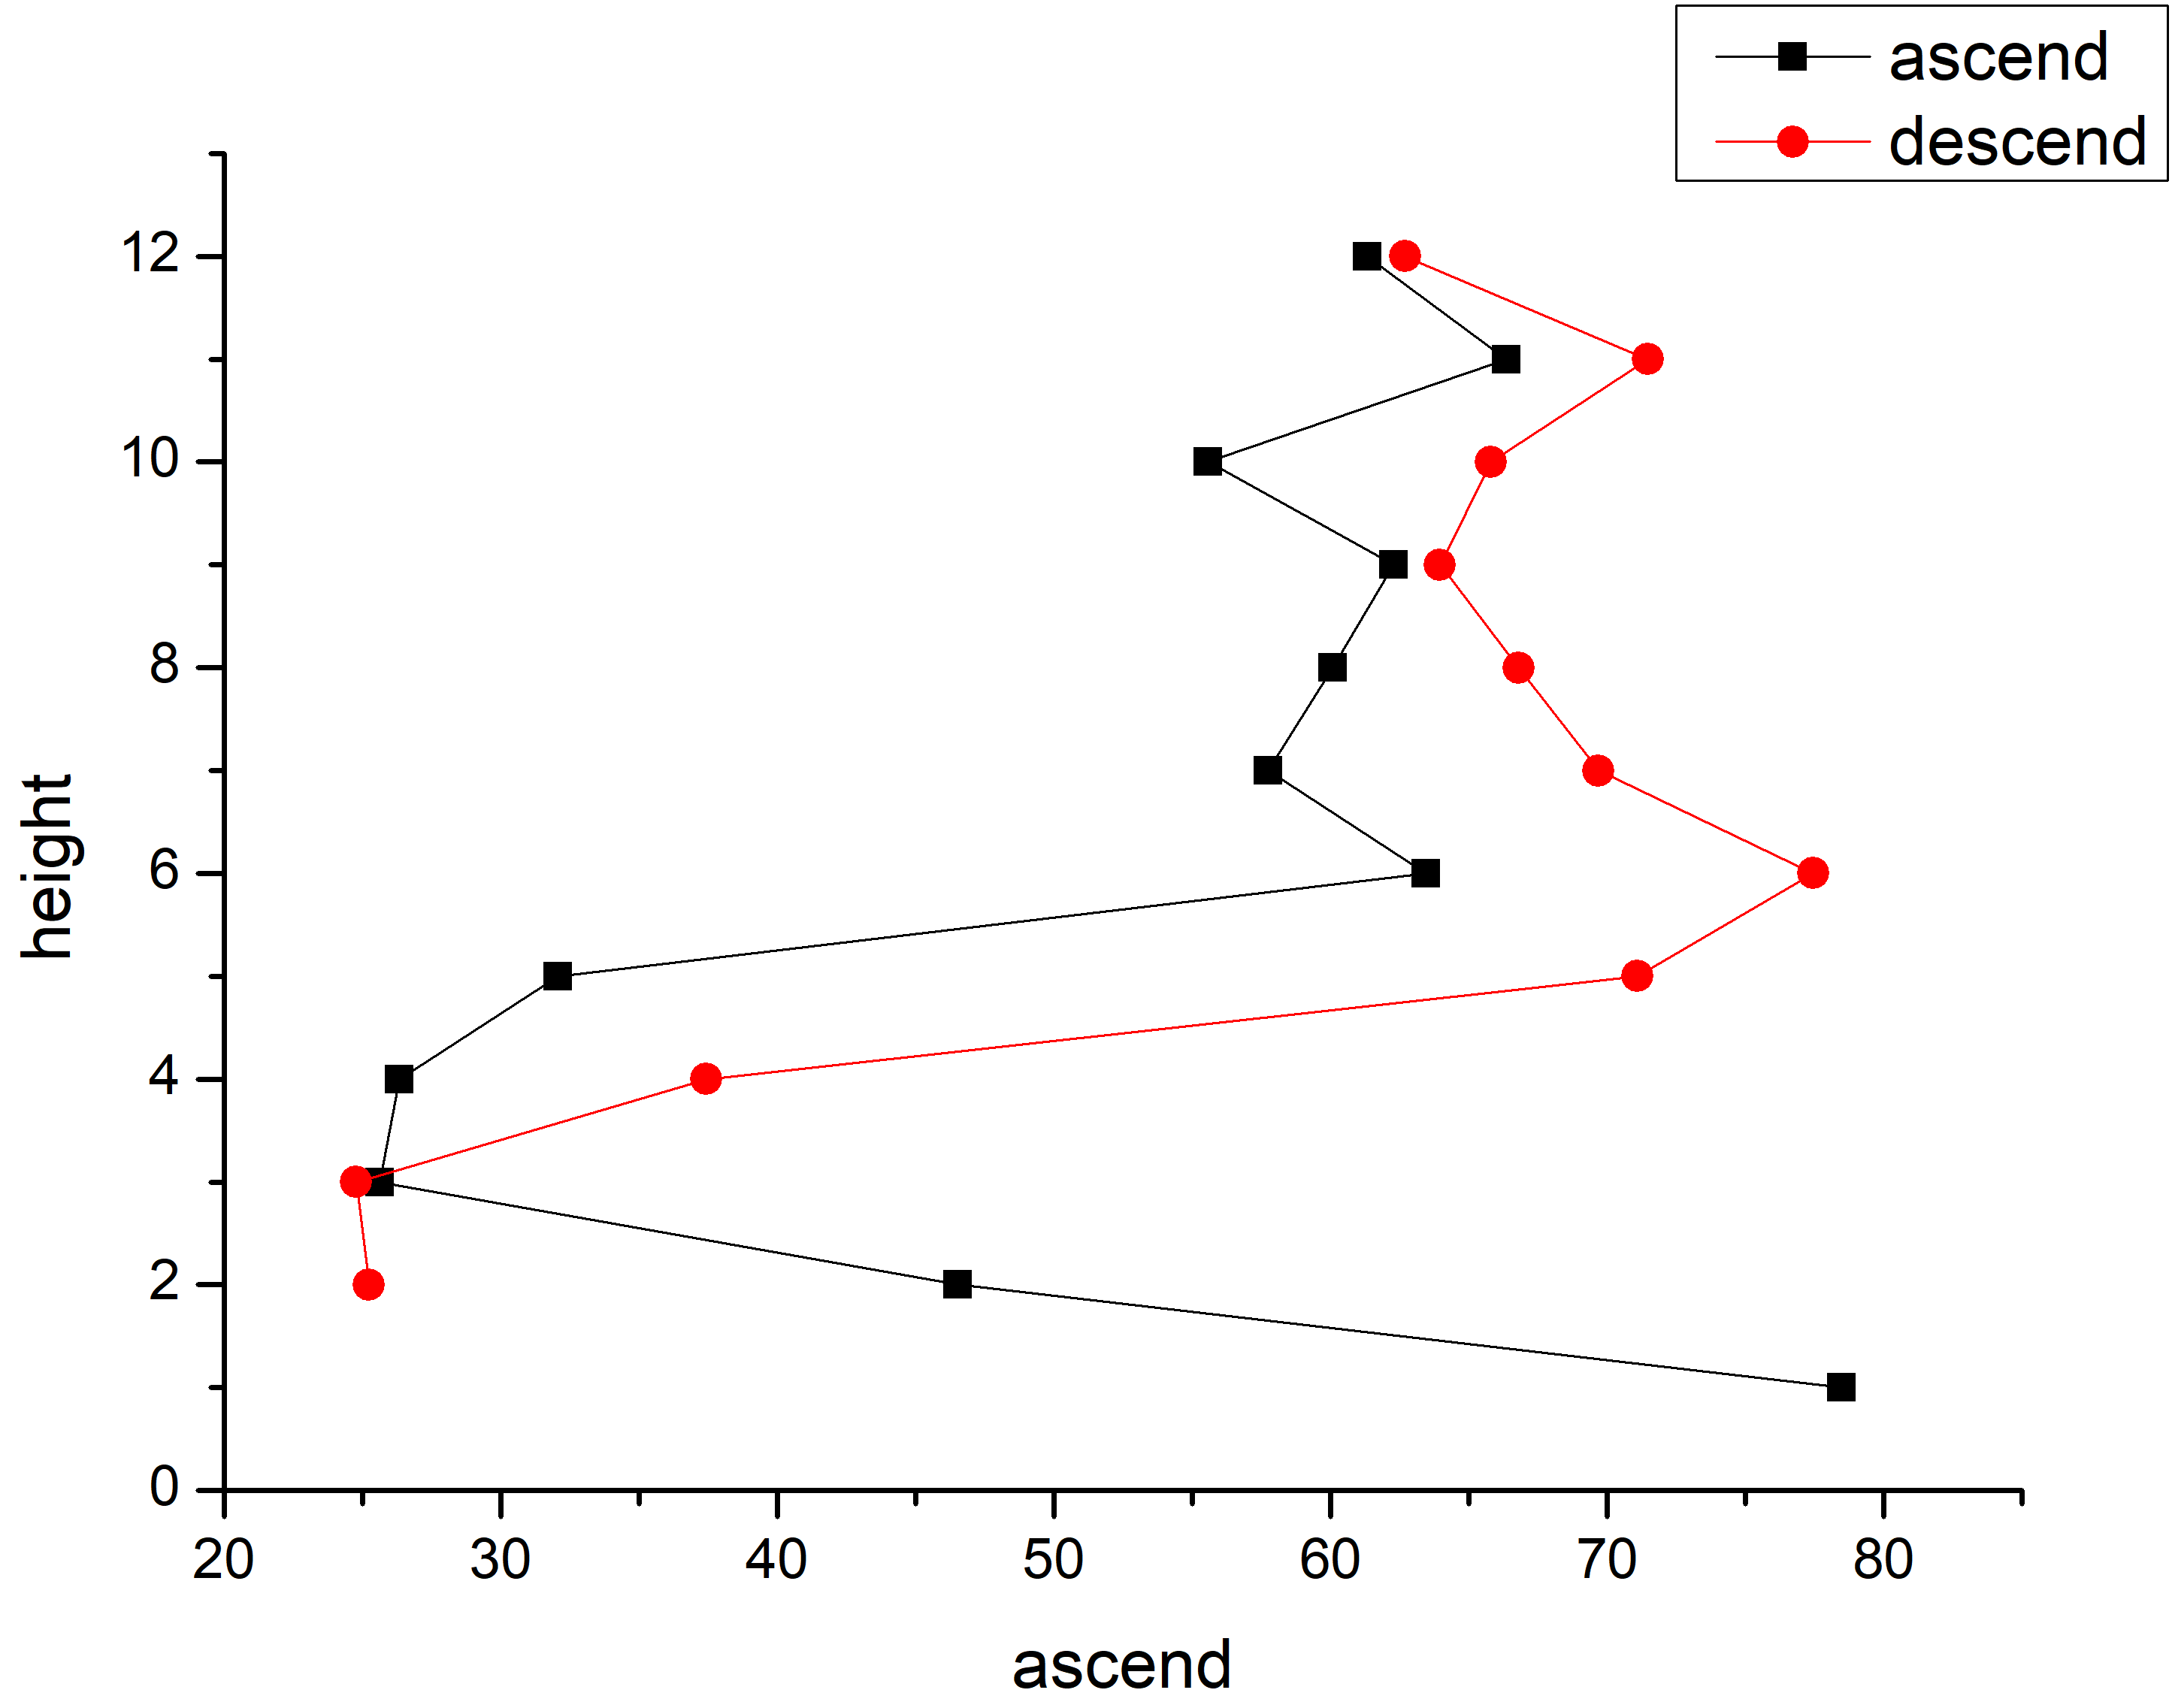
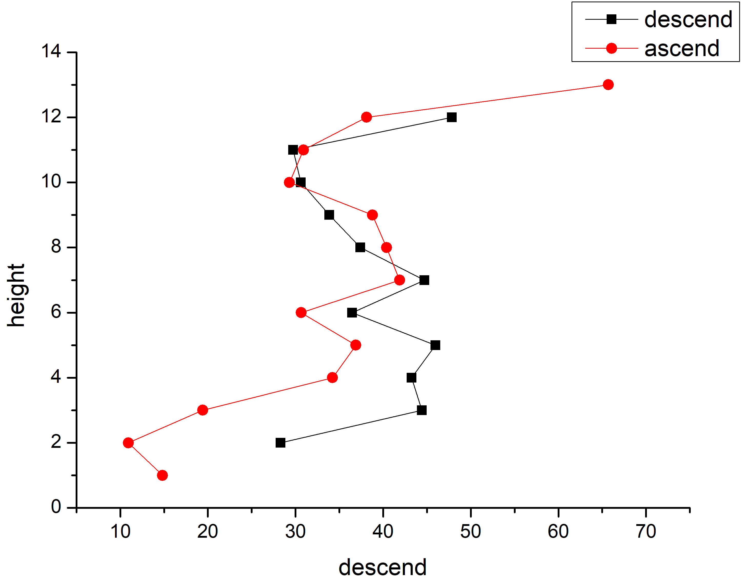
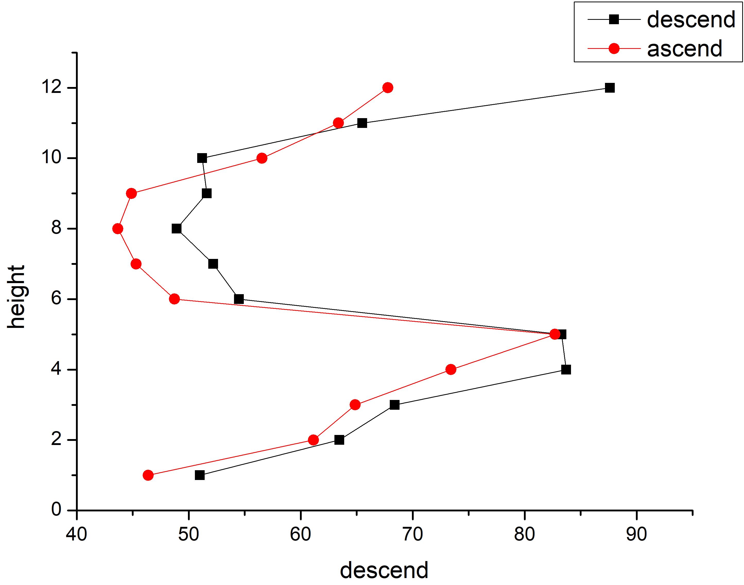
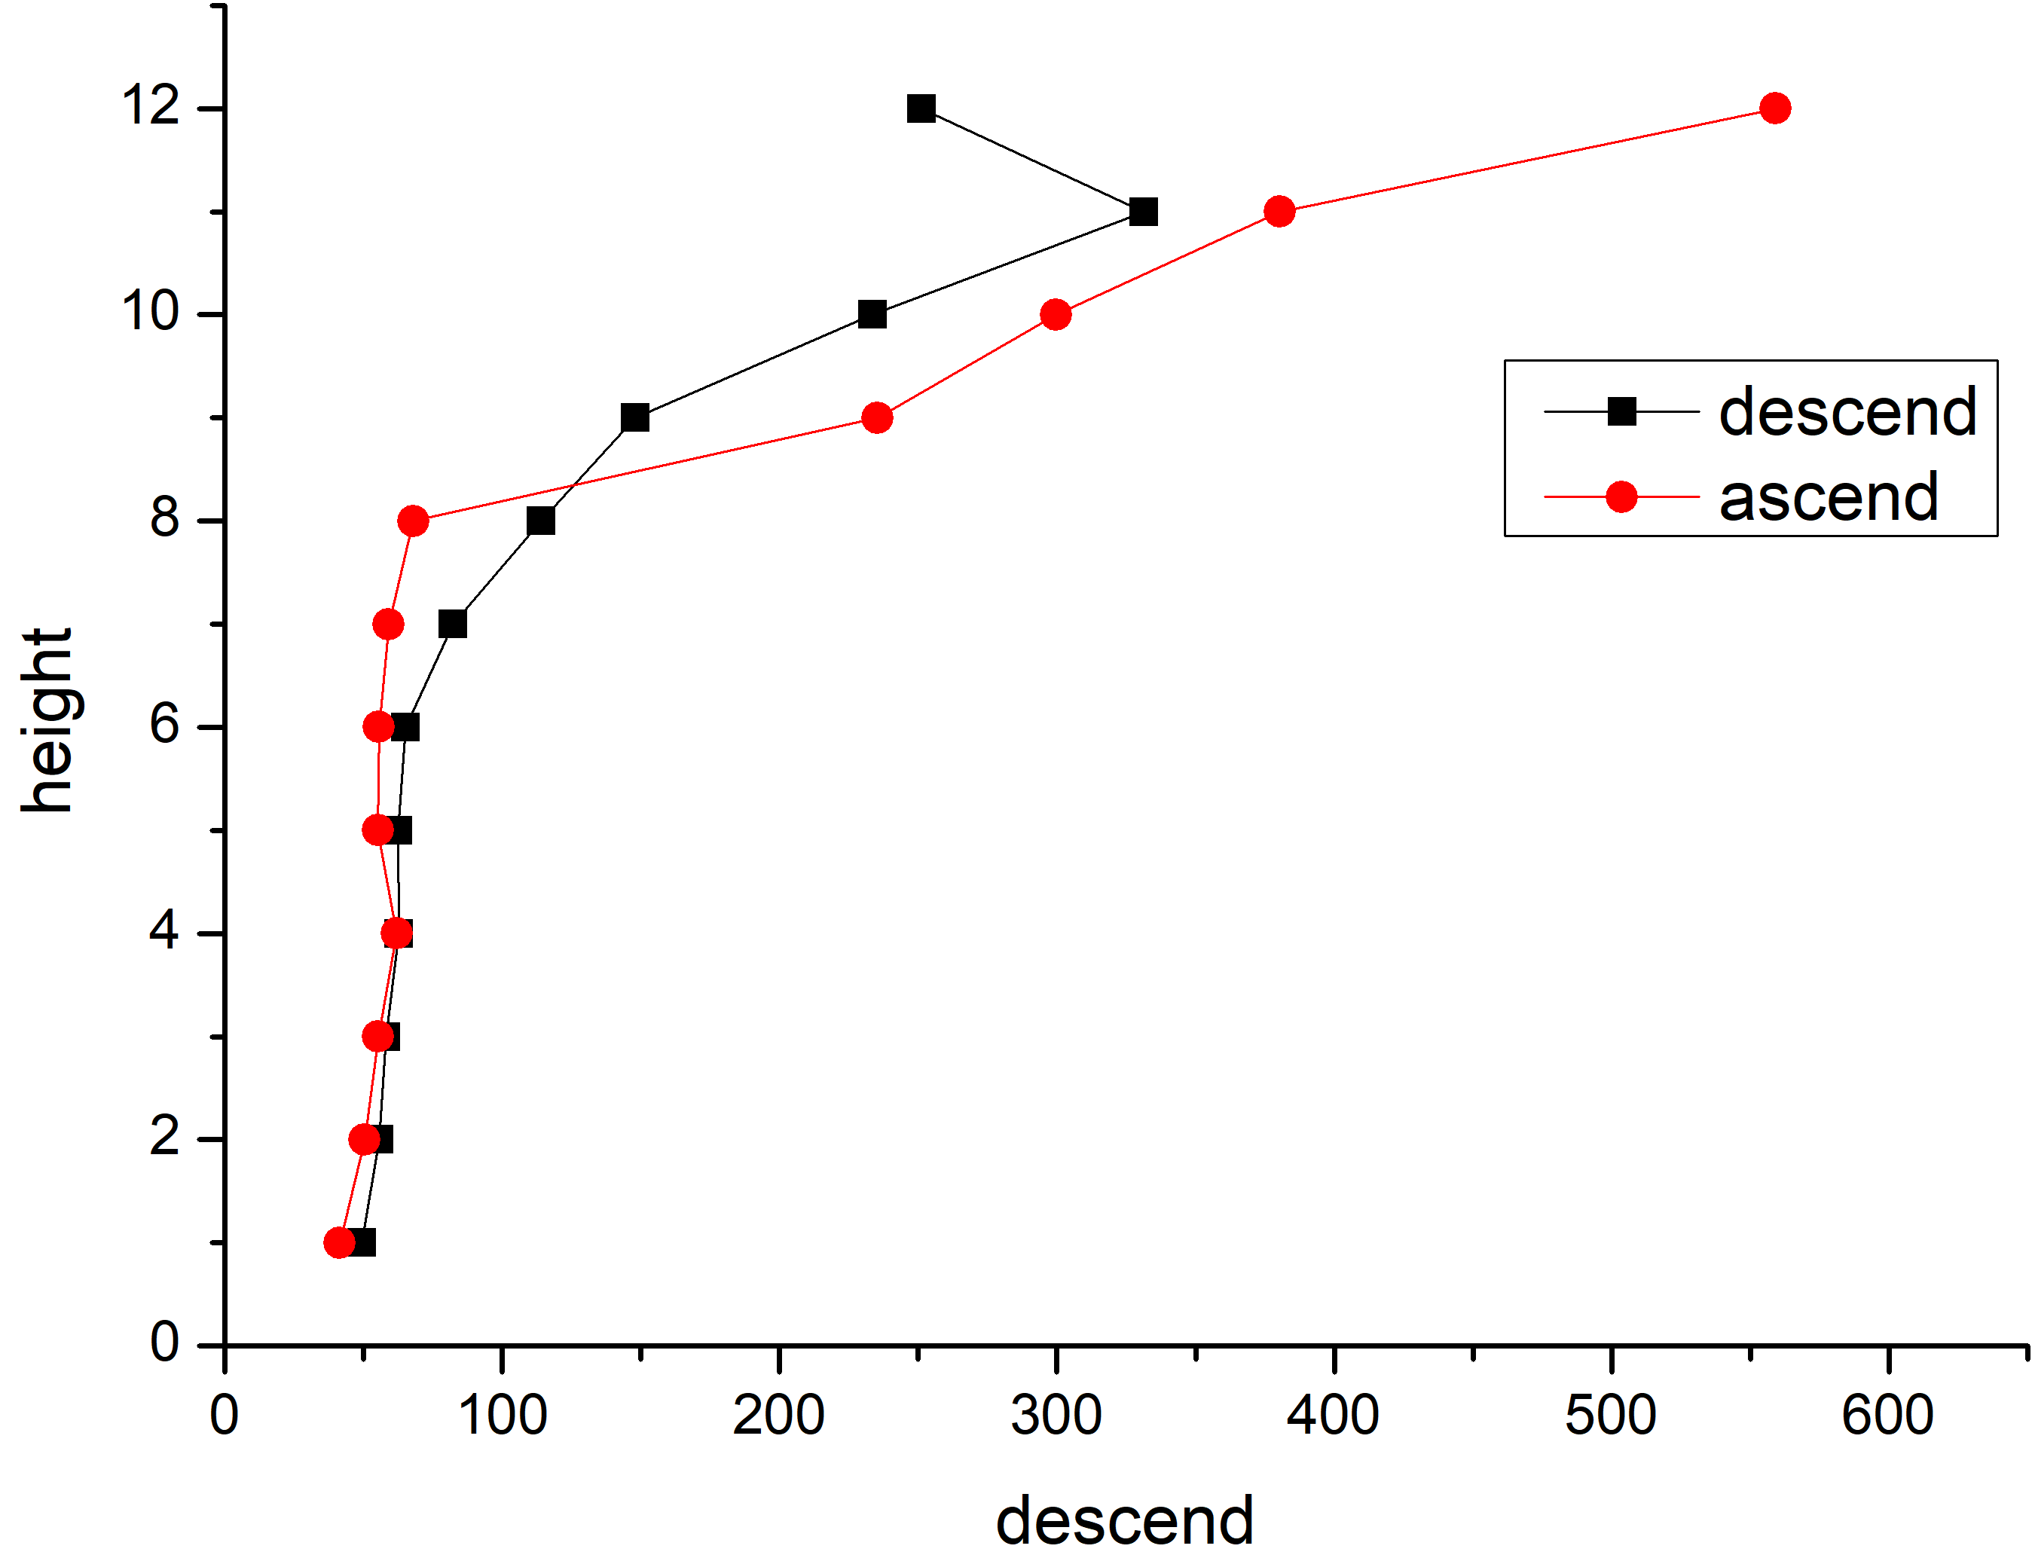
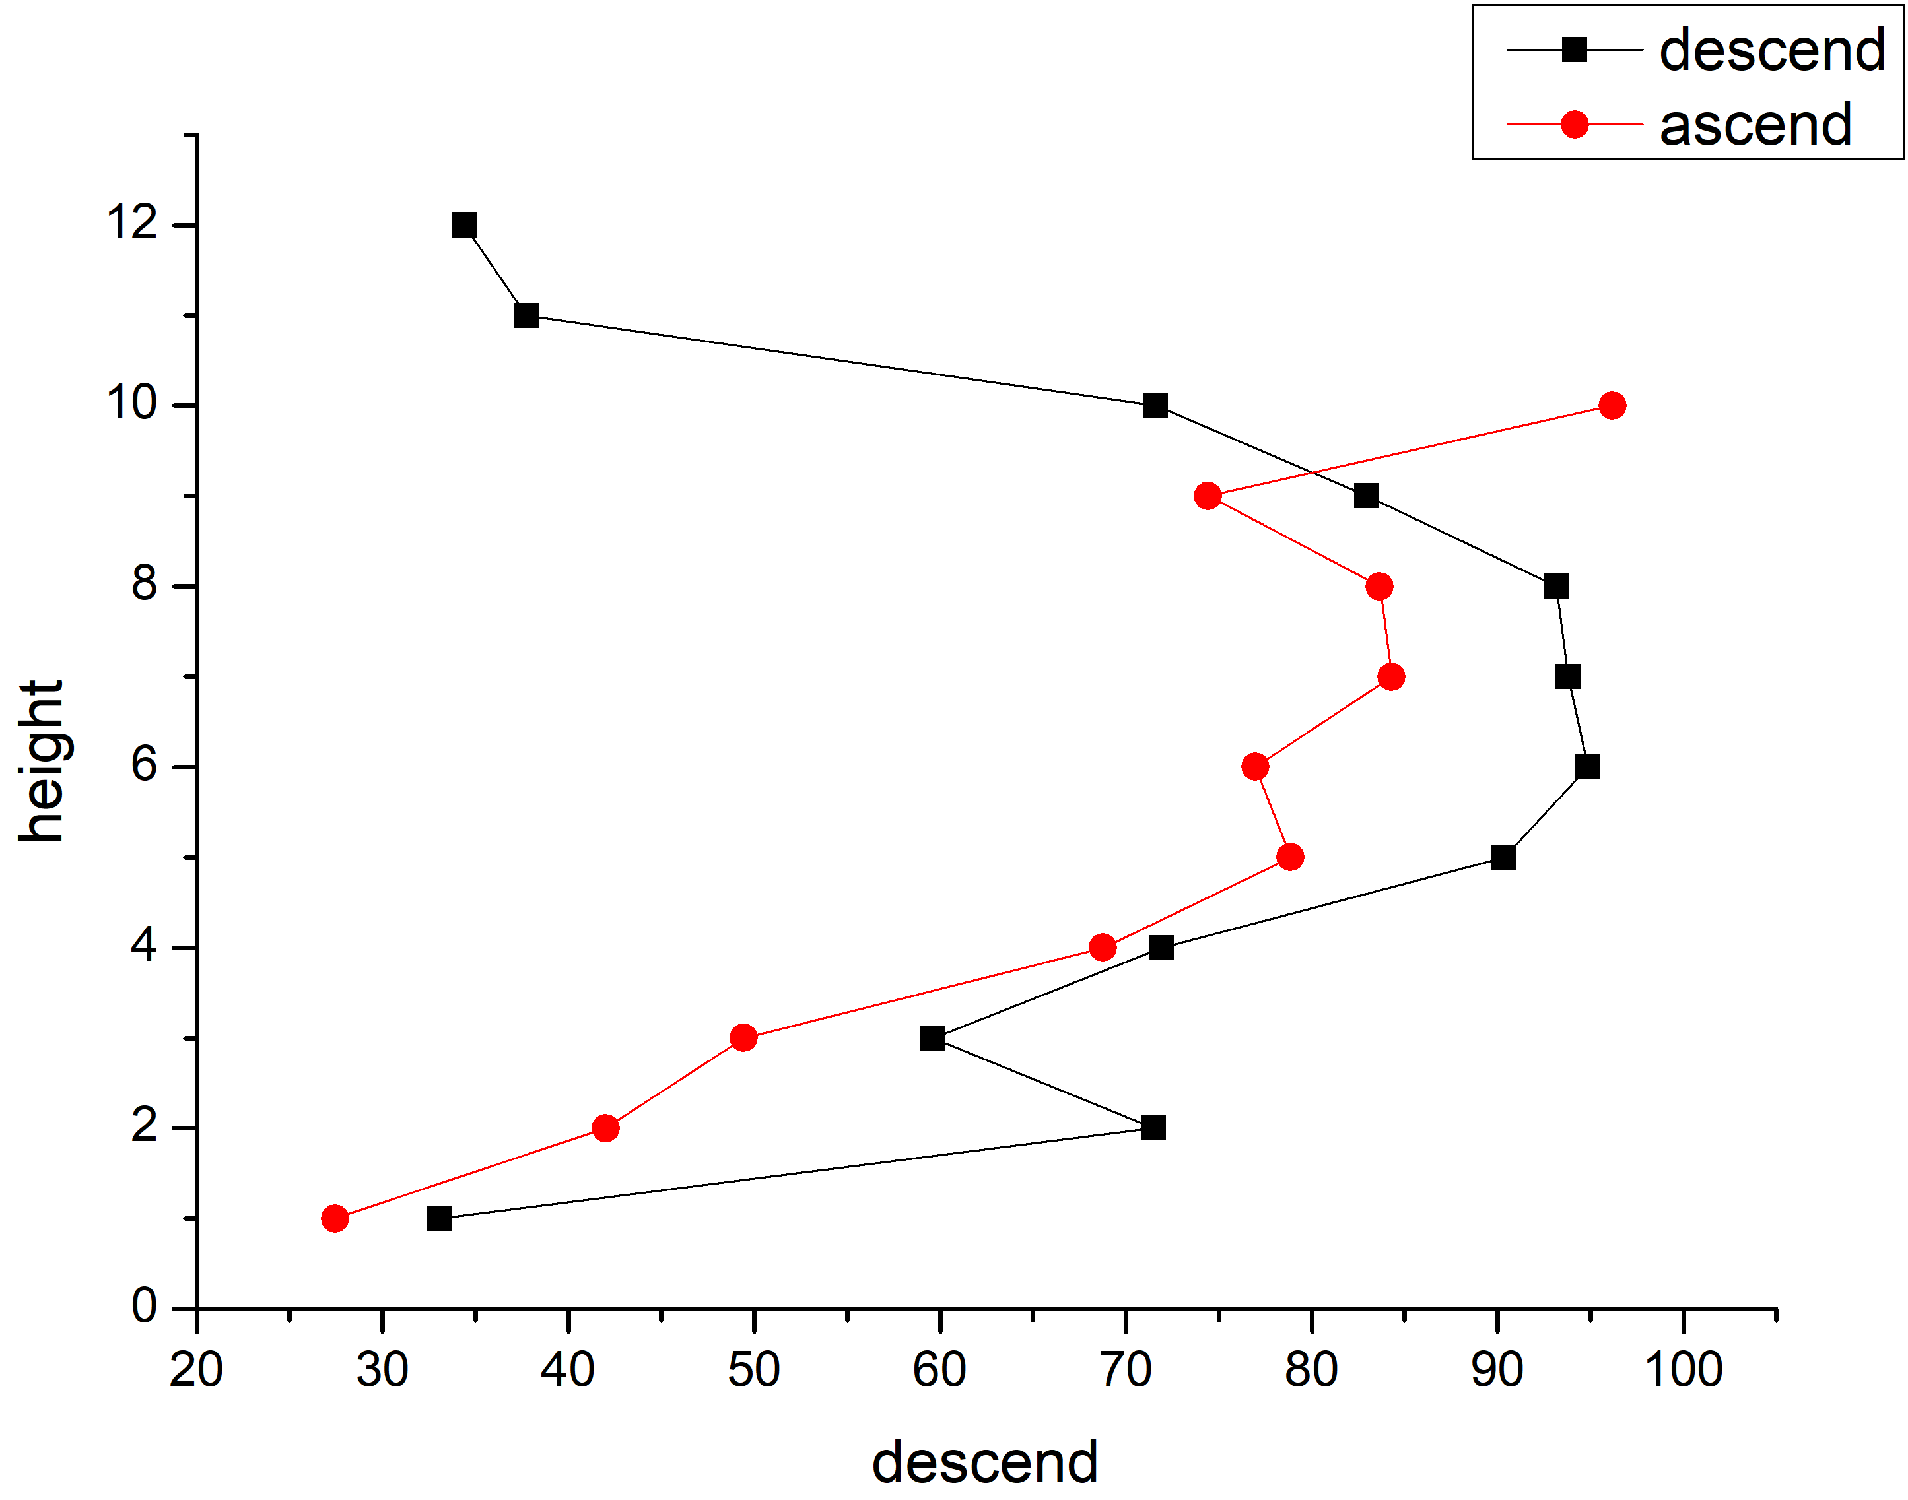
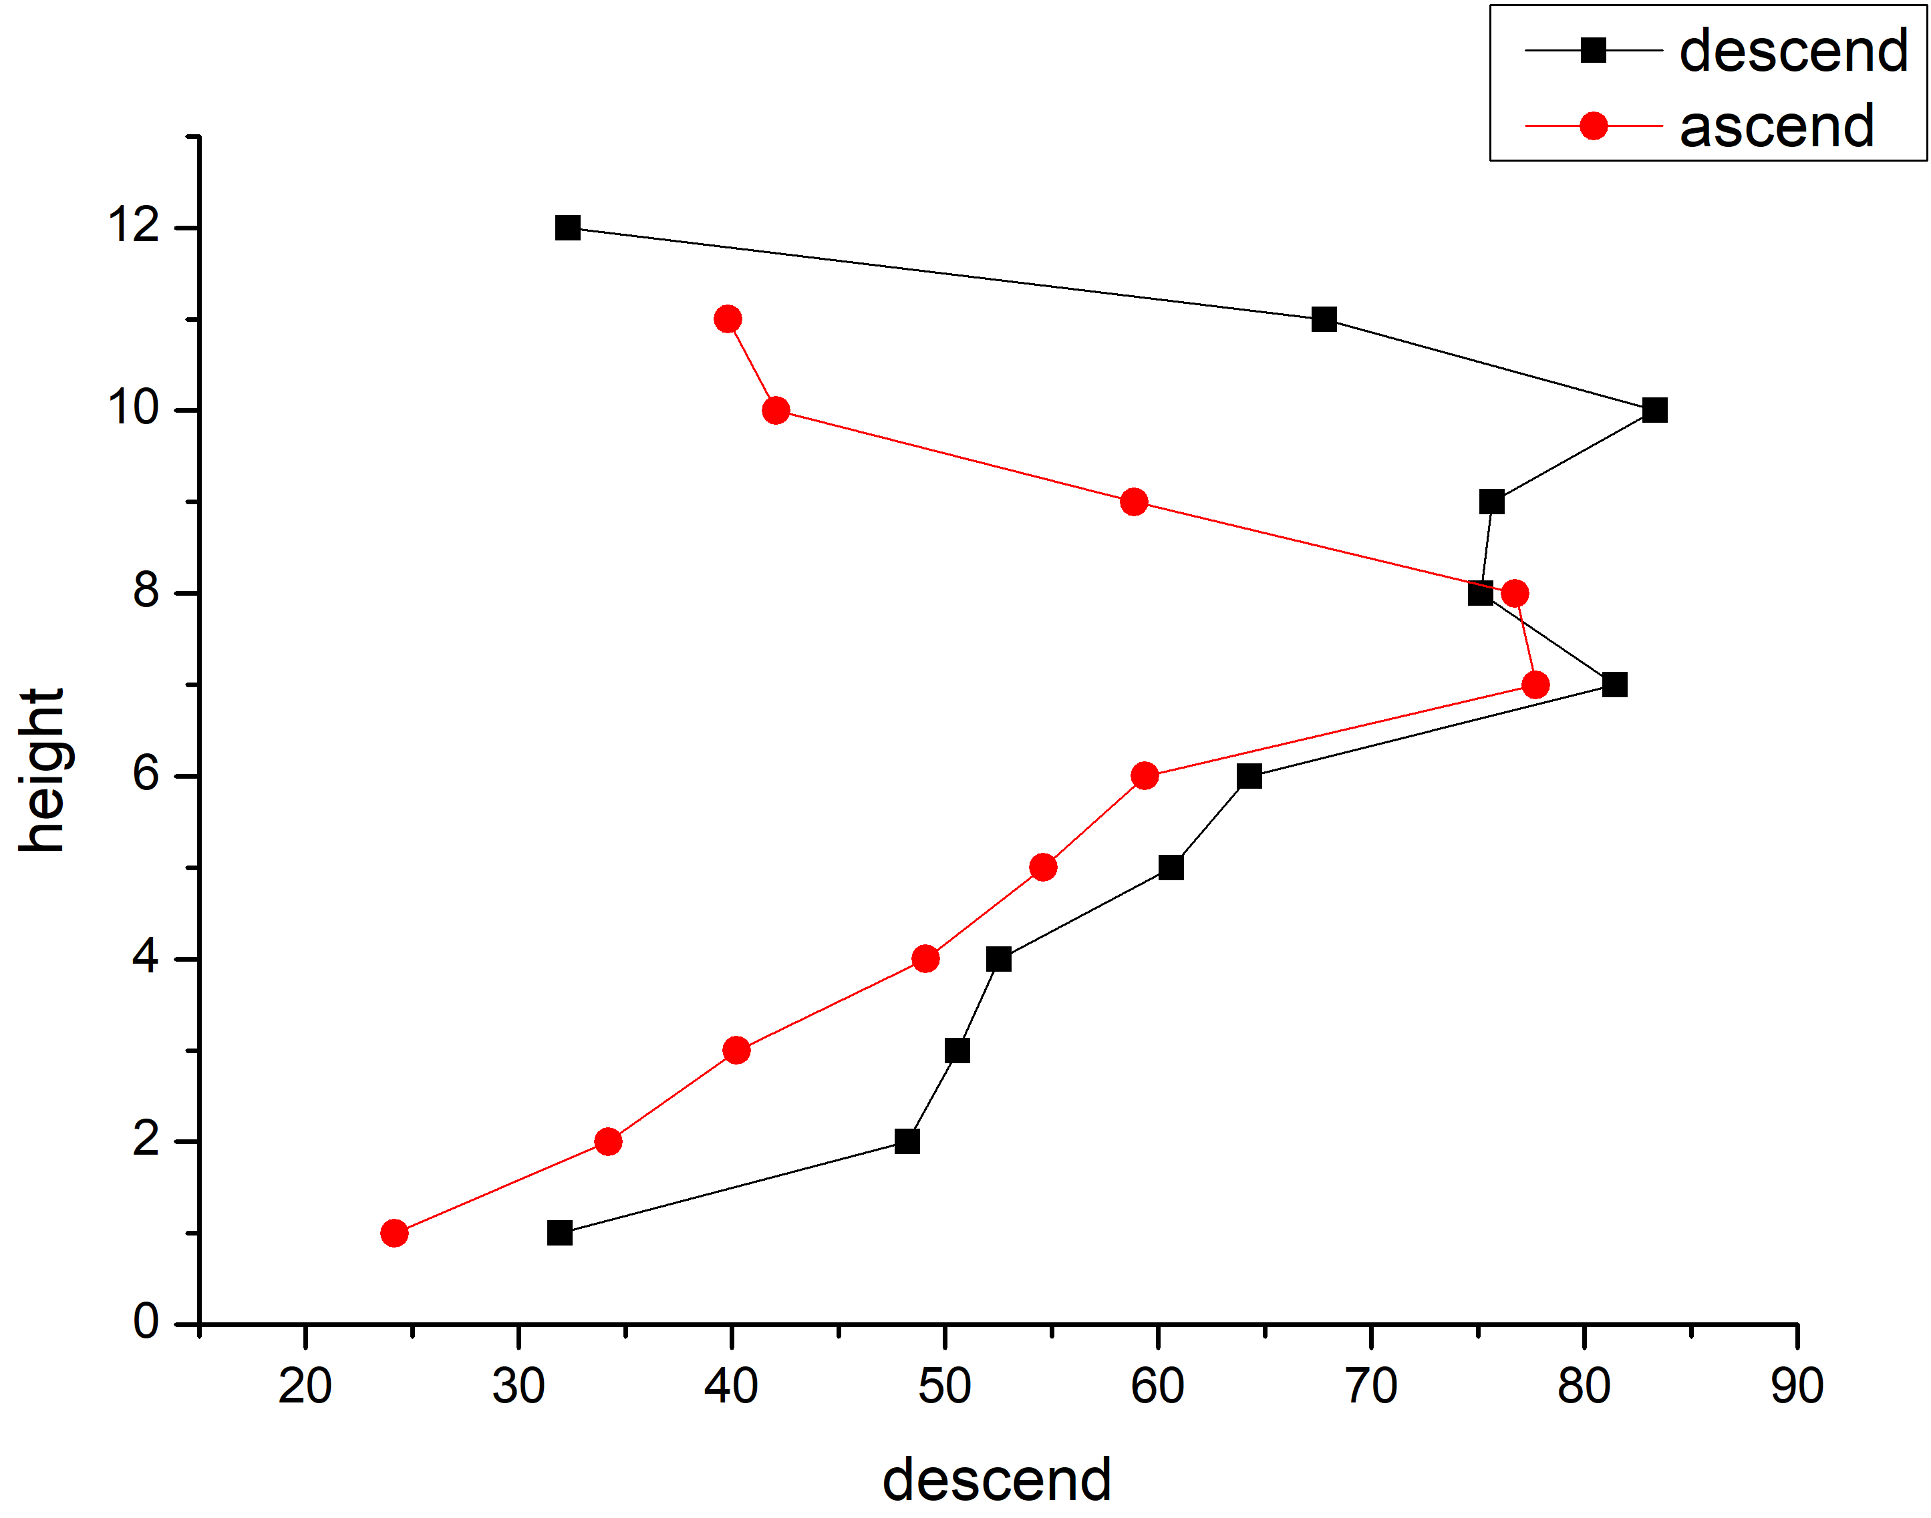
4. Ascent and descent? No.
Tokyo: ascent and descent at similar times.
Concentrations are different, but sometimes ascent is high, sometimes descent is high. Averaging will eliminate differences.

