Slide 1


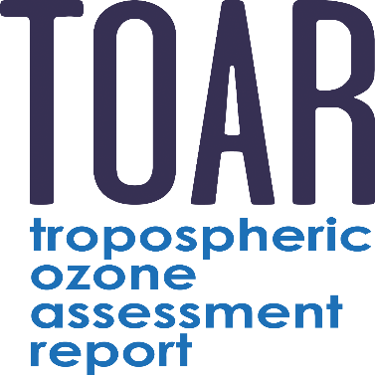

Global Ground-based Tropospheric Ozone
Measurements: Reference Trends (2000-2022) from the TOAR-II/HEGIFTOM Project
Phase II
Anne M. Thompson^{1,2}, Roeland Van Malderen³, Debra. E. Kollonige^{2,4}, Ryan M. Stauffer², Herman G. J. Smit⁵, Kai-Lan Chang^{6,7}, Corinne Vigouroux⁸, Irina Petropavlovskikh^{6,9}, Bryan Johnson⁹, Patrick Cullis⁹, Thierry Leblanc¹⁰, Valérie Thouret¹¹, Eliane Maillard Barras¹², Pawel Wolff¹¹, David Tarasick¹³, Audrey Gaudel^{6,7}
(1) Atmospheric Chemistry & Dynamics Lab, NASA Goddard Space Flight Center, Greenbelt, MD; (2) GESTAR, Univ. of Maryland, Baltimore County, Baltimore, MD; (3) Royal Meteorological Institute of Belgium, Uccle, Belgium; (4) Science Systems & Applications, Inc, Lanham, MD; (5) Forschungszentrum Jülich, Germany; (6) CIRES, Univ. of Colorado, Boulder, CO; (7) NOAA Chemical Sciences Laboratory, Boulder, CO; (8) Royal Belgian Institute for Space Aeronomy, Uccle, Belgium; (9) NOAA Global Monitoring Laboratory, Boulder, CO; (10) Jet Propulsion Laboratory, California Institute of Technology, Wrightwood, California; (11) Univ. Paul Sabatier III, CNRS - LAERO, Toulouse, France; (12) Federal Office of Meteorology and Climatology, MeteoSwiss, Payerne, Switzerland; (13) Environment Climate Change Canada, Downsview, ONT Canada

Slide 2
Outline
Phase II
WHAT is IGAC/TOAR II?
WHY Is HEGIFTOM (Harmonization and Evaluation of Ground-based Instruments for Free Tropospheric Ozone Measurements) so important in Ozone (TOAR II) & Climate Assessments?
HEGIFTOM: WHAT, HOW, WHERE. Data Status.
Present “all-site” results for TOAR II
  “Total” & “free” trop. O₃ column trends by two (QR & MLR) methods
  Focus O₃-sonde data (~40 sites) – compare 4 other instruments
Summary: Trends to date for 2000-2022 show:
  All sites within + 3 ppbv/dec ➔ equivalent to 1-8%/dec, for TrOC, depending on location and independent of statistical method
  Globally trends are ~50:50 positive, negative, for TrOC and FT O₃

Slide 3

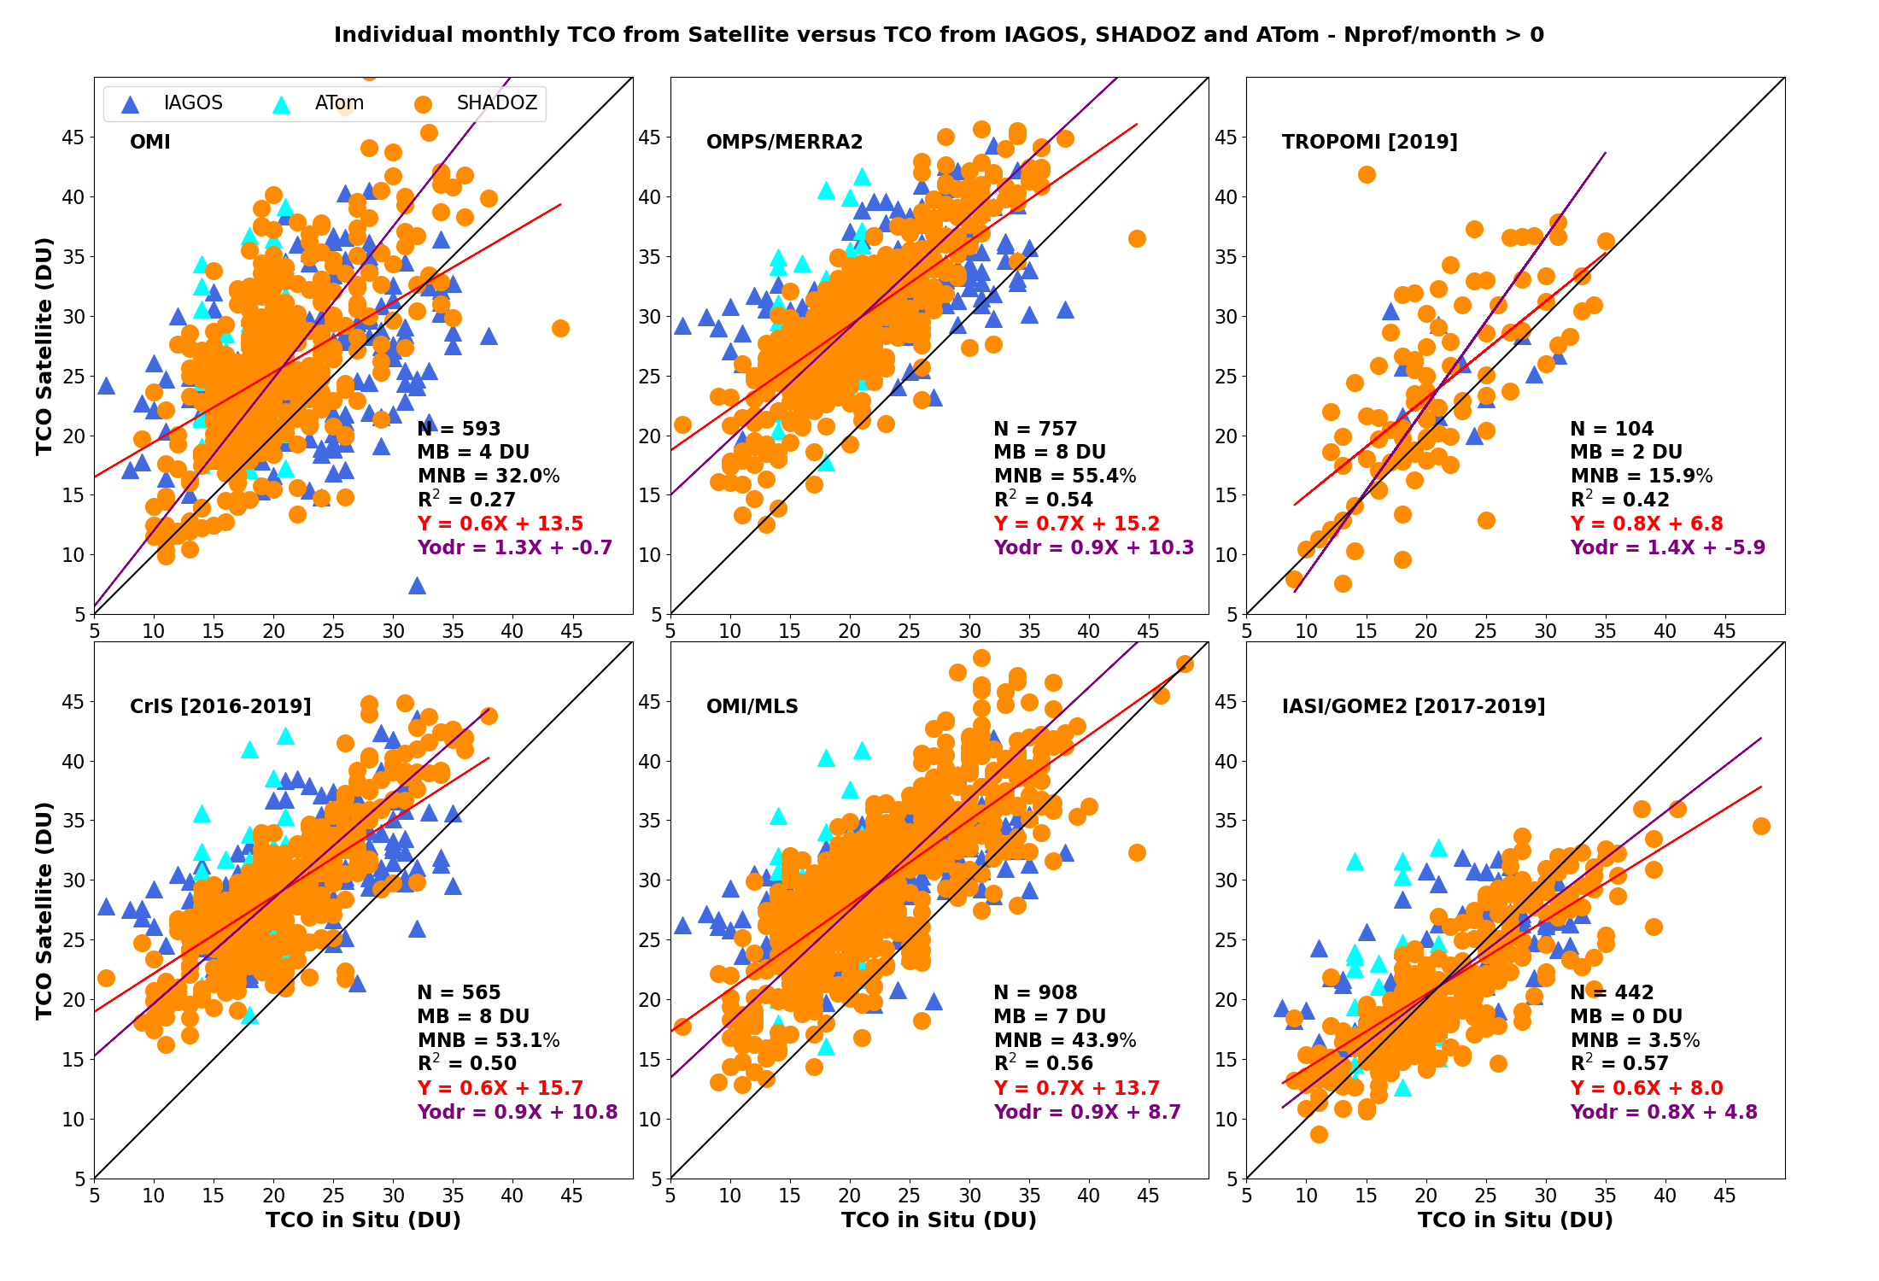
WHAT IS IGAC/TOAR II? Why HEGIFTOM?
Phase II
Intl Global Atmos. Chem. project (IGAC)/TOAR (Tropo. Ozone Assessment Report) “Report” appeared as 6 papers in Elementa, 2017-2020. Above: Satellite data (4 types, Gaudel et al., 2018) inconclusive trends, 2005-2016
TOAR II kicked off in 2021. Aims to deliver its Reports in late 2024/early 2025.
  Based on Copernicus papers completed by July 2024
  Statistical approach and figure formats prescribed
TOAR II Tropical Tropo. Ozone satellite products (Gaudel et al., 2024) show little progress with “newer, better” data. Too uncertain, poor correlation, r² 0.3-0.6 (Below). Global trends remain positive, negative (not shown)
No definitive satellite Assessment of FT trends, i.e, greatest radiative forcing region

Slide 4
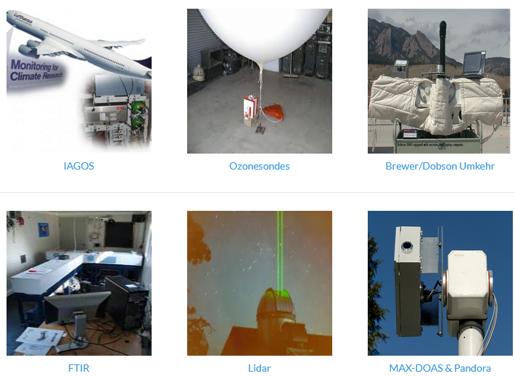
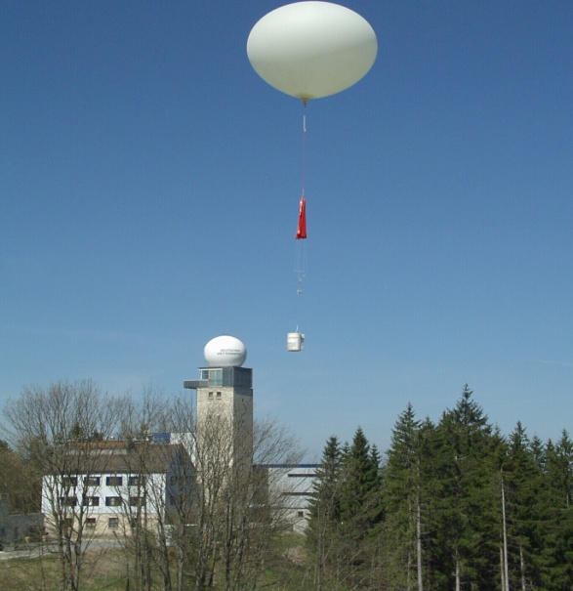





WHAT & HOW: HEGIFTOM Data to the Rescue!
Phase II
HEGIFTOM: IGAC/TOAR II Activity, Co-Leads: R. Van Malderen & H. G. J. Smit
Alternative to still-evolving satellite TrOC (tropospheric ozone column) products:
FT ozone from 5 ground-based instrument types, most from NDACC & related networks: in-service aircraft [IAGOS], ozonesondes,FTIR, Brewer/Dobson Umkehr, Lidar (Photos, Right)
All instrument types have been used in HEGIFTOM. Reprocessed data based on rigorous protocols and absolute standards, thus ensuring harmonized time-series, with artifacts removed. Contributing networks
Each measurement is delivered with uncertainty and a quality flag
This Study: Total trop. O₃ , “TrOC” and FT column trends. First sondes, then all 5 instrument types compared
TrOC=
surface
-300
hPa
FT,
700-
300 hPa
http://hegiftom.meteo.be/datasets

Slide 5
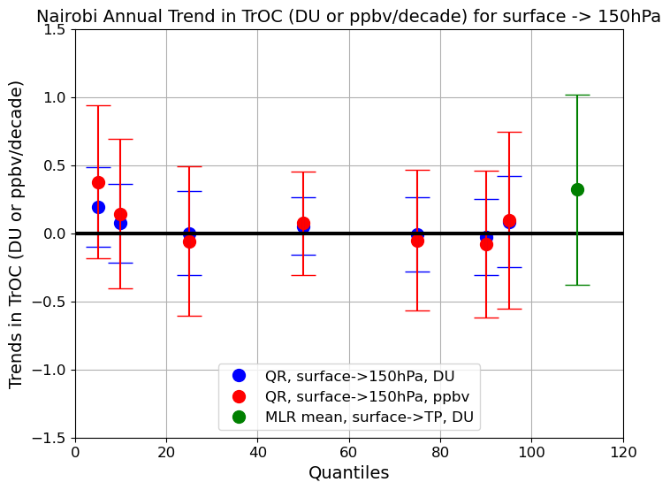
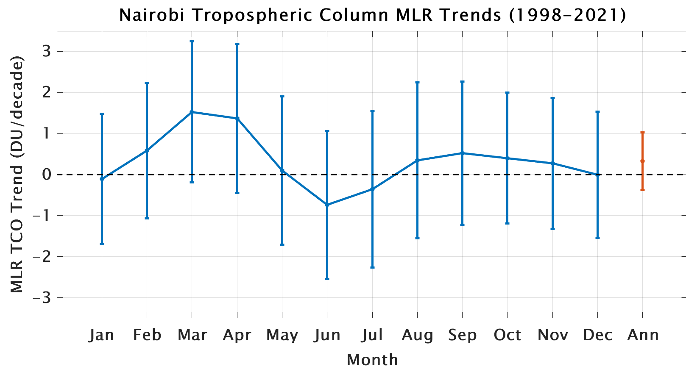

HEGIFTOM Trends. Input & Guidelines
Phase II
Largest
Increase at
Low O₃
Large Mar-Apr Increase masked by negligible annual mean trend in O₃
Recommended TOAR II statistical approach is Quantile Regression (QR) with NOAA-provided test code, e.g., K-L Chang et al., (2023; JGR; 10.1029/2022JD038090)
Alternative: Multiple-Linear Regression (MLR) as used in Thompson et al., 2021 & Stauffer et al., ACP, 2024. MLR is standard of stratospheric ozone Assessment community
Above example for a typical SHADOZ station shows merits of each approach. QR gives insights into low-mid-ozone-O₃ profiles. Monthly means from MLR give insight into meteorological or chemical signatures responsible for O₃ trends

Slide 6
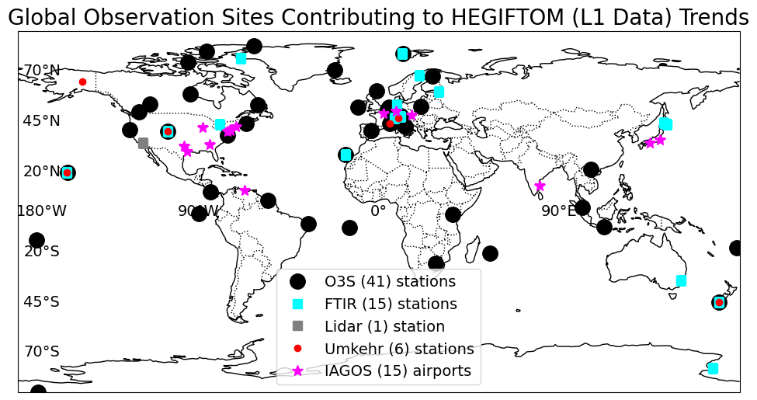
HEGIFTOM Sites/Datasets for 2000-2022 Trends
Phase II
L1 QR Data Trends (78):
  O3Sonde (41)
  FTIR (15)
  IAGOS (15)
  Umkehr (6)
  Lidar (1)
L3 QR Data Trends (68):
  O3Sonde (37): excludes Hanoi, San Cristobal, LaQuila, Watukosek
  FTIR (14): excludes Boulder
  IAGOS (10)
  Umkehr (6)
  Lidar (1)
L3 MLR Data Trends (62):
  O3Sonde (38): excludes San Cristobal, LaQuila, Watukosek
  FTIR (14): excludes NyAlesund
  IAGOS (3)
  Umkehr (6)
  Lidar (1)
TOAR II Protocol: Require Minimum Sample No. to reduce trends uncertainty. L1 QR analyses use all data from 78 sites; only 50%-ile results shown. Monthly means (L3) are subject to more gaps so fewer sites (68, 62) are analyzed

Slide 7
Trends Questions Addressed with HEGIFTOM Data
Phase II
How do TrOC (surface to 300 hPa) trends (2000-2022) compare computed with QR and MLR? Answer with analysis of L3 (monthly mean) TrOC from ozonesondes
How do TrOC trends vary by region? Examine trends longitudinally
How do FT (Free Tropospheric) and TrOC trends compare and why might they differ? Determine FT ozone trends (700-300 hPa column)
How do TrOC trends from sondes compare to those from other instruments (IAGOS, FTIR, Dobson Umkehr, Lidar)? Compare trends at colocated stations

Slide 8
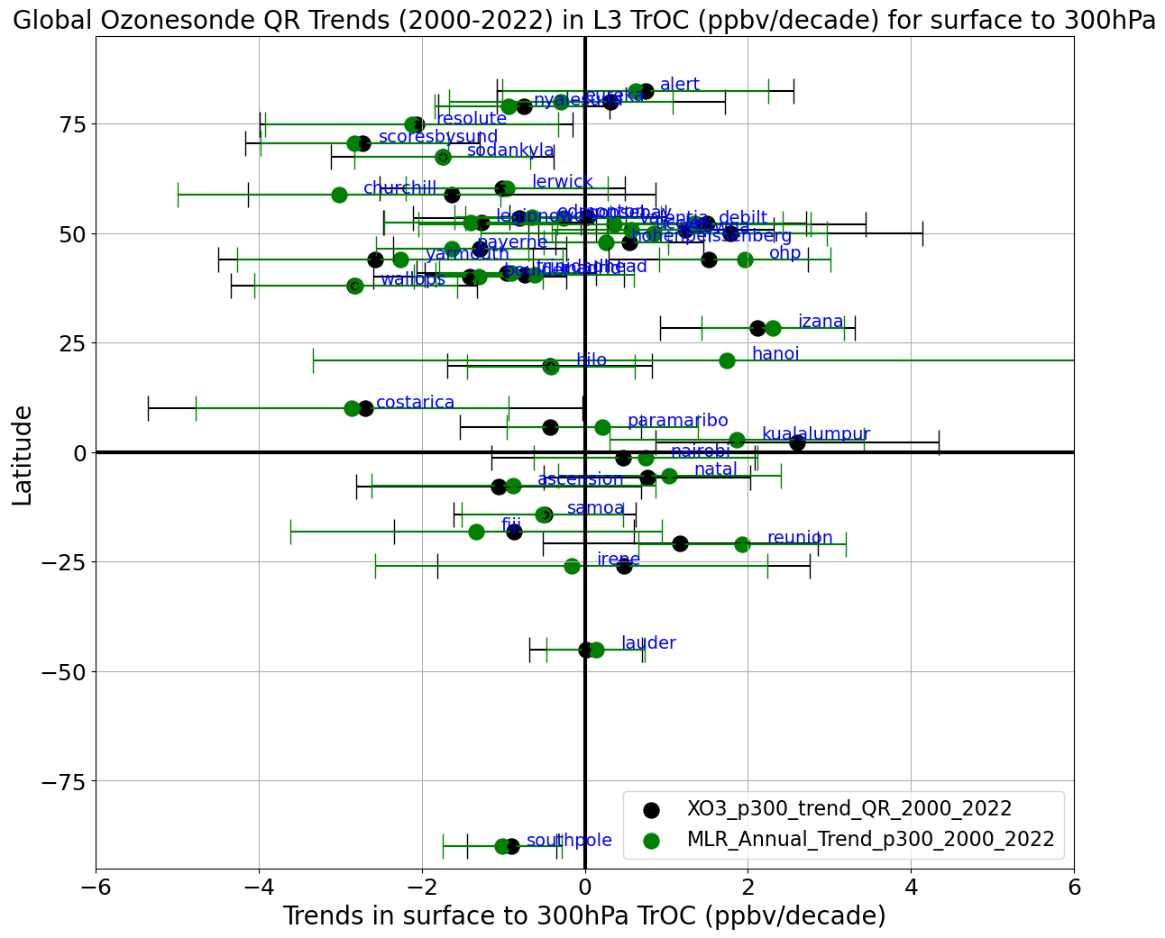
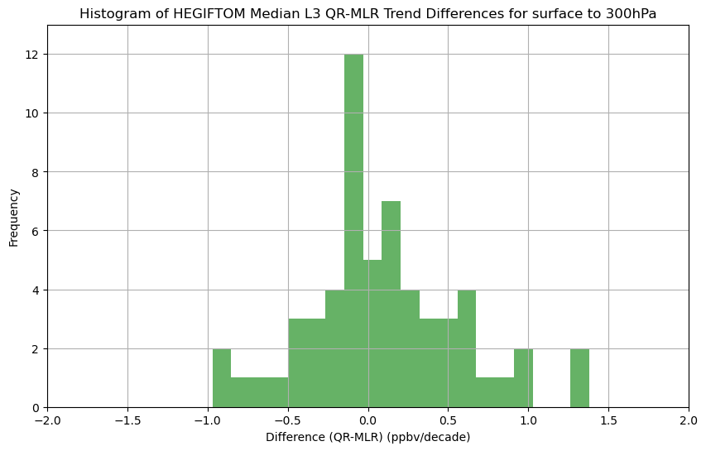
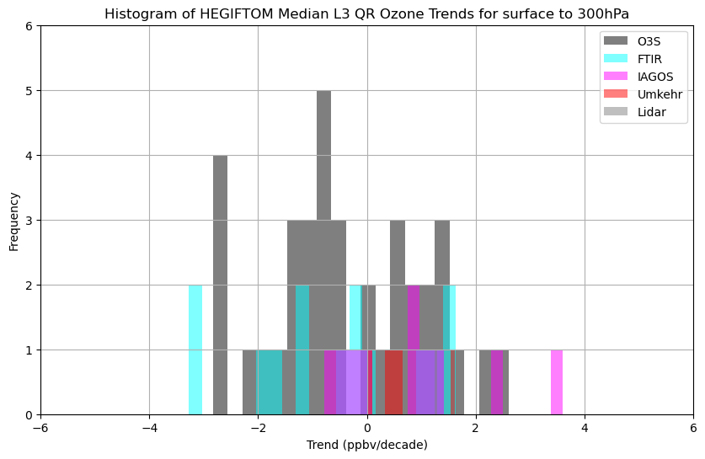
Ques 1. MLR & QR TrOC TRENDS SIMILAR
Phase II
60 sites w/ MLR & QR trends
Sonde trends in Gray
Left: Sonde trends for trop. column (surface-300 hPa, ppbv/dec) with L3 data mostly overlap within uncertainty (black=QR, green=MLR). Center: Small bias toward larger MLR trend
Right: Positive: negative trends ~50:50. Given uncertainty, ~50% of sites show no trend!
Notes:
The second trends slide shows the QR results again as a function of latitude, with the MLR trends in blue. The latter are larger, also more uncertain. We are looking into the reasons for discrepancy btn the two approaches, e.g. only the median 50%ile is used in the QR…
What do these FT changes represent?? Given FT ozone columns (~7-12 DU) the trends range from -2% to + 2%/dec (Left) except for Izana, Hanoi, and several tropical sites. E. Pacific/Americas display smaller increases than over Europe/Africa or Asia/W. Pacific (Right).

Slide 9
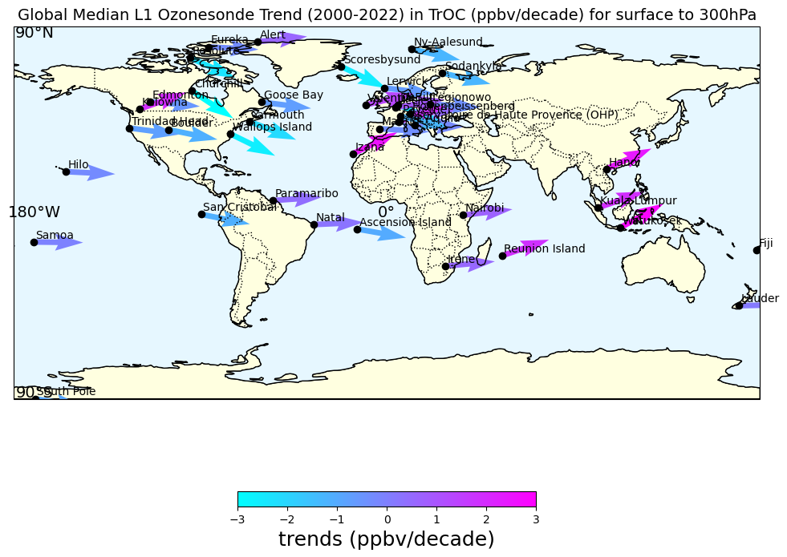
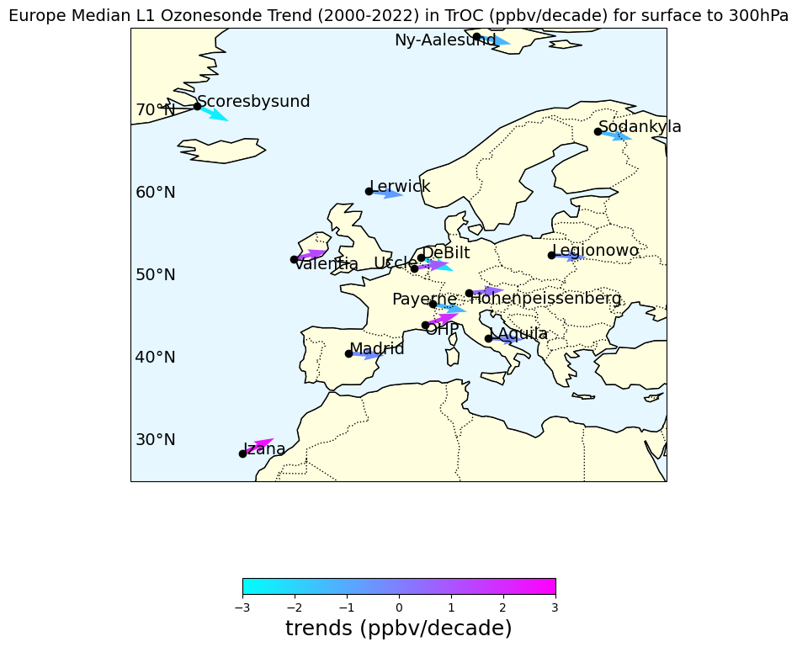
Ques 2. Ozonesonde TrOC Regional Trends
Phase II
Sonde (black points), 50-%ile median profiles, L1 data analyzed with QR, 2000-2022
Left: TrOC (surf-300 hPa) column, negative-> zero trends, blue shades
Trends < 3 ppbv/dec, positive or negative, all lat, long (2 outliers). Right: Western Europe sonde trend zoom
+ trend
no trend
- trend

Slide 10
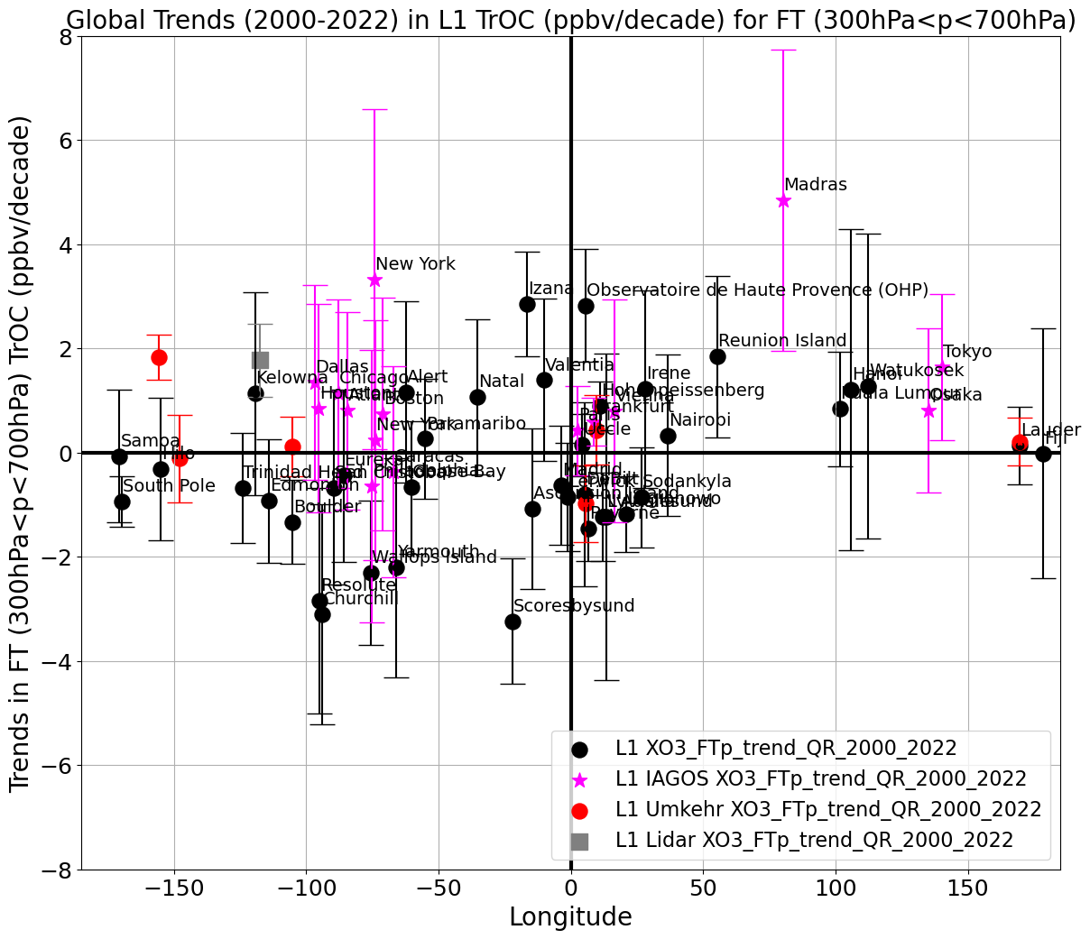
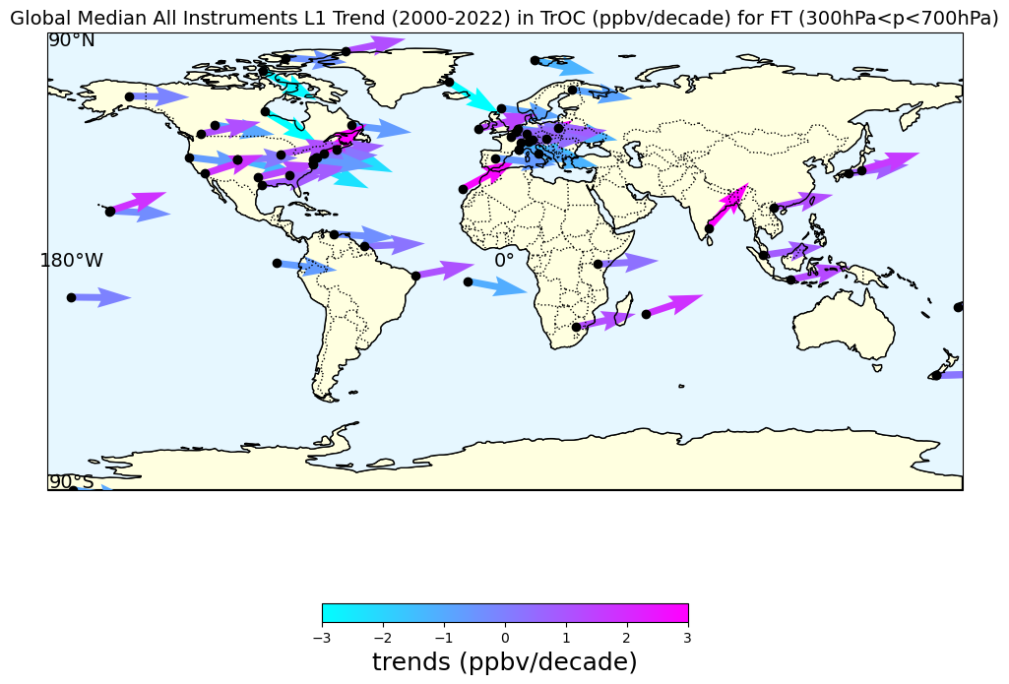
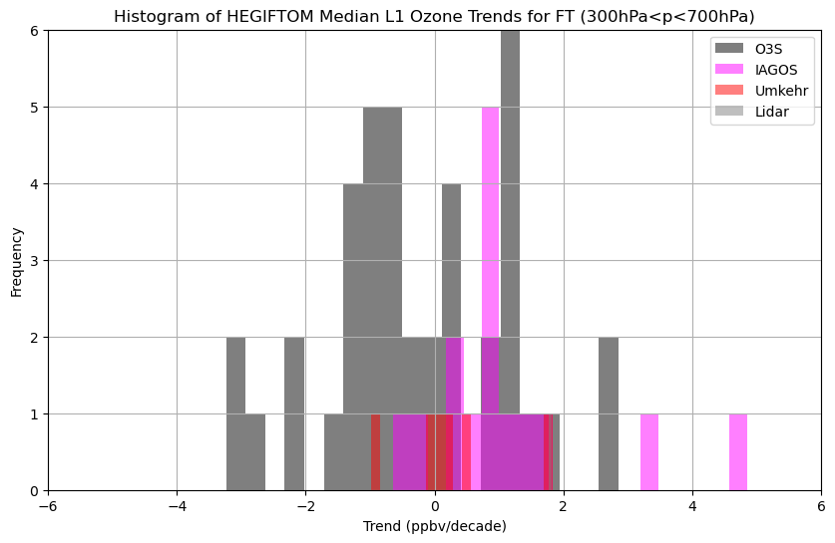
Ques 3. All-Site FTOC Median Trend Variability
Phase II
Left: Sites (sondes, IAGOS, Umkehr, lidar), 50-%ile median profiles, L1 analyzed with QR, 2000-2022. Upper Right: FT OC, 700-300 hPa, mostly smaller than TrOC trends; several exceptions in tropics.
Changes mostly < 2.0 ppbv/dec, positive OR negative
+ trend
no trend
- trend

Slide 11
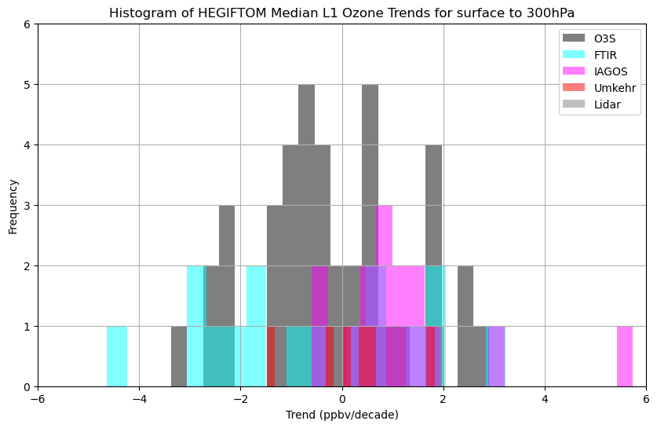
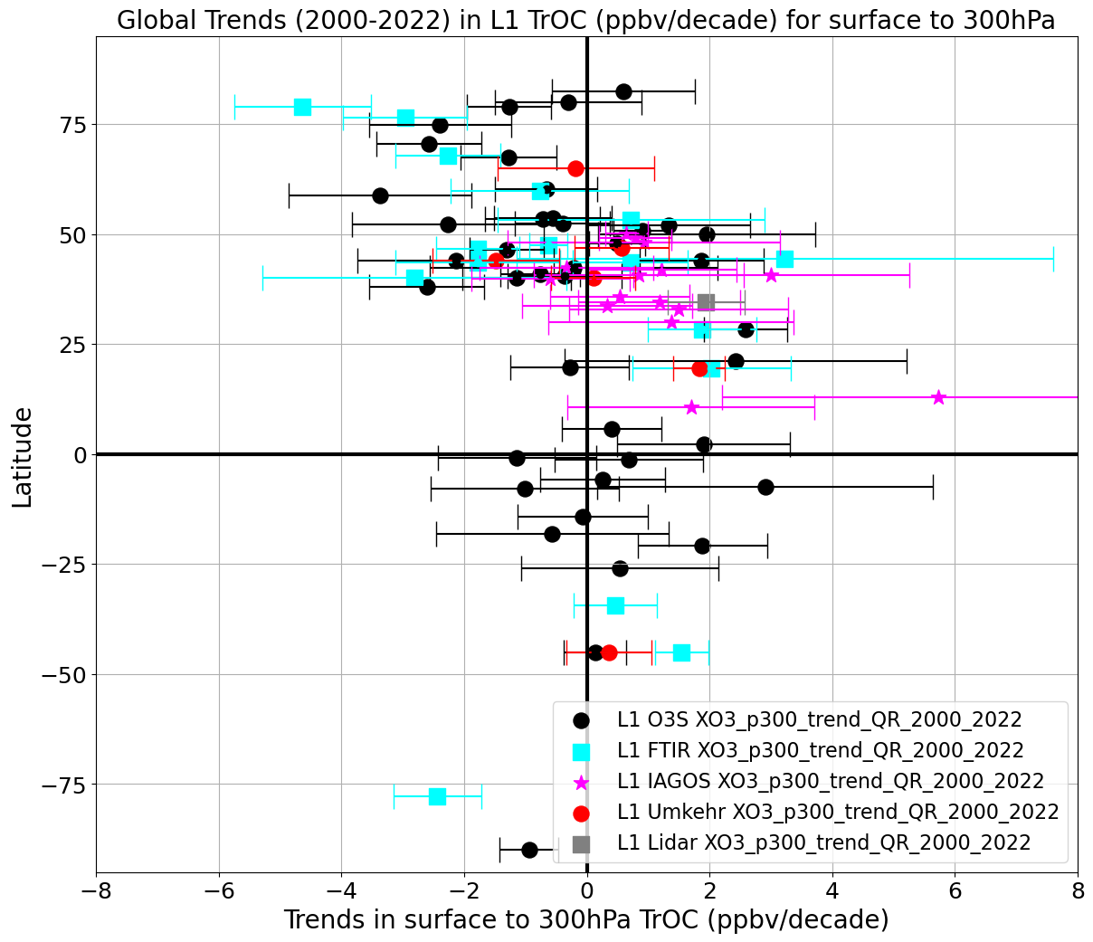
Ques 4. TrOC Trends with All Sites, Instruments Compared (Sonde, FTIR, Lidar, IAGOS, Umkehr)
Phase II
All but 5 Sites within + 3 ppbv/decade
HEGIFTOM multi-site, multi-instrument data show TrOC trends + 3 ppbv/dec globally, independent of method*
  *Caveats: little Asian data, varying uncertainty

Slide 12
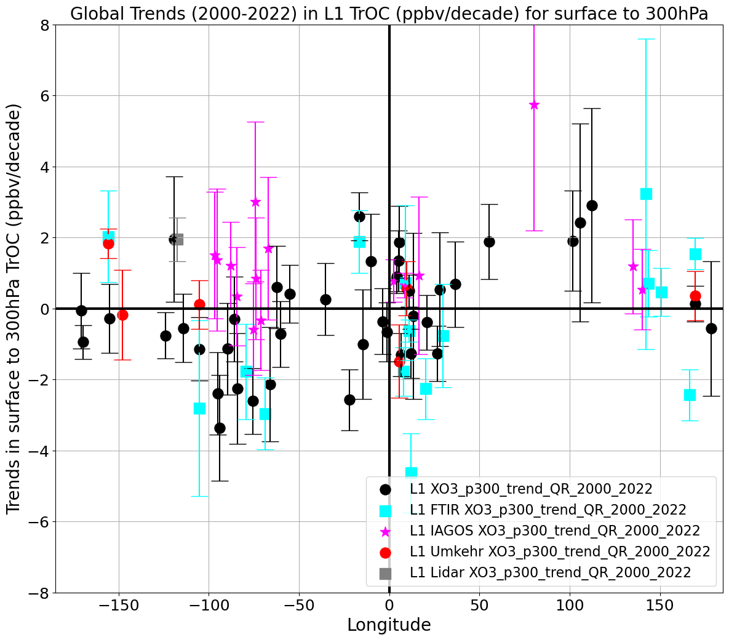
Conclusions – HEGIFTOM TOAR II Trends
Phase II
Significance: HEGIFTOM time-series is the highest quality DATA available to TOAR II. TRENDS PROVIDE CLEAR CONSTRAINTS FOR SATELLITE AND MODEL PRODUCTS!
What do HEGIFTOM “consistent” TrOC + 3 ppbv/dec trends mean? Different changes regionally -- % not globally equivalent! →
“Uniform” FT trends (+ 2 ppbv/dec) may suggest dynamics acting above BL
R. Stauffer Talk tomorrow 1115 MT
Work in progress:
  Lowest Trop. O₃ (surf to 700 hPa) being investigated
  QR trends at 5%-ile, 95th%-ile
  We are studying statistical approaches for regional trends
Tropics -> (+/-) 1-2% /dec (Réunion +4%/dec)
SE Asia -> (+/-) 5-8% /dec
N. America -> (+/-) 1-2% /dec (Wallops -4%/dec)
W. Europe -> (+/-) 1-2% /dec

Slide 13
Thank you! Acknowledgments. Bibliography
Phase II
Acknowledgments: Dozens of funding organizations. Hundreds of researchers who have operated and collected ozone ground-based data over the past 30 years!
Chang, K-L. et al. (2024) Challenges of detecting free tropospheric ozone …https://doi.org/10.5194/egusphere-2023-2739
Gaudel et al. (2018) Tropospheric Ozone Assessment Report: Present-day distribution and trends… https://doi.org/10.1525/elementa.291
Gaudel, A., et al. (2024) Tropical tropospheric ozone distribution and trends from in situ…, ACP, https://doi.org/10.5194/egusphere-2023-3095
Kollonige, D. E., et al. (2023) Tropical Tropospheric ozone trends (1998-2020) This Meeting, Tues Poster
Stauffer, R. M., et al. (2019) The effects of a changing observing system on MERRA-2-based ozone … https://agupubs.onlinelibrary.wiley.com/doi/10.1029/2018JD030090
Stauffer, R, M., et al. (2023) Dynamical drivers of free-tropospheric ozone… https://doi.org/10.5194/egusphere-2023-2618
Stauffer, R. M., et al. (2023) Dynamical drivers of free-tropospheric ozone… This Meeting, Wed Talk
Smit, H. G. J., A. M. Thompson et al. (2021) WMO/GAW ASOPOS Report 268 https://library. wmo.int/records/item/57720-ozonesonde-measurement-principles-and-best-operational-practices
Smit, H. G. J. et al. (2024) New insights from the Juelich OzoneSonde … https://doi.org/10.5194/amt-17-73-2024
Thompson, A. M., et al. (2021) Regional and seasonal trends in tropical ozone from SHADOZ profiles… https://agupubs.onlinelibrary.wiley.com/doi/10.1029/2021JD034691

Slide 14
Supplementary Figures
Phase II

Slide 15
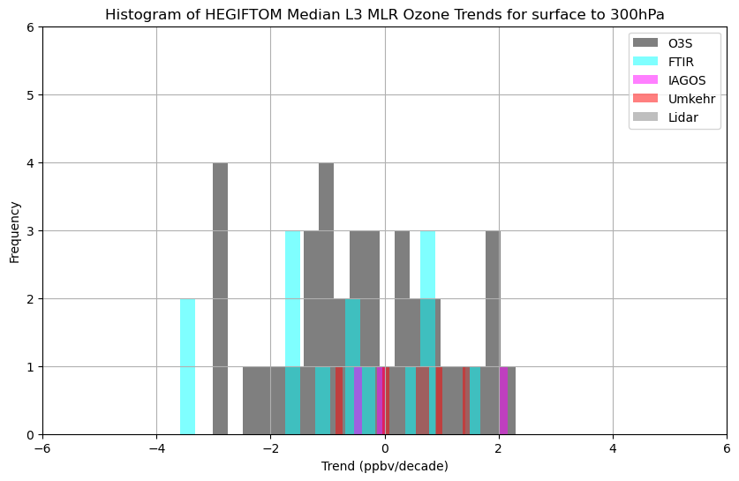
Biases visible here? Maybe QR & FTIR sl more negative
Left QR L3 Trends for all datasets , surface to 300hPa
Right MLR L3 Trends for all datasets , surface to 300hPa
For L3 there are slightly fewer stations than for L1
Phase II

Slide 16
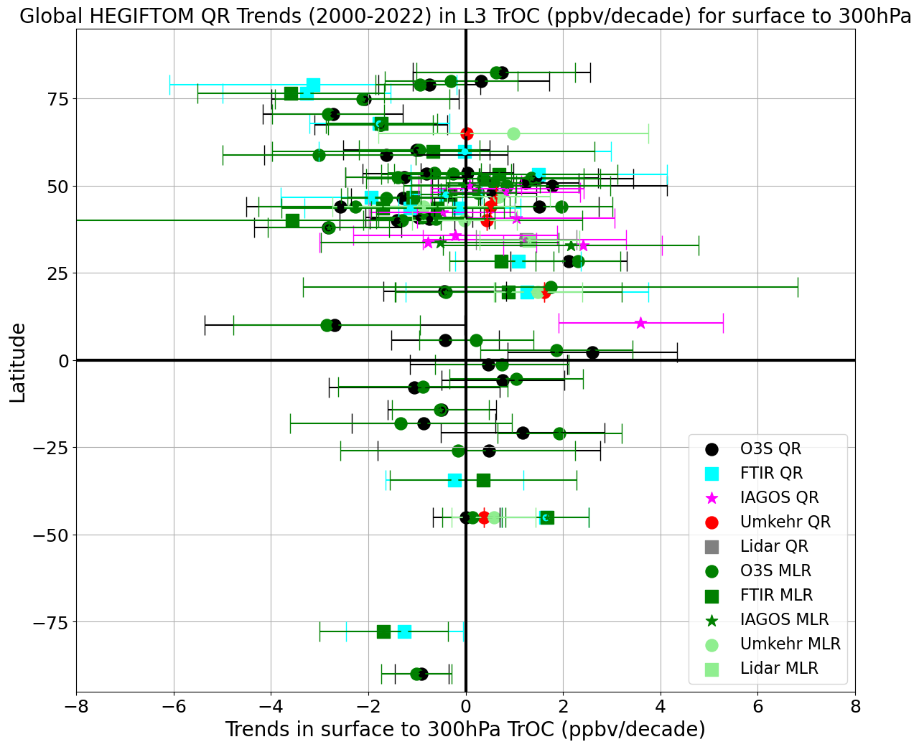
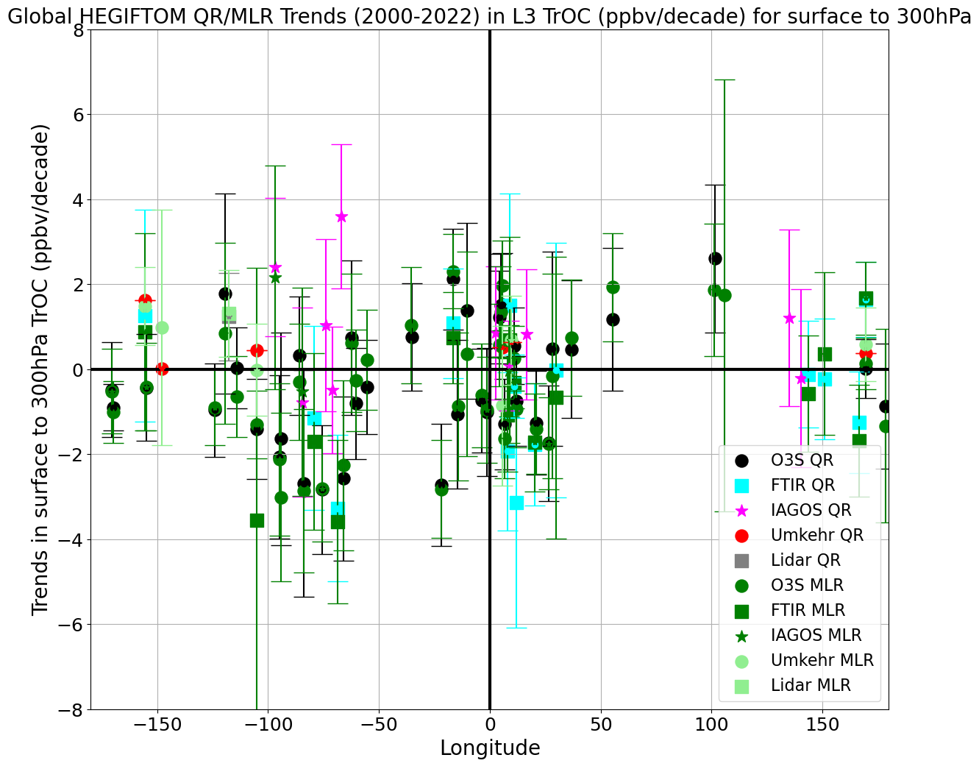
Ques 4- 22/April HEGIFTOM QR and MLR L3 Trends-
All TrOC Data: Surface to 300hPa Most stations within +/- 3 (ppbv/decade)

Slide 17
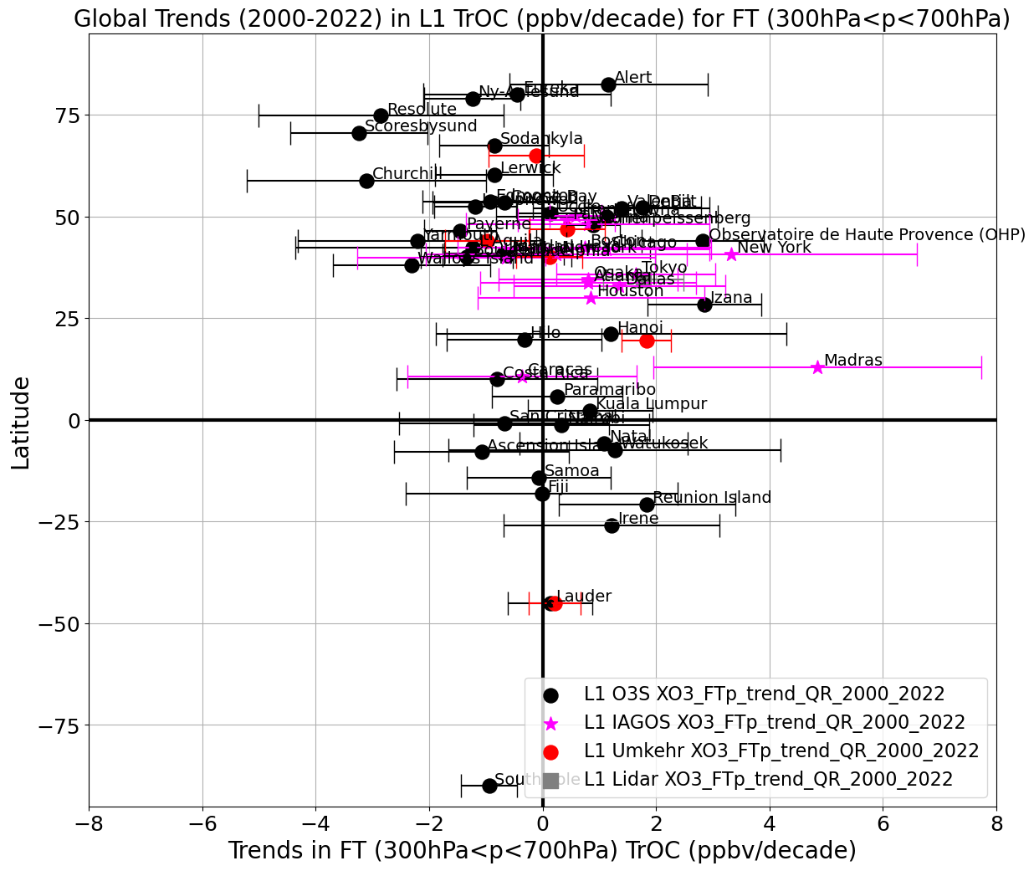
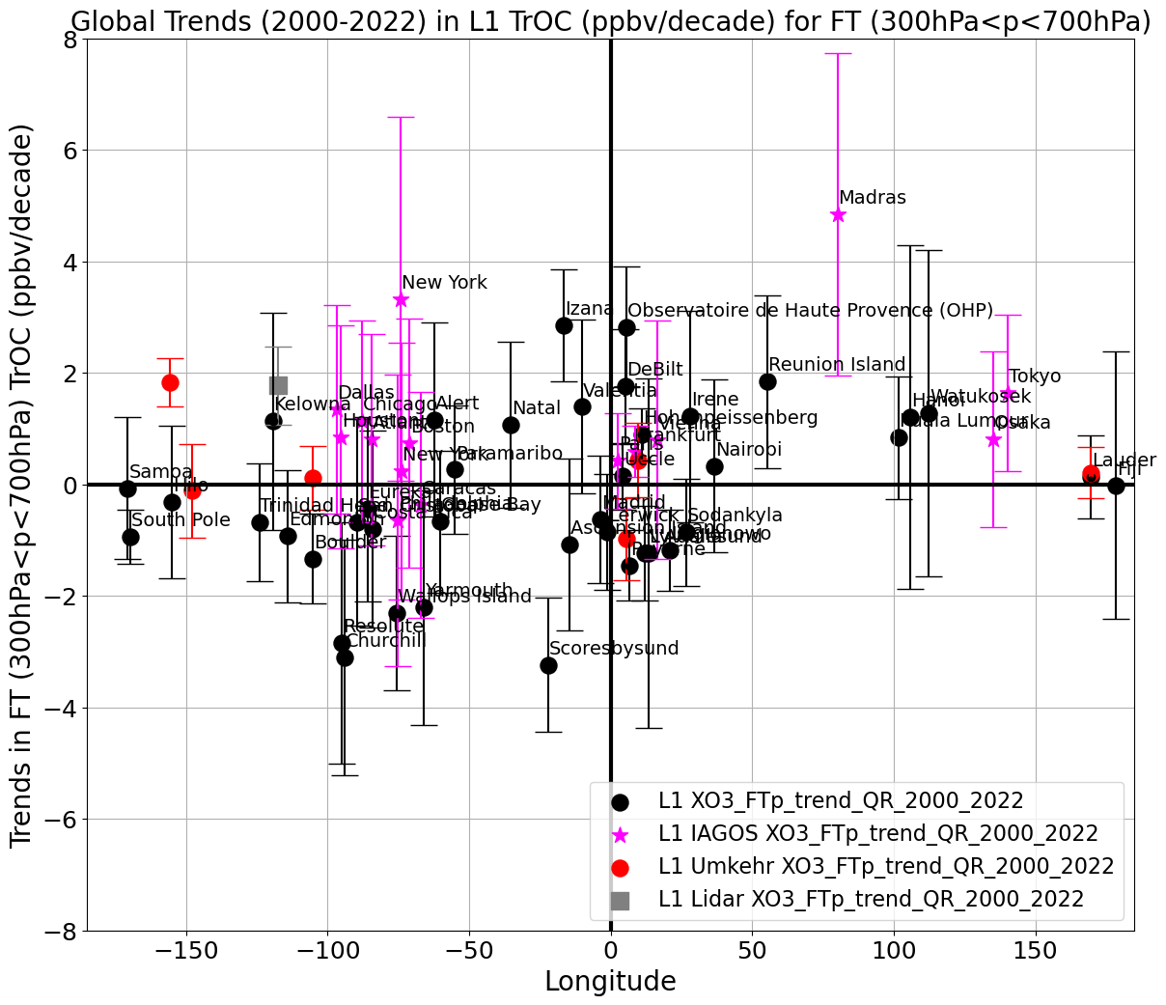
FT – data from 3 inst QR L1 Trends for all , for ~60 sites FT (300<p<700hPa). Most stations within +/- 2 (ppbv/decade)

